Slide 1
An Evaluation of the Vestigial Signal Defense for Civil GPS Anti-Spoofing
Kyle Wesson, Daniel Shepard, Jahshan Bhatti, and Todd Humphreys
Presentation at ION 2011| September 22, 2011

Slide 2
Acknowledgements

Slide 3
Outline
Civil Anti-Spoofing Overview
Interference Model
Video Comparison: Interference
Interference Detection Metrics
Ongoing Work

Slide 4
Types of Civil Anti-Spoofing
Civil Anti-Spoofing
Cryptographic
Security-Enhanced GPS
(NMA or SCA)
Non-Cryptographic
Dual-Receiver Correlation
Multi-Antenna Defense
Vestigial Signal Defense (VSD)
Why not cryptographic anti-spoofing?
Requires infrastructure and possibly changes to GPS IS
Vulnerable to initial phase of spoofing attack
Why VSD?
Implementable today!
Software-only defense; requires no additional receiver hardware

Slide 5
What is the Vestigial Signal Defense?
FACT: Suppressing authentic GPS signal during a spoofing attack is difficult
OPPORTUNITY: Ad-mixture of spoofing and authentic GPS signal can lead to detectable corruption of the complex correlation function
PROBLEM: Interaction of spoofing and authentic GPS signal is similar to interaction of multipath and direct-path GPS signal
DEFINITION: VSD is a technique for monitoring distortion in the complex correlation function
VSD Goal: Reduce the degrees-of-freedom available to a spoofer, making it mimic multipath (i.e., “corner in” the spoofer)

Slide 6
Interference Model
Direct Path:
Multipath:
Spoofing:

Slide 7
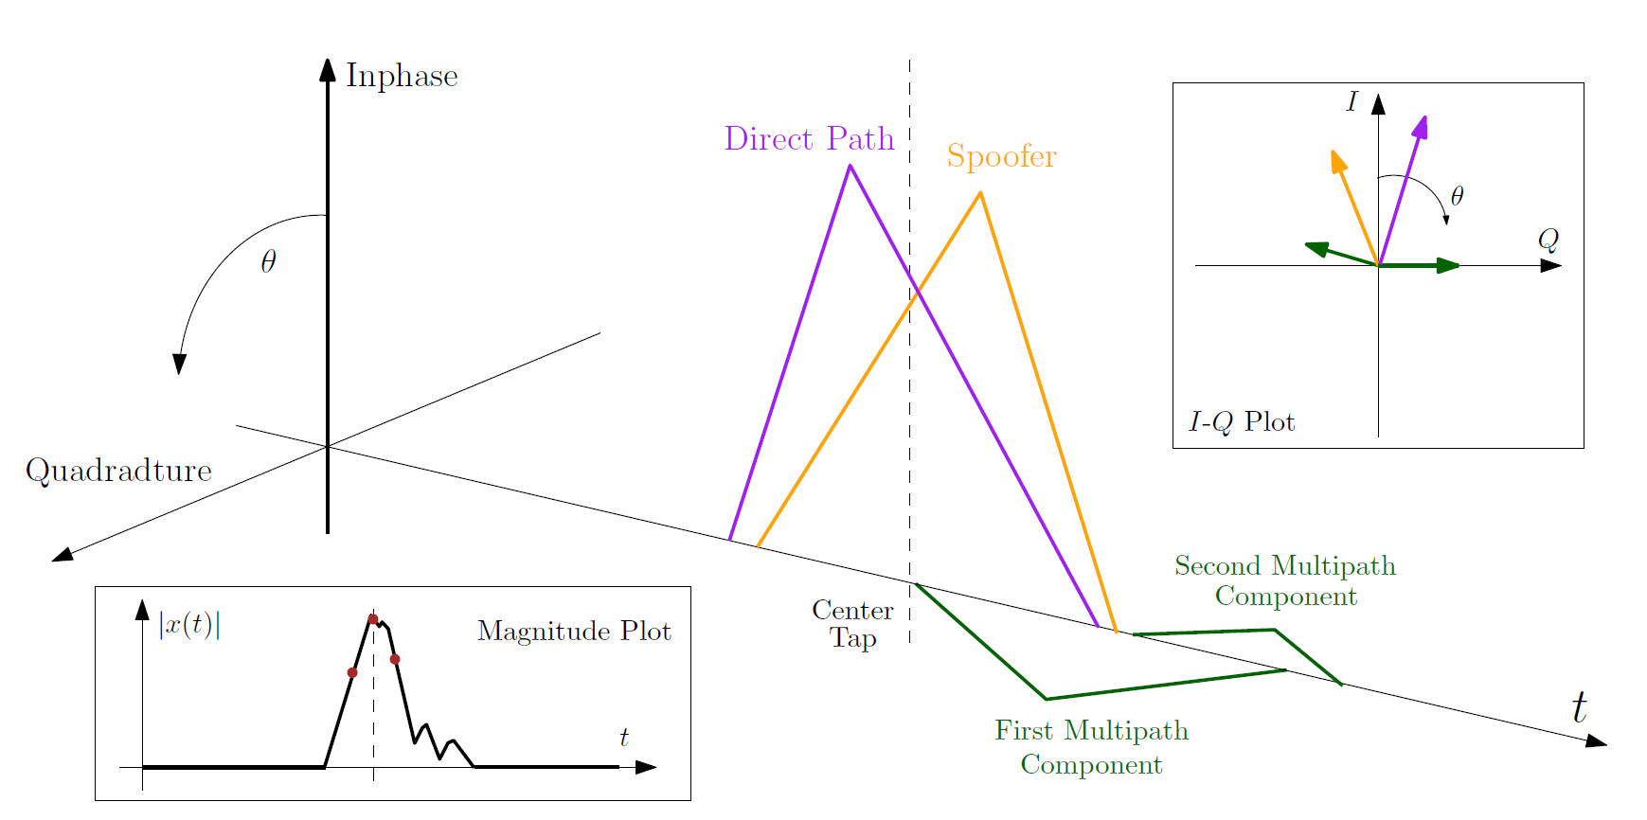
Visual: Complex Correlation Domain

Slide 8
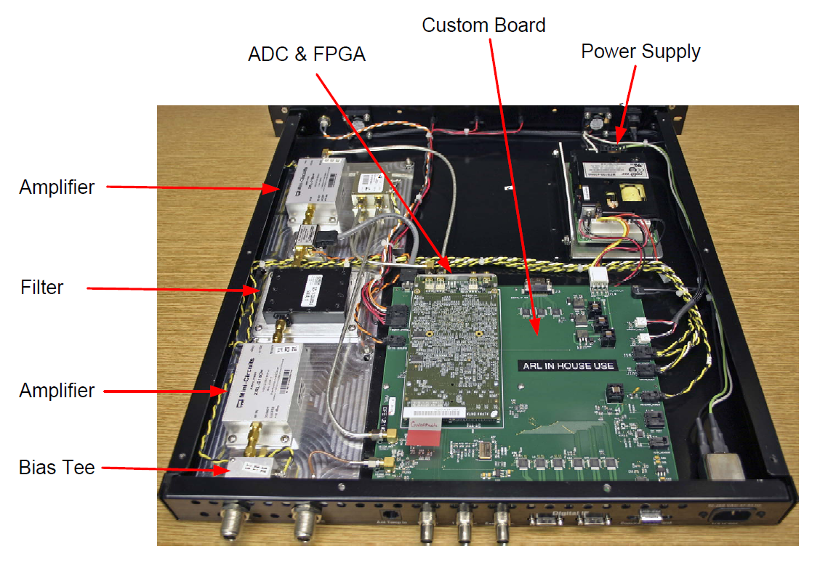
Interference Comparison: The Tools
The Spoofer
Real-time civil GPS spoofer
Enables civil anti-spoofing research
Described in open-literature
Debut at ION GNSS 2008
The Multipath Monitor (GCAF)
500 MHz bandwidth
512 Correlation Tap Dump at 1000 Hz
Designed at UT Applied Research Labs
Debut at ION GNSS 2010
loaned by University of Texas Applied Research Laboratory

Slide 9
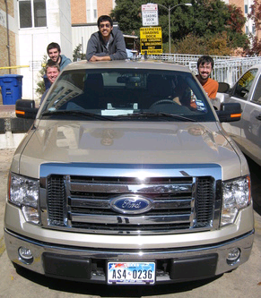
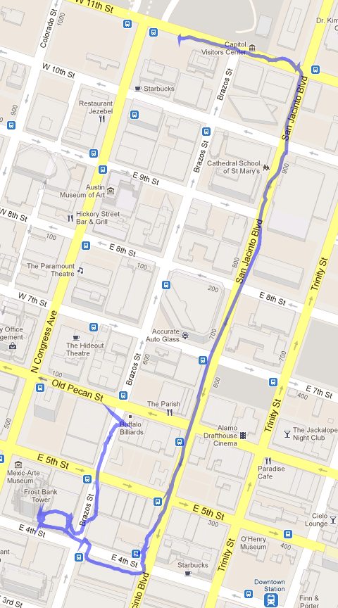
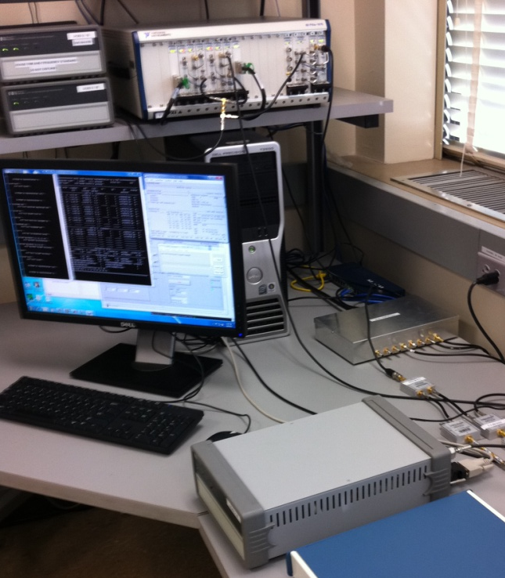
Multipath Wardriving Campaign
1) NI RFSA can record 30 MHz bandwidth about GPS L1 frequency slaved to OCXO clock
2) Loaded test equipment into truck and recorded data in downtown Austin, Texas
3) Post-processed data with software-defined GPS receiver

Slide 10
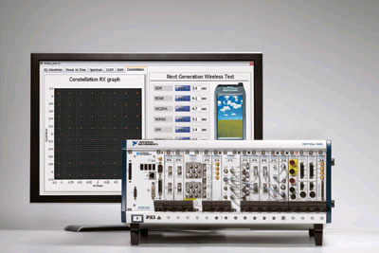
Test Setup
Spoofer
Multipath Record/Playback
GCAF

Slide 11
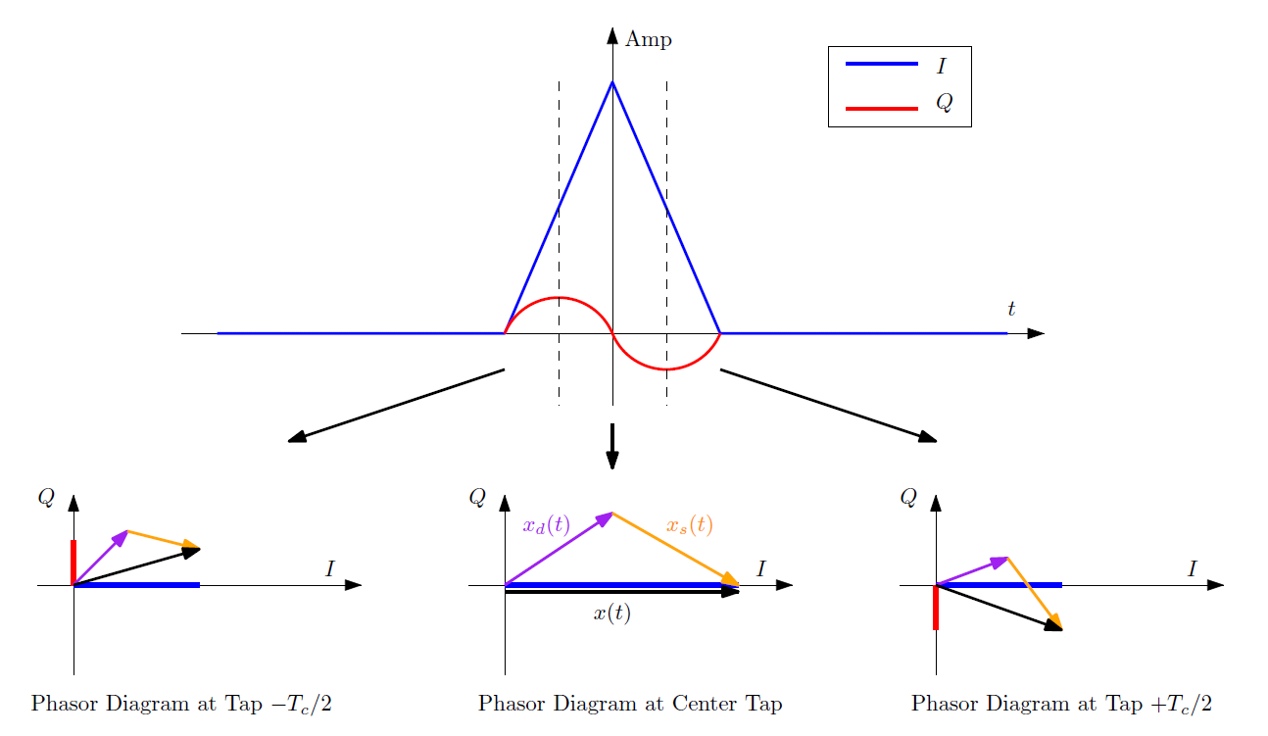
Complex Correlation Domain Explanation

Slide 12
Is it Spoofing or Multipath?

Slide 13
Videos

Slide 14
Observations
Multipath can look like spoofing!
Spoofing can look like multipath!
Detecting the difference between spoofing and multipath is difficult!

Slide 15
Proposed Spoofing Detection Metrics
Sensible Suggestion: Apply signal quality and multipath monitoring metrics to spoofing detection:
Delta-Test [1]:
Ratio-Test [1,2,3]:
[1] Ledvina, B.M. et al., “An In-Line Anti-Spoofing Device for Legacy Civil GPS Receivers,” (2010) Institute of Navigation ITM, San Diego, CA.
[2] Cavaleri, A. et al., “Detection of spoofed GPS signals at code and carrier tracking level," (2010) Satellite Navigation Technologies and European Workshop on GNSS Signals and Signal Processing (NAVITEC).
[3] Cavaleri, A. et al., “Signal Quality Monitoring Applied to Spoofing Detection,” (2011) ION GNSS, Portland, OR. [Session C3, Paper #1]

Slide 16
Examining the Ratio Test (1/3)
Mean = 0.42
Std = 0.011
P_{F}= 5.7e-7

Slide 17
Examining the Ratio Test (2/3)
Corresponds to Video
Mean = 0.43
Std = 0.009
P_{F}= 5.7e-7

Slide 18
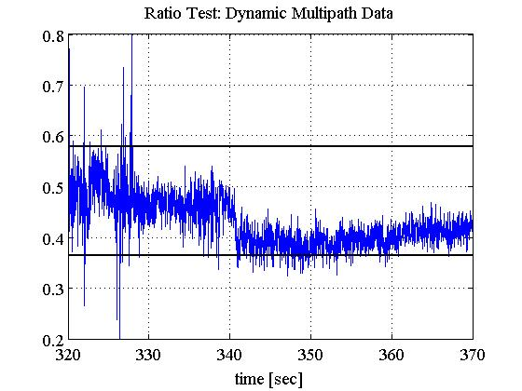
Examining the Ratio Test (3/3)
Corresponds to Video
Mean = 0.47
Std = 0.021
P_{F}= 5.7e-7

Slide 19
Takeaways
Possible high false alarm rate if no reliable method to differentiate spoofing and multipath
Most metrics ignore quadrature component
Certain taps may be better discriminators than others

Slide 20
Ongoing Work
Maximum-likelihood {α, τ, θ} tracking:
Bistatic-radar-based localization of interference sources
Tertiary hypothesis tests on α

Slide 21
Conclusions
Multipath can look like spoofing!
Spoofing can look like multipath!
Blind application of signal quality monitoring may lead to a high false alarm rate
VSD is still under development
Goal: reduce the degrees-of-freedom available to a spoofer, making it mimic multipath
Multipath and Spoofing Data Set Available:
http://radionavlab.ae.utexas.edu

