Slide 1
Characterization of Receiver Response to a Spoofing Attack
Daniel Shepard and Todd Humphreys
Presentation at ION 2011| September 22, 2011

Slide 2
Overview
Anatomy of a Spoofing Attack
Questions to answer
Test Procedure
Test Results
Summary of Findings

Slide 3
Anatomy of a Civil GPS Spoofing Attack
A spoofer seeks to alter a target receiver’s Position-Velocity-Time (PVT) solution by transmitting fictitious GPS signals
Attacks considered Proximity Spoofing Attacks which were first envisioned by Logan Scott in 2003
A typical spoofing attack involves: 1) alignment, 2) increase power, 3) carry receiver off

Slide 4
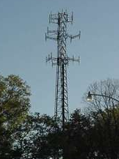
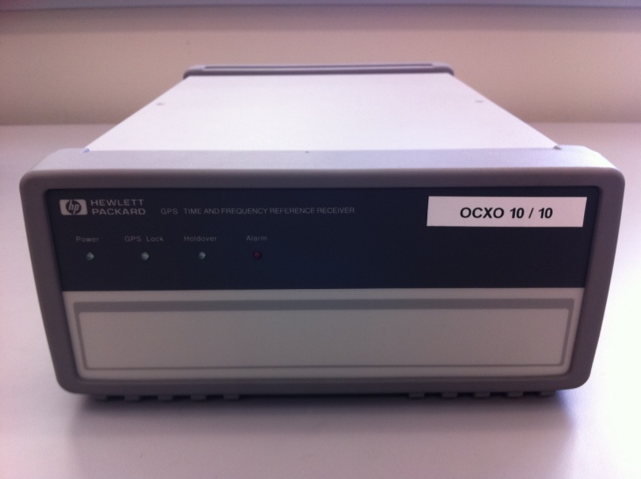
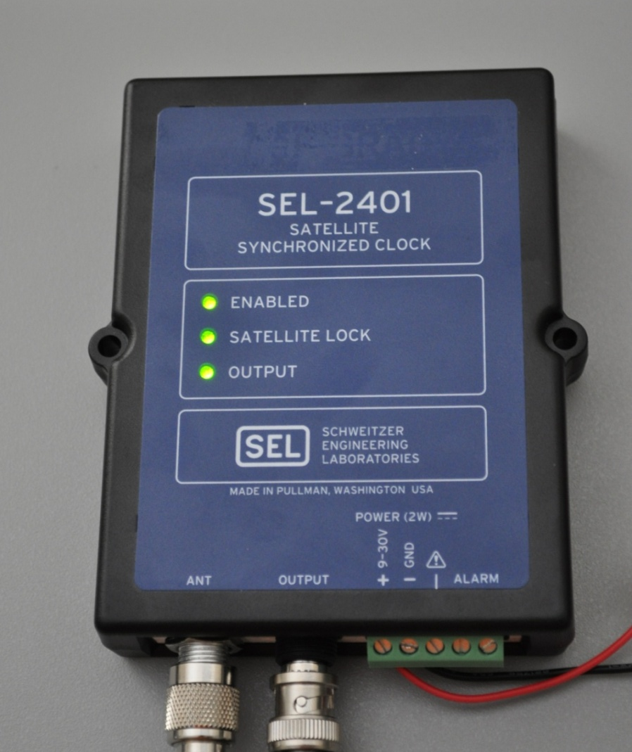
GPS Dependency Begets Vulnerability
Telecommunications
Network
Smart Grid:
Synchrophasor Measurement Units (SMUs)

Slide 5
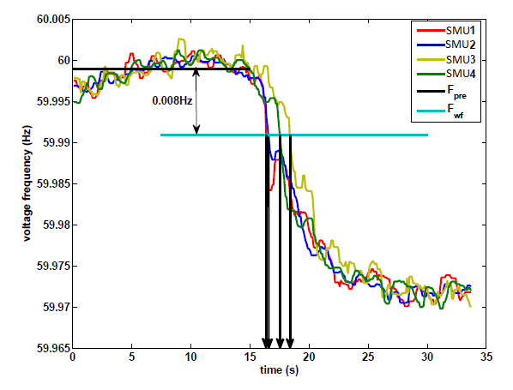
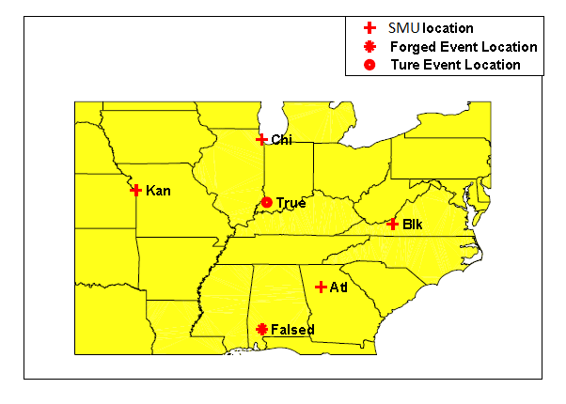
Zhang Paper on Synchrophasor Spoofing
Considers the effects of a Spoofing Attack or Time Stamp Attack on fault location using SMUs
However, these results failed to consider any limits on spoofer induced dynamics

Slide 6
Research Questions to Assess Critical Infrastructure Vulnerability
Would a jamming-power-to-noise-power (J/N) type jamming detector trigger on a spoofing attack?
How aggressively can receiver dynamics be manipulated by a spoofing attack?

Slide 7
Would a J/N-type jamming detector trigger on a spoofing attack?
Power ratio (η): Ratio of spoofing signal power to authentic signal power
A power ratio above 3 would cause input power to exceed 95% of natural variation → J/N-type jamming detector would trigger
What power ratio is required for reliable spoofing?
P_{spoof}
P_{auth}

Slide 8
How Aggressively can Receivers be Manipulated?
We would like to know:
How quickly could a timing or position bias be introduced?
What kinds of oscillations could a spoofer cause in a receiver’s position and timing?
How different are receiver responses to spoofing?
Approach: Determine maximum velocity at which a receiver can be spoofed over a range of accelerations without:
Causing loss of lock of satellites
Raising alarms
v
a
t

Slide 9
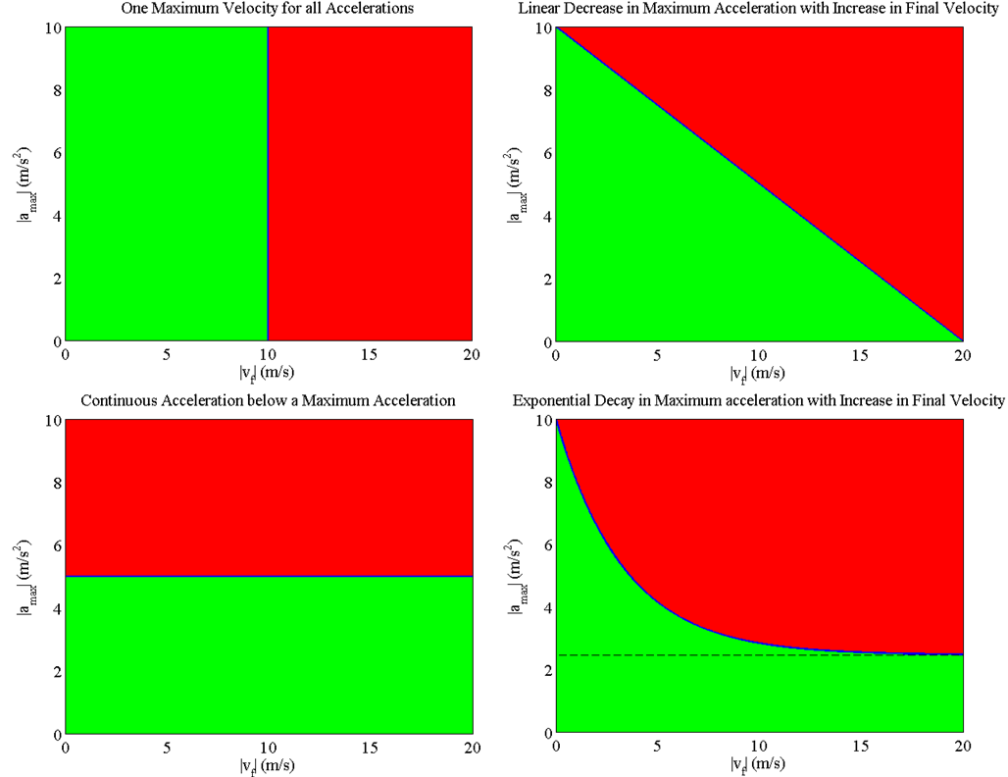
How Aggressively can Receivers be Manipulated? (cont.)
These are some potential shapes for the velocity-acceleration curves
Green: represents the region where a spoofer can operate without being detected
Red represents the region where a spoofer might be unsuccessful

Slide 10
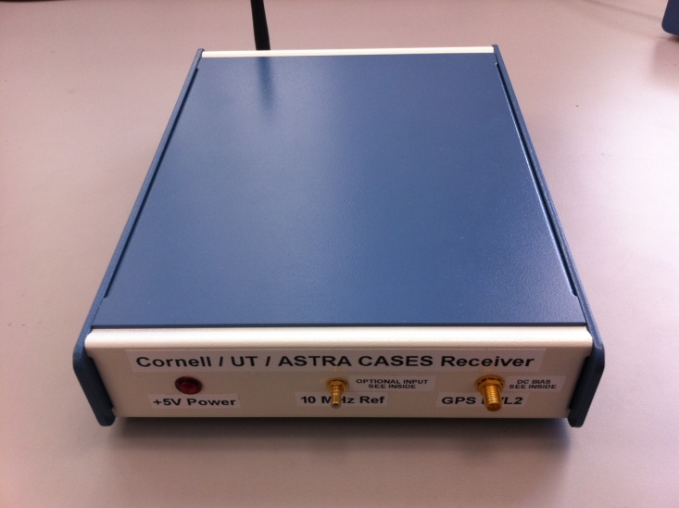
Tested Receivers
Science receiver: CASES receiver
Developed for Ionosphere monitoring
Telecommunications Network Time Reference Receiver: HP 58503B
Commonly used in cell phone base stations (Symmetricom predecessor)
High quality Ovenized Crystal Oscillator (OCXO) steered by the GPS time solution

Slide 11
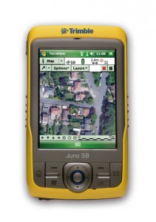
Tested Receivers (cont.)
Power Grid Time Reference Receiver: SEL-2401
Provides timing for power grid Synchrophasor Measurement Units (SMUs)
Low quality Temperature Controlled Oscillator (TCXO) slaved to the GPS time solution
Name brand receiver: Trimble Juno SB

Slide 12
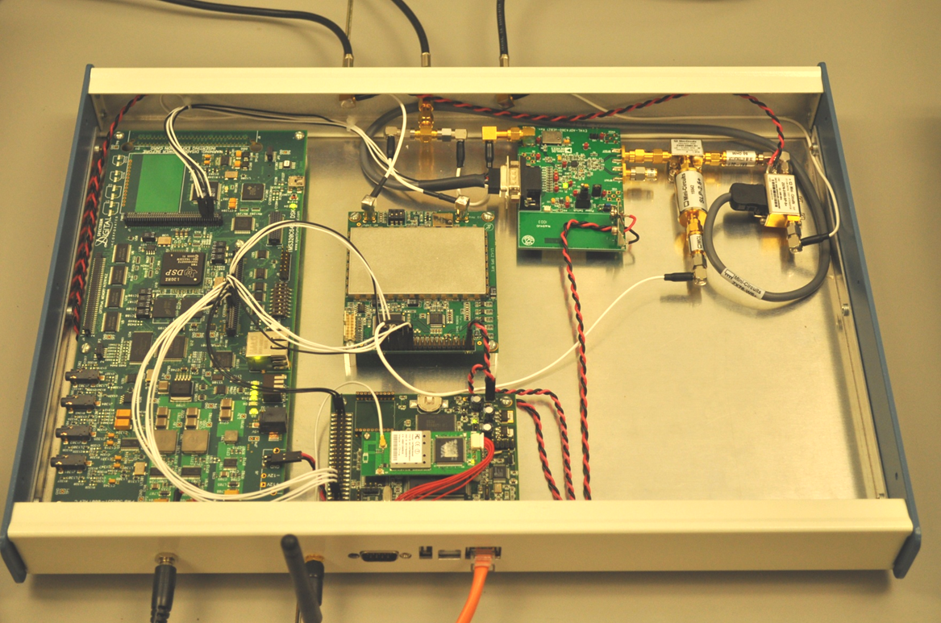
The Civil GPS Spoofer
Introduced in 2008 by Humphreys
Improved Spoofer capable of:
Tracking all L1C/A & L1C signals
Producing up to 10 L1C/A spoofed signals
Precise code phase alignment and frequency lock
Data bit prediction
Remote control of spoofer suggested position, velocity, and acceleration and signal power via internet

Slide 13
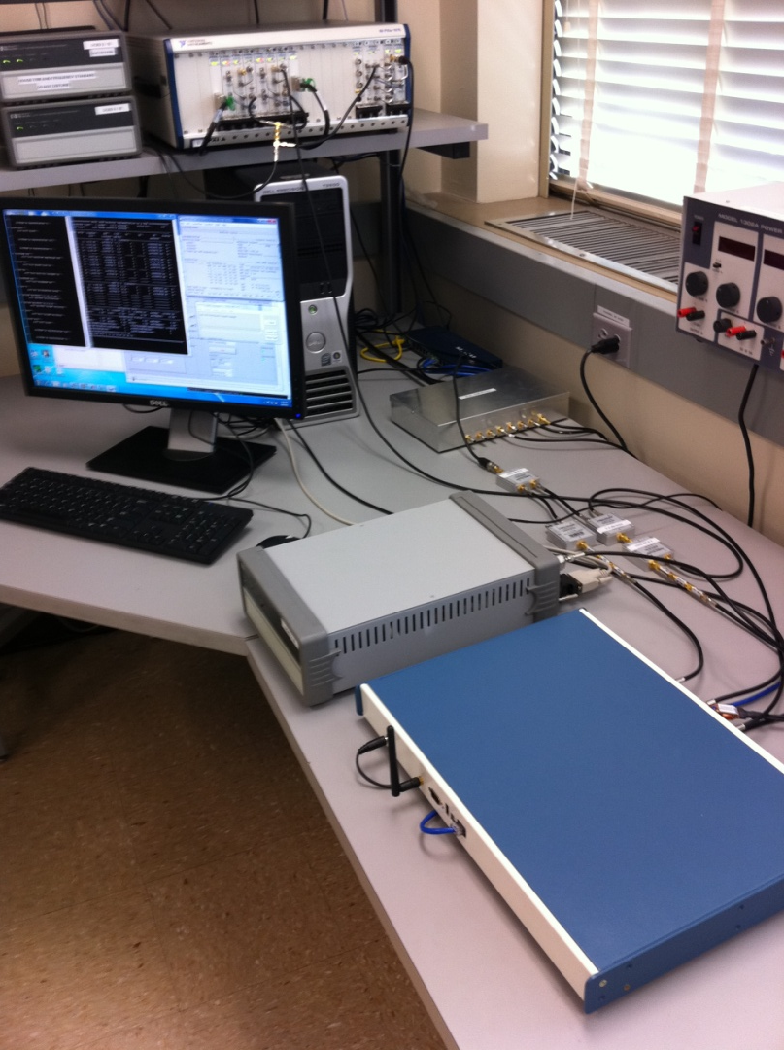
Test Setup
RFSA
A National Instruments Radio Frequency Signal Generator (RFSG) produced 6 GPS signals at constant power
The spoofed signals were summed with the RFSG signals
This combination was fed to:
the target receiver
a National Instruments Radio Frequency Signal Analyzer (RFSA) used for visualization
RFSG
Signal Conditioning
Control / Feedback Computer
Target Receiver
Spoofer

Slide 14
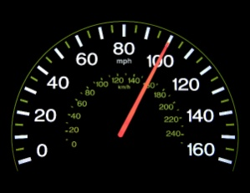
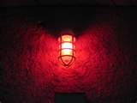
Procedure
Power Ratio
Spoofed Velocity and Acceleration
1. Power Adv. = x dB
2. Attempt Carry-off
3. Check for Success (Remove Authentic Signal)
4. Measure the Power
1 m/s
SV | 1 | 5 | 12
C/N₀ | 50 | 21 | 50
1. Acceleration = a m/s²
2. Velocity = v m/s
3. Check for Success (watch for alarms)
4. Iterate until a maximum velocity is found
v_{max} found?
v
no
a
yes
t

Slide 15
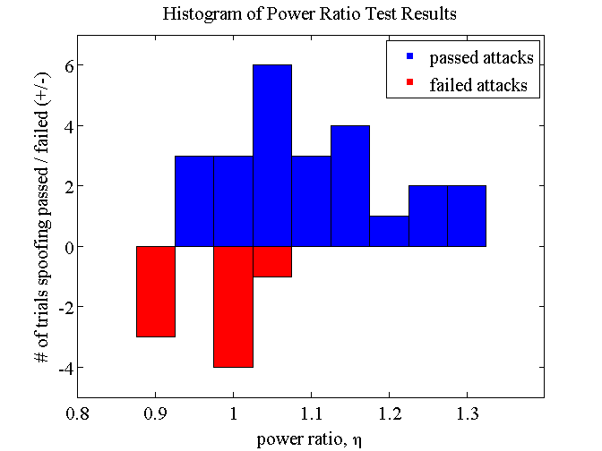
Results: Power Ratio
A power ratio of about 1.1 or greater is needed to capture a target receiver with high confidence
This increase in absolute received power is well below the natural variations due to solar activity
Implications:
A spoofing attack would easily evade detection by a J/N sensor: J/N sensors are necessary, but not sufficient
Downstream signal processing is crucial for reliable spoofing detection

Slide 16
Results: Spoofed Velocity and Acceleration
The data points collected for each receiver were fit to an exponential curve of the form:
This curve fit:
Defines the upper bound in the velocity-acceleration plane below which a sophisticated spoofer can successfully spoof that particular receiver
Can be used to assess the security implications of a spoofing attack

Slide 17
Results: Spoofed Velocity and Acceleration of Science Receiver
Notice the asymptote at 5 m/s² acceleration
Maximum speed is only limited by the doppler frequency range to around 1300 m/s (4.3 μs/s)
Implications:
Acceleration limited to 2 m/s² due to phase trauma
No limitation on velocity up until the receiver is unable to track the signal

Slide 18
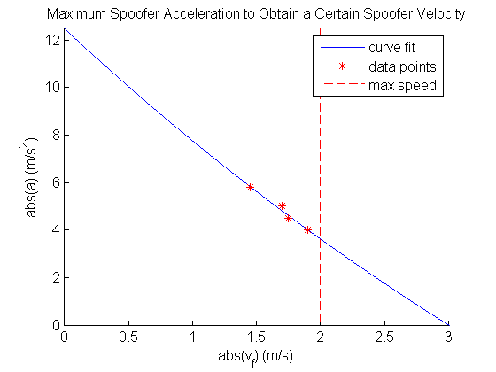
Results: Spoofed Velocity and Acceleration for Telecommunications Network Time Reference Receiver
Due to this receiver placing trust in the frequency stability of its oscillator, it cannot be moved very quickly
Maximum achievable speed in time is 2 m/s (6.67 ns/s)
Implications:
Can still be carried 10 μs off in time in around 35 min, which would disrupt call hand-off

Slide 19
Results: Spoofed Velocity and Acceleration for Power Grid Time Reference Receiver
Can be easily manipulated by the spoofer
Corresponding induced phase angle rate is shown for a 60 Hz phasor
Implications
Can reach a maximum speed of 400 m/s resulting in a phase angle rate of 1.73º/min
Oscillations are not possible due to the low acceleration capability of spoofer

Slide 20
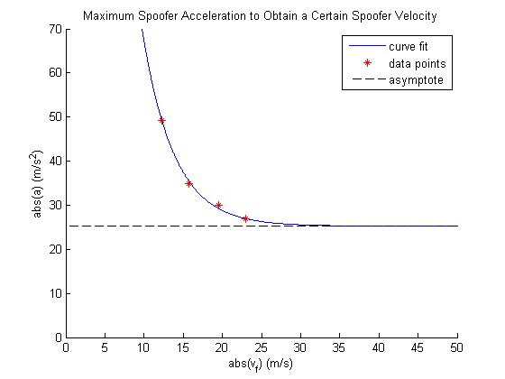
Results: Spoofed Velocity and Acceleration for Name Brand Receiver
Most easily manipulated receiver tested to date
Can be accelerated continuously at about 25 m/s² until the doppler frequency range is reach at a velocity of about 1300 m/s
Implications
Large accelerations and velocities may be possible in many name brand receivers

Slide 21
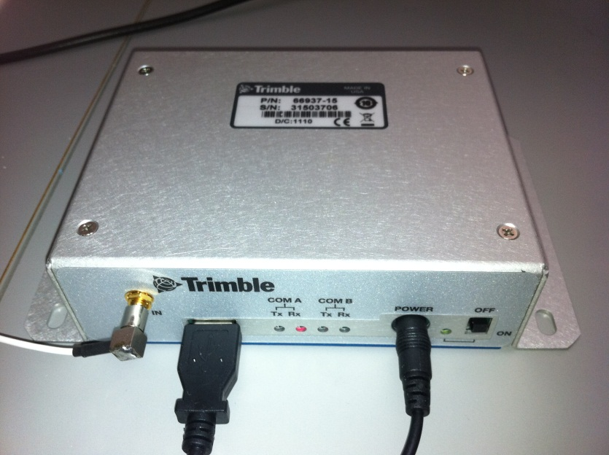
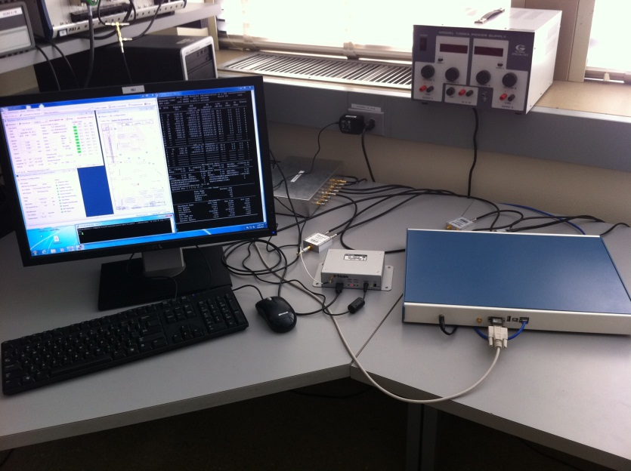
Trimble Resolution SMT
Suggested to be unspoofable based on tests performed at White Sands
Myth Busted
Quite Spoofable

Slide 22
Summary of Findings
We’ve never met a civil receiver we couldn’t spoof
J/N-type jamming detector won’t catch a spoofer, but does restrict it
There are vast differences in the dynamic response to spoofing between receivers
Large oscillations in position and timing are difficult to induce due to low acceleration capability of the spoofer
Areas of vulnerability exist in CDMA cell phone networks and the power grid

