Slide 1
Probabilistic Secure Time Transfer: Challenges and Opportunities for a Sub-Millisecond World
Kyle D. Wesson, Prof. Todd E. Humphreys, Prof. Brian L. Evans
The University of Texas at Austin
NITRD Workshop on “New Clockwork” | October 26, 2012

Slide 2
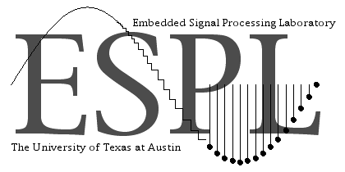

Slide 3
Sources of Time and Frequency
GPS
10 ns Time Accuracy
1 x 10⁻¹³ Frequency Stability
WWVB
0.1 – 15 ms Time Accuracy
1 x 10⁻¹⁰ - 1 x 10⁻¹² Frequency Stability
ITS* (NTP)
10 ms Time Accuracy
1 x 10⁻⁷ Frequency Stability
ITS* (PTP)
0.1 ms Time Accuracy
1 x 10⁻⁹ Frequency Stability
*Internet Time Service
*Internet Time Service
*Internet Time Service
Cesium (Cs) Clock
10 ns Time Accuracy
Cannot Recover Time independently
1 x 10⁻¹³ Frequency Stability
Rubidium (Rb) Clock
10 μs Time Accuracy
Cannot Recover Time Independently
5 x 10⁻¹¹ Frequency Stability
10⁻⁹
10⁻⁸
10⁻⁷
10⁻⁶
10⁻⁵
10⁻⁴
10⁻³
10⁻²
10⁻¹
10⁰
GPS
PTP
NTP
Cs
Rb
WWVB
1 ns
1 μs
1 ms
1 s
M. Narins, FAA

Slide 4
Critical Infrastructure/Key Resource Sector | Uses GPS Timing?
 | Yes | No
Communications Sector | X
Emergency Services Sector | X
Information Technology Sector | X
Banking & Finance Sector | X
Healthcare & Public Health Sector | X
Energy/Electric Power and Oil & Natural Gas SubSector | X
Nuclear Sector | X
Dams Sector | X
Chemical Sector | X
Critical Manufacturing | X
Defense Industrial Base Sectors | X
Postal & Shipping Sector | X
Transportation Sector | X
Government Facilities Sector | X
Commercial Facilities Sector | X
National Monuments and Icons Sector |  | X
Agriculture and Food Sector |  | X
Water and Wastewater Sector |  | X
M. Narins, FAA

Slide 5
Challenges
Can’t trust civil GPS receivers to deliver secure time
Can’t defend against a near-zero-delay meaconing attack
Can’t verify pending leap second changes in advance
Can’t catch a patient time saboteur by comparison with local clocks
Can’t distinguish multipath from spoofing on dynamic platform

Slide 6
1 km
 | Attack | Description
Jamming | Unintentional | Solar radio bursts
 | Intentional | Denial of service via RF noise
Spoofing | Meaconing | Record and playback of entire RF spectrum
 | Security Code Estimation and Replay | Estimate security code on-the-fly and playback with estimated value to defeat security enhanced GPS (not publically available)
 | Data Bit Forgery | Alter ephemeris or leap second indicators

Slide 7
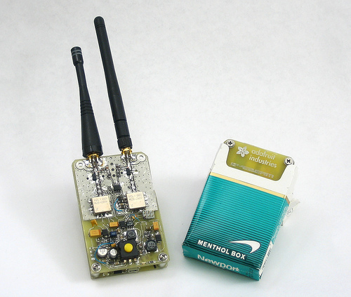
GPS Jammers

Slide 8
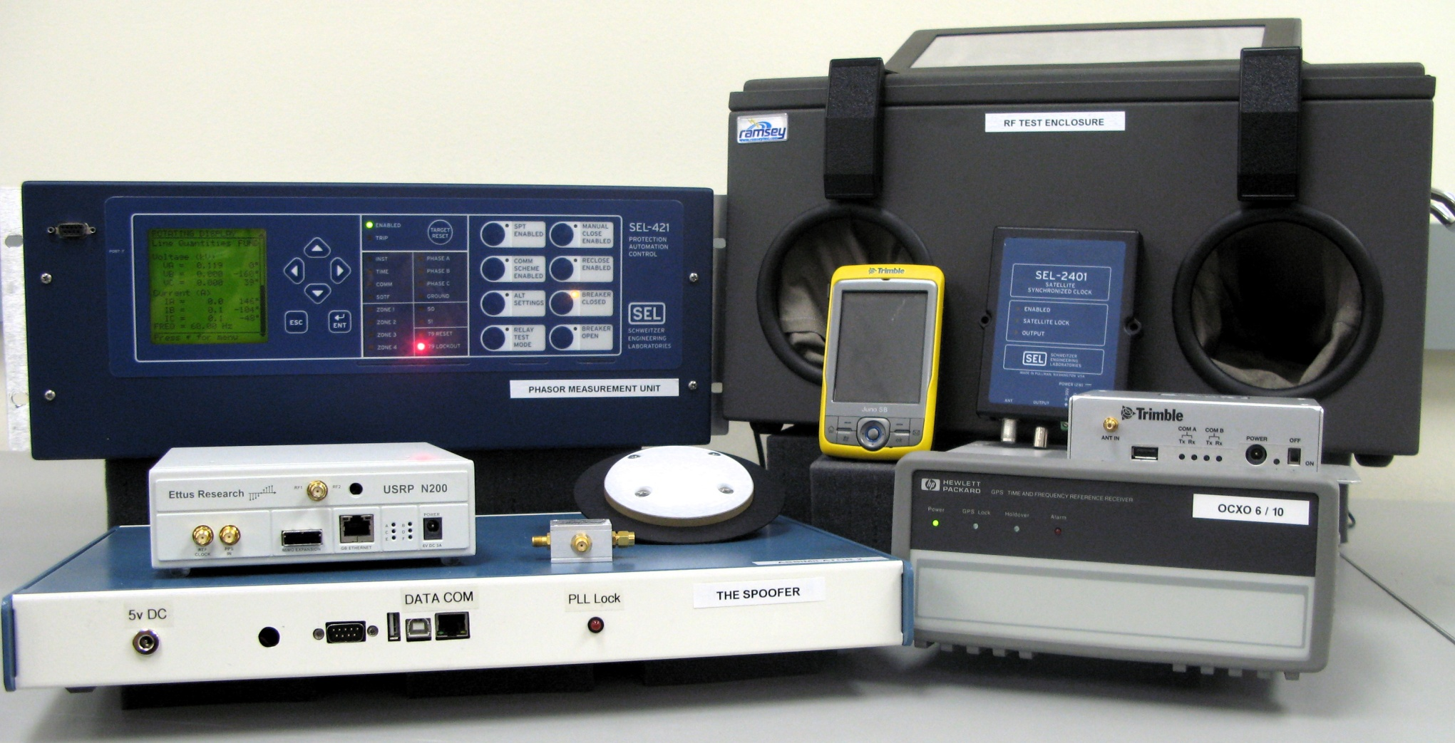
University of Texas Spoofing Testbed

Slide 9
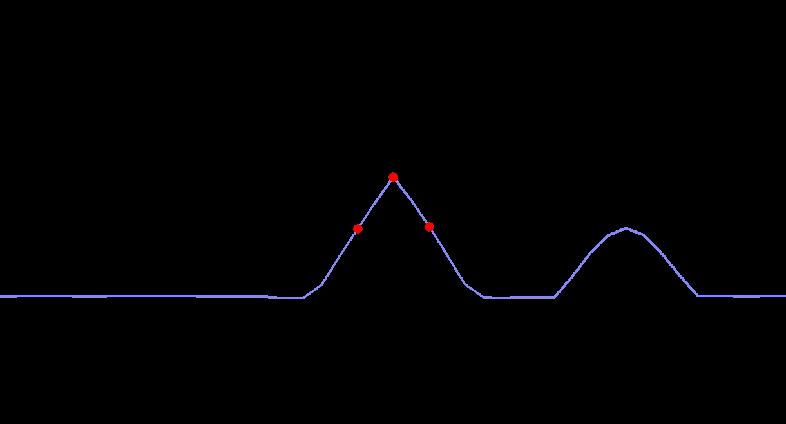
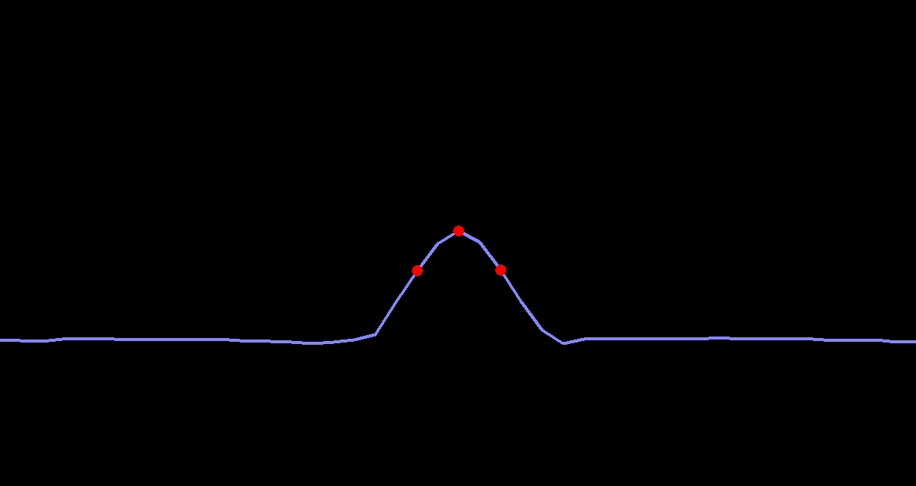
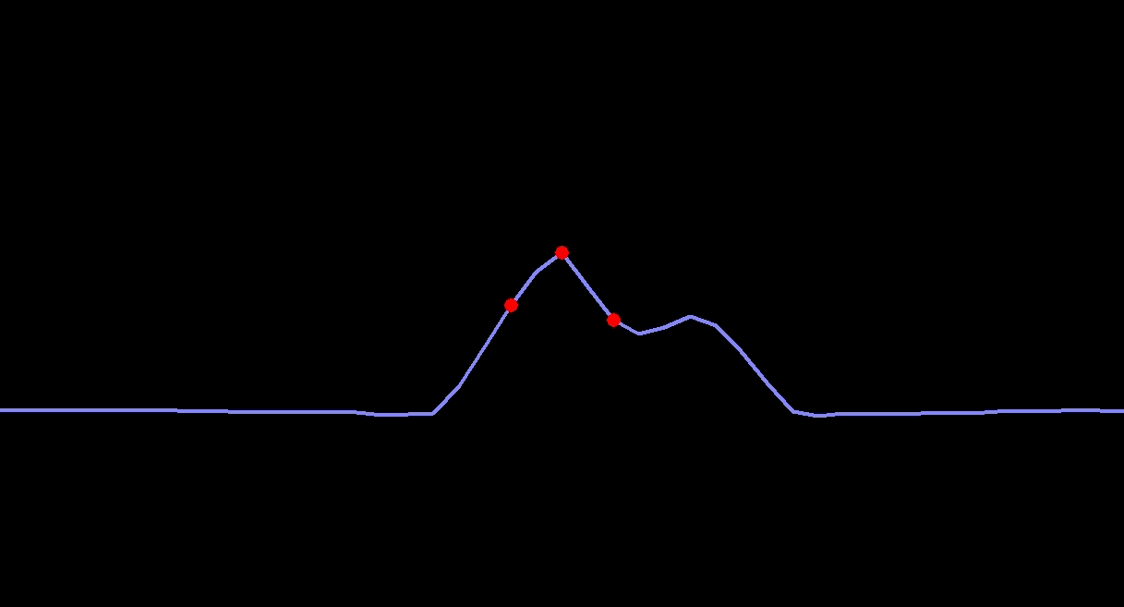
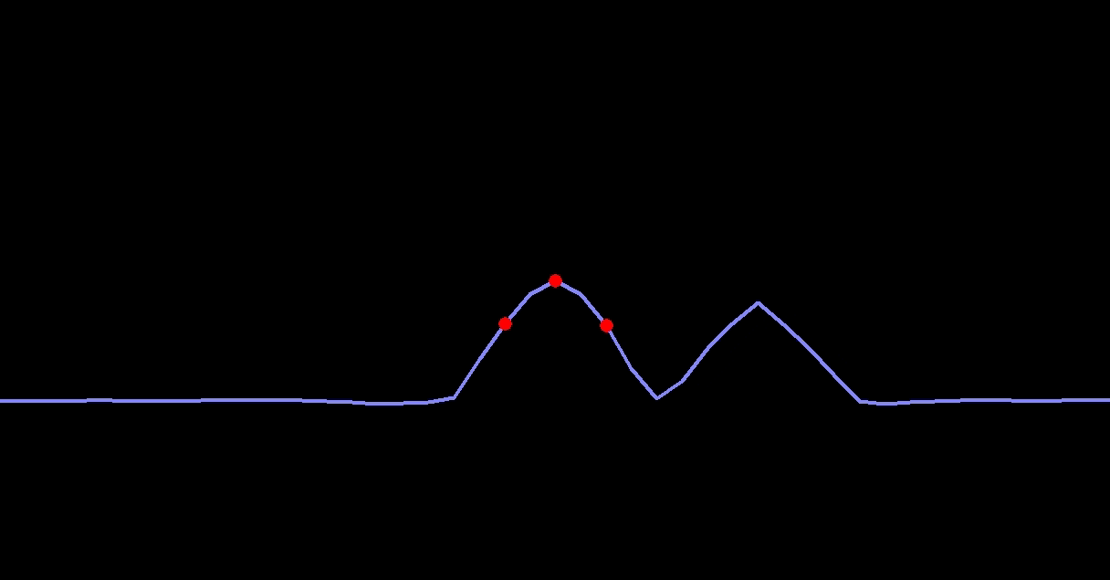
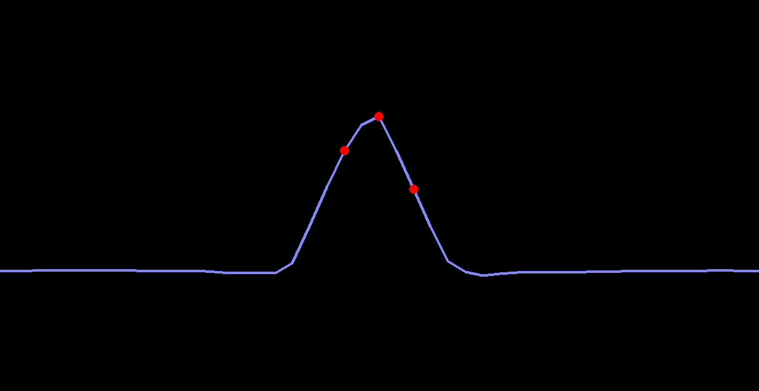
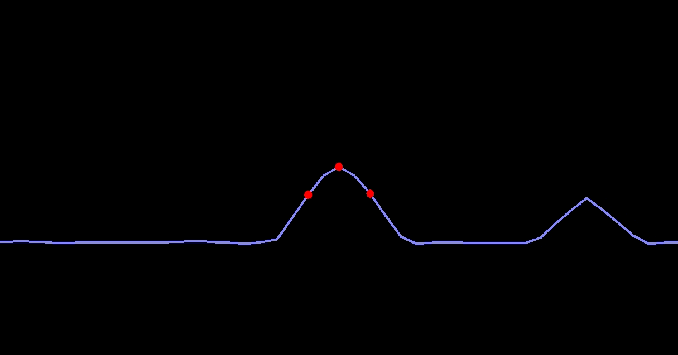
GPS Spoofer

Slide 10
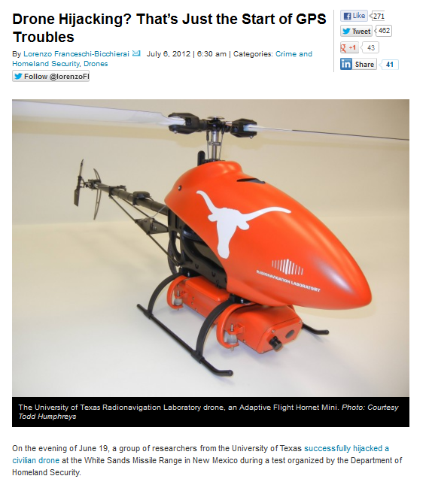

Slide 11
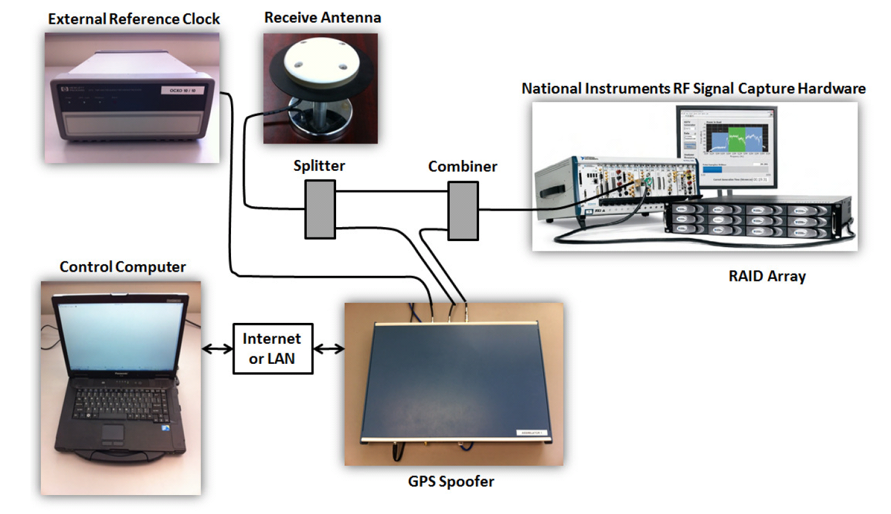
The Texas Spoofing Test Battery:
Toward a Standard for Evaluating
GPS Signal Authentication Techniques

Slide 12
Challenges
Can’t trust civil GPS receivers to deliver secure time
Can’t defend against a near-zero-delay meaconing attack
Can’t verify pending leap second changes in advance
Can’t catch a patient time saboteur by comparison with local clocks
Can’t distinguish multipath from spoofing on dynamic platform
Can’t trust other dependent time systems

Slide 13
NTP/PTP Timing Attacks
 | Attack | Description
Jamming | Unintentional | Network failure
 | Intentional | Denial of service (flood network with bogus traffic)
Spoofing | Delay/Replay | Man-in-the-middle rebroadcast to alter delay estimates
 | Masquerade | Act as false grandmaster
 | Message Modification | Modify message content
J. Tsang, UBC, LERSSE-TR-2006-02

Slide 14
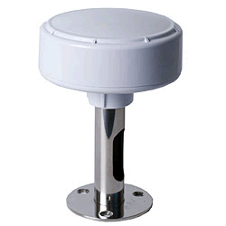
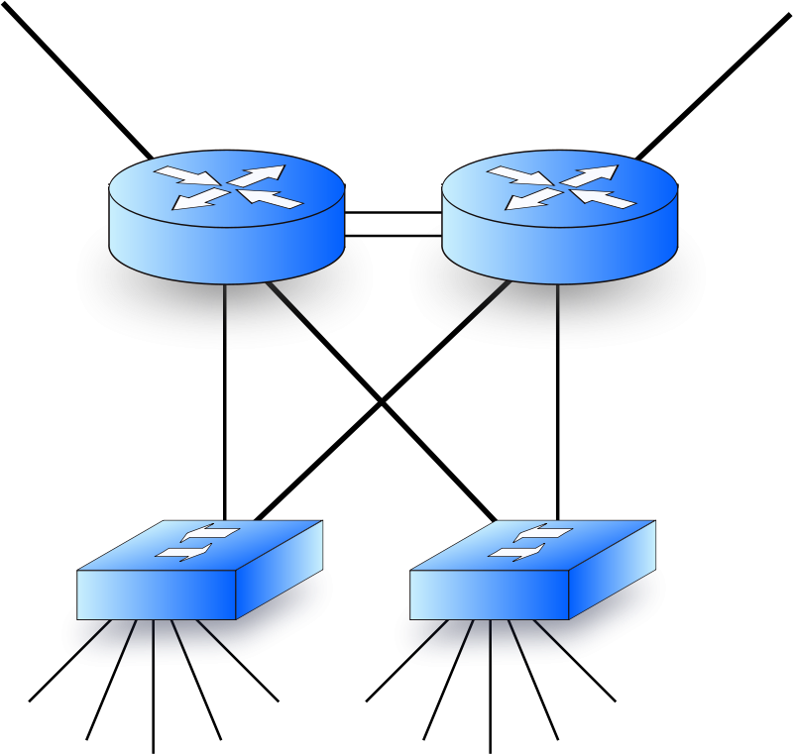
Hybrid Cyber-Physical Attacks
GPS
Internet Traffic
Network

Slide 15
Challenges
Can’t trust civil GPS receivers to deliver secure time
Can’t defend against a near-zero-delay meaconing attack
Can’t verify pending leap second changes in advance
Can’t catch a patient time saboteur by comparison with local clocks
Can’t distinguish multipath from spoofing on dynamic platform
Can’t trust other time systems
Can’t make strong guarantees: timing demands a probabilistic security model

Slide 16
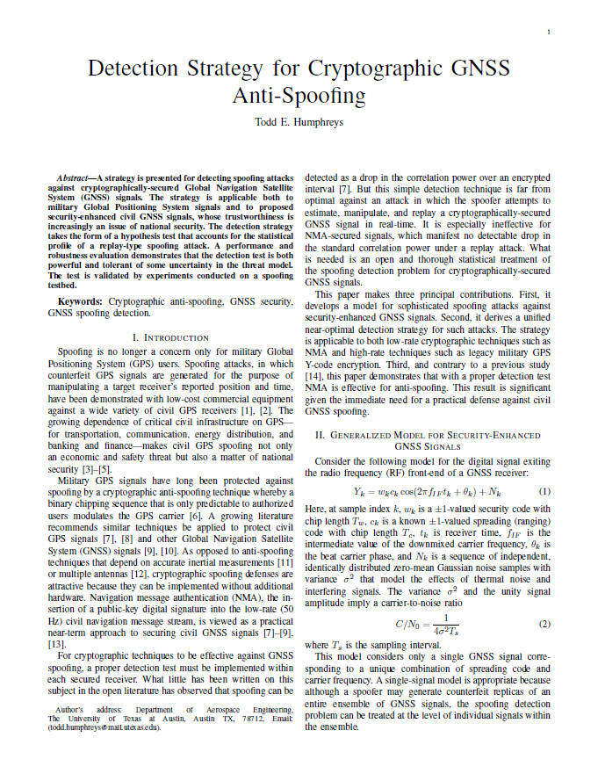
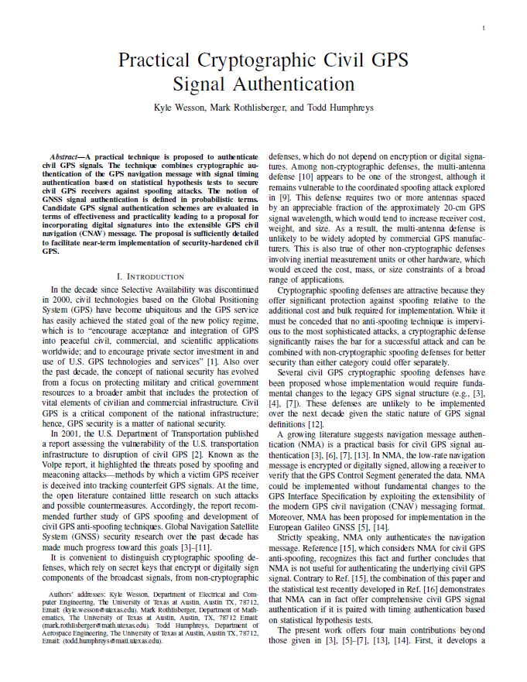
http://rnl.ae.utexas.edu/publications

Slide 17
Security-Enhanced GNSS Signal Model
Security code :
Generalization of binary modulating sequence
Either fully encrypted or contains periodic authentication codes
Unpredictable to would-be spoofer

Slide 18
Attacking Security-Enhanced GNSS Signals
Meaconing: Spoofer records and re-broadcasts entire block of RF spectrum containing ensemble of GNSS signals
Security Code Estimation and Replay (SCER) Attack: Spoofer estimates unpredictable security code chips from authentic signals on-the-fly

Slide 19
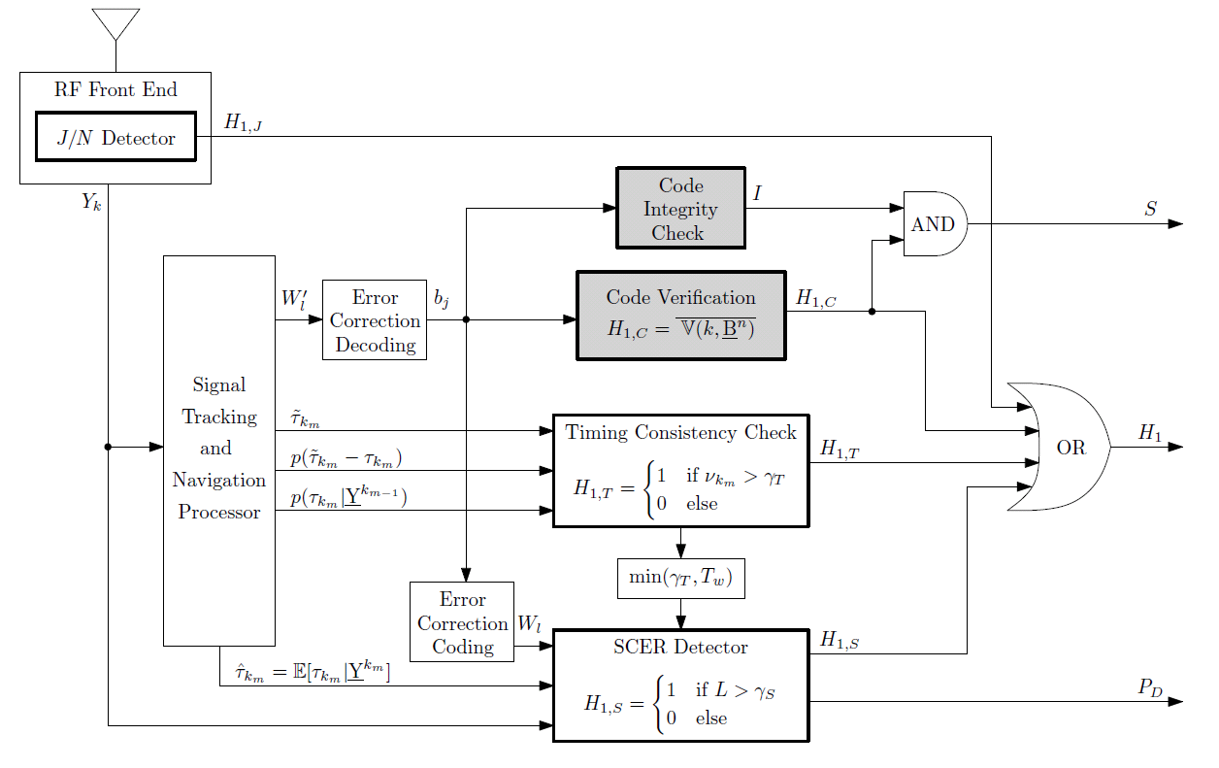
Public-Key Signal Authentication: Receiver Perspective
Look at the probablisitic nature of this problem specifically
PD H1J H1T
H1C and I are like crypto
Code Origin Authentication
Code Timing Authentication
Wesson, K., Rothlisberger, M., and Humphreys, T. E., “Practical Cryptographic Civil GPS Signal Authentication,”
NAVIGATION: The Journal of the Institute of Navigation, 59(3):177-193.

Slide 20
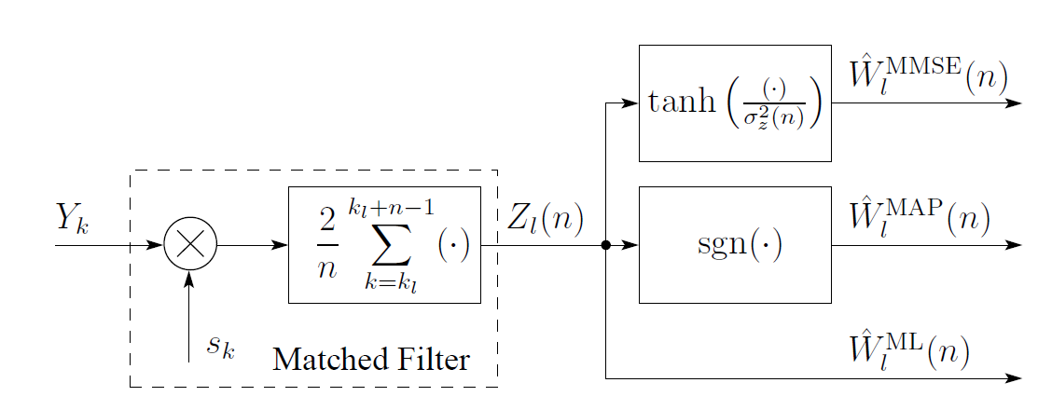
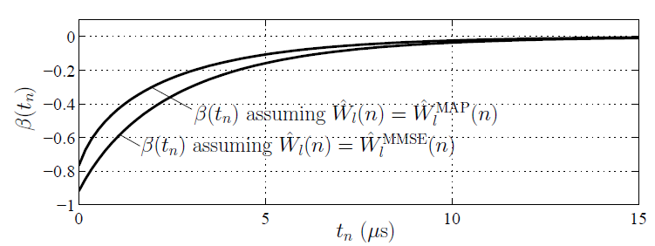
Security Code Estimation and Replay Detection
Inside the Spoofer:
Security Code Chip Estimation
Talk about statistics and probablility and how we need to look at the statistics
Inside the Defender: Detection Statistic Based on Specialized Correlations

Slide 21
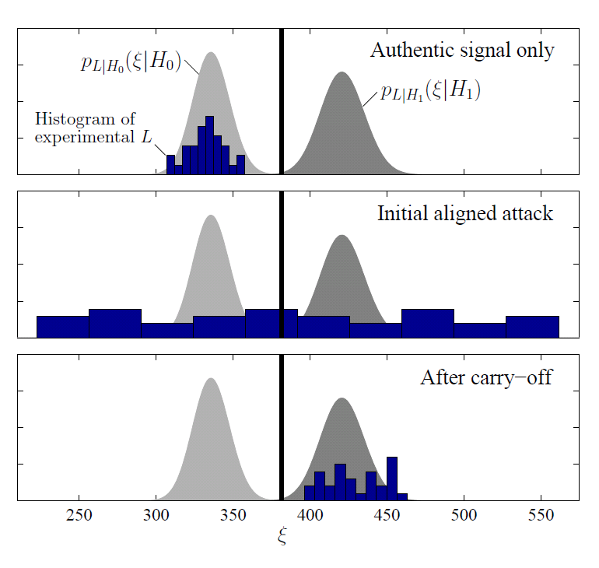
Security Code Estimation and Replay Detection:
Hypothesis Testing During an Attack
Humphreys, T. E., “Detection Strategy for Cryptographic GNSS Anti-Spoofing,”
IEEE Transactions on Aerospace and Electronic Systems, to be published.

Slide 22
Operational Definition of GNSS Signal Authentication
GNSS signal is declared authentic if since some trusted initialization event:
logical output S has remained low, and
logical output H₁ has remained low, and
output P_{D} has remained above an acceptable threshold

Slide 23
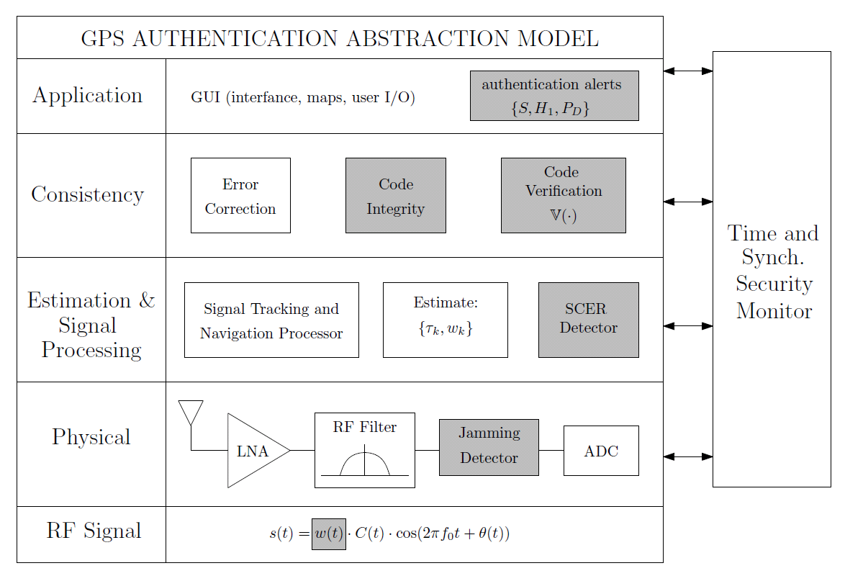
What are essential elements to enable secure time transfer?
Ask questions; are there others that I’m missing here?

Slide 24
What are essential elements to enable secure time transfer?
Layer | Description
Application Level | User alerts and management
Consistency Level | Code verification and validation
Estimation Level | Security code estimation and replay attack detection
Physical Level | Jamming detection to detect intentional interference
Signal Level | Unpredictable bits or chips embedded in signal

Slide 25
Challenges
Can’t trust civil GPS receivers to deliver secure time
Can’t defend against a near-zero-delay meaconing attack
Can’t verify pending leap second changes in advance
Can’t catch a patient time saboteur by comparison with local clocks
Can’t distinguish multipath from spoofing on dynamic platform
Can’t trust other time systems
Can’t make strong guarantees: timing demands a probabilistic security model

