Slide 1
GNSS VULNERABILITIES AND THREATS
Thursday, 3:55pm, room 24
This session will discuss techniques for enhancing the ability of receivers to detect, disregard, and operate through intentional and unintentional interference.
Per Enge, Christoph Guenther, Chris Hegarty, Mark Psiaki, Logan Scott, Todd Humphreys (moderator)

Slide 2
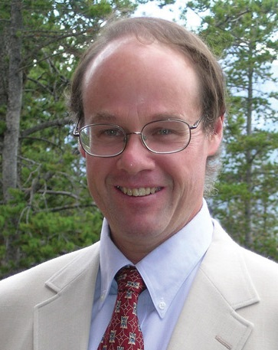
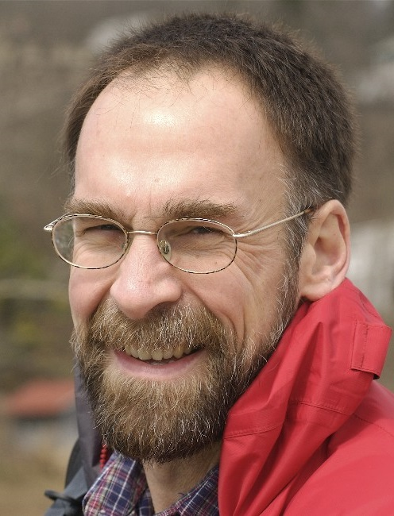
Logan Scott
President, LS Consulting
Mark Psiaki, Cornell
Professor of Mech. and Aero. Eng.

Slide 3
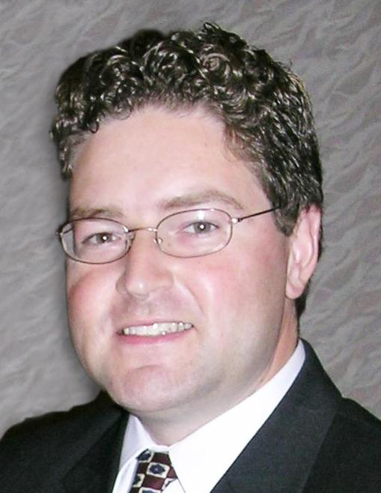
Christoph Guenther, DLR, TUM
Director of DLR Institute of Communication and Navigation
Chris Hegarty, MITRE
Director for Communications, Nav., & Surveillance Engineering

Slide 4
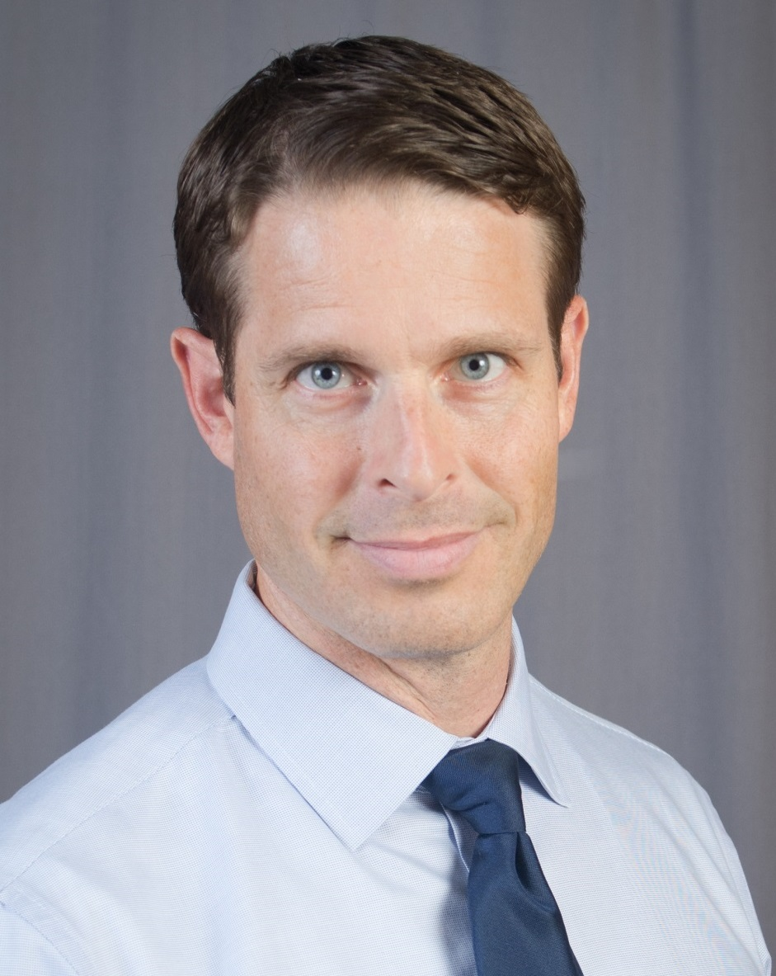
Per Enge, Stanford
Director of Stanford center for PNT
Todd Humphreys, UT Austin
Moderator

Slide 5
Civil GNSS Interference Defenses
Cryptographic
Non-Cryptographic
SSSC on L1C
(Scott)
J/N Sensing
(Scott, Ward, UC Boulder, Calgary)
Stand-Alone
SSSC or NMA on WAAS
(Scott, UT)
Sensor Diversity Defense
(DLR, Stanford, MITRE, DARPA, BAE, UT)
NMA on L2C, L5, or L1C
(UT, MITRE, Scott, GPSD)
Single-Antenna Spatial Correlation
(Cornell, Calgary)
Correlation Anomaly Defense
(UT, TENCAP, Ledvina, Torino)
P(Y) Cross-Correlation
(Stanford, Cornell)
Multi-Element Antenna Defense
(DLR, MITRE, Cornell, Stanford)
Networked
GNSS signal authentication is fundamentally a problem of statistical decision theory
Mobility Trace Analysis
(UT)

Slide 6
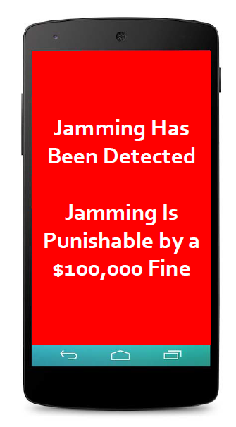
Will classic military anti-jam strategies be effective in a civil environment?
How can smartphones help prevent GNSS jamming?
What motivates civil GNSS jamming?
What are the recent trends?

Slide 7
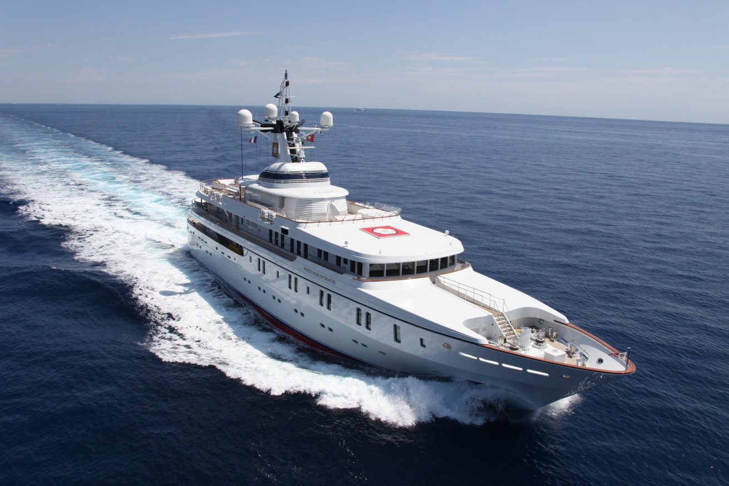
Could you tell us how you thwarted a GPS spoofing attack on a superyacht this summer?
How broadly applicable is your technique?

Slide 8
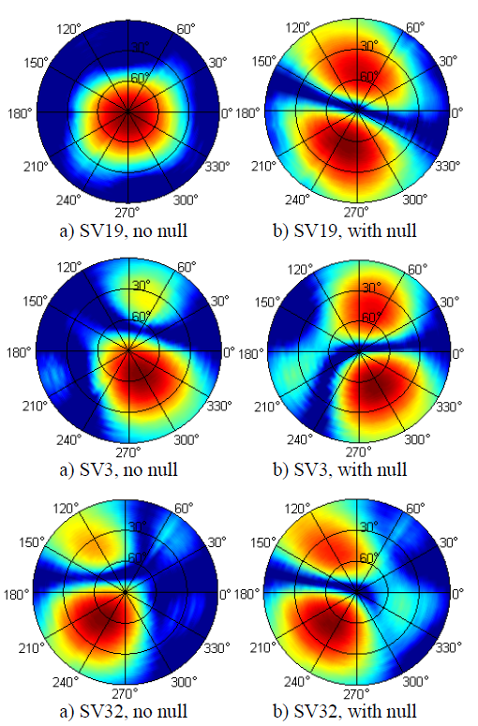
How effective are the most advanced DLR multi-element arrays against jamming and spoofing?
Can such arrays be made small enough for widespread adoption?

Slide 9
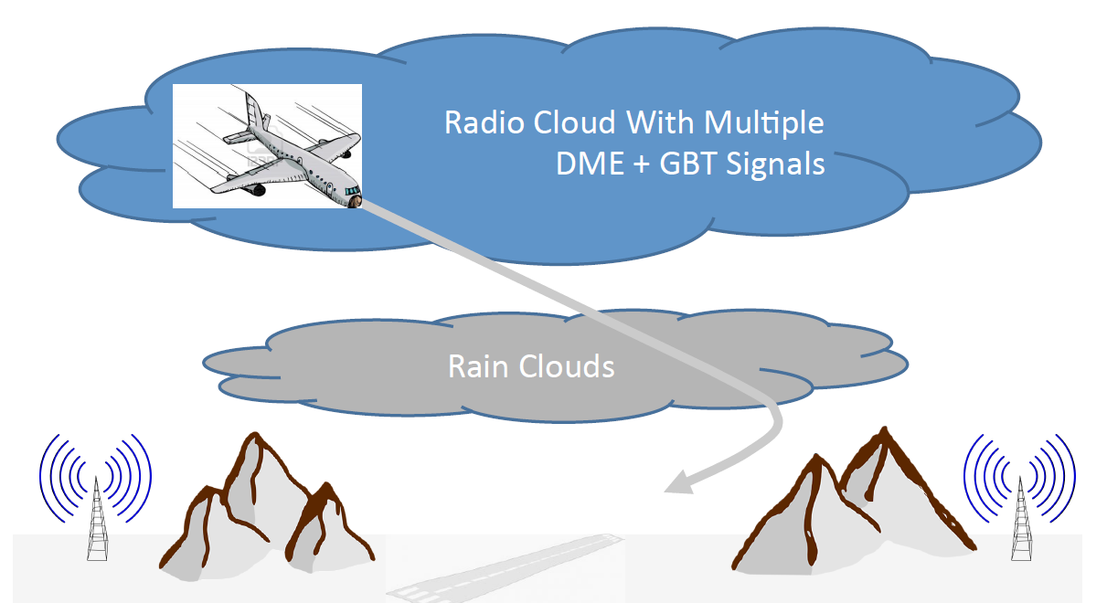
How can DME and inertial sensors be combined to offer a reliable backup to GPS for aviation?
What can you tell us about the high-level recommendations of the GPS Intentional Interference and Spoofing Study Team (GIISST)?

Slide 10
An Augmented Perspective on Interference
GNSS
Interference
Robust and Secure
Nav. and Timing
Secure perception: Navigation,
timing, and collision avoidance

Slide 11
An Augmented Perspective on Interference
GNSS
Interference
Robust and Secure
Nav. and Timing
Secure perception: Navigation,
timing, and collision avoidance
If you’re moving, you’re navigating, and modern navigation also requires precise timing and collision avoidance. The ION has the right depth and breadth of expertise in sensor fusion, physical-layer signal processing, and security to address the general problem of secure perception, which extends far beyond GNSS interference.

Slide 12
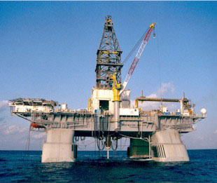
Example: Deep water drilling
Dynamic positioning is a key technology for drilling and production
In deepest waters, only GNSS and acoustic navigation sensors are practical
The usual 3-system redundancy is waived so long as there are multiple DGPS receivers
Deepwater Horizon (~2009)

Slide 13
Example: Deep water drilling
Dynamic positioning is a key technology for drilling and production
In deepest waters, only GNSS and acoustic navigation sensors are practical
The usual 3-system redundancy is waived so long as there are multiple DGPS receivers
Deepwater Horizon (~2009)
We need to secure not only the GNSS receivers but also backup positioning systems (e.g., hydro acoustic)

Slide 14
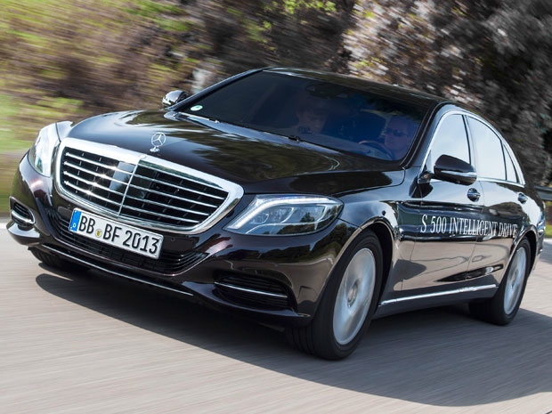
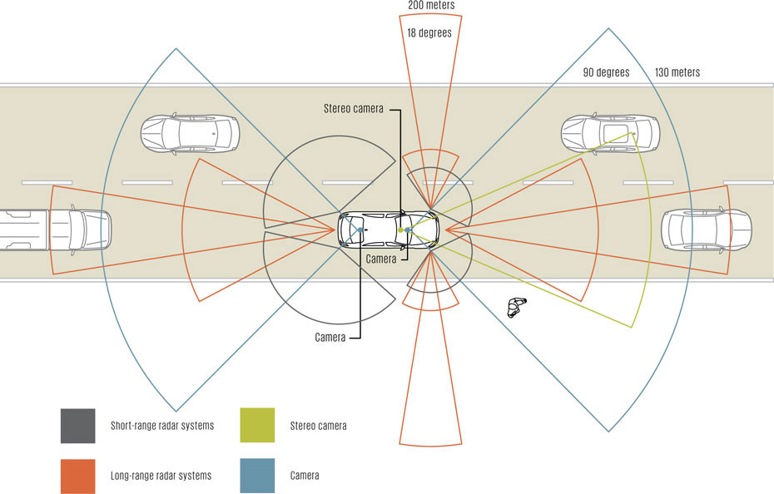
Example: Self-Driving Cars
The eyes of self-driving cars will not be lidar or cameras, but low-cost radar sensors
Perfected over the last two decades by Bosch, Daimler, etc.
Short and long range, automotive radar sees through rain and fog
Photo: Daimler
Illustration: John MacNeill

Slide 15
Example: Self-Driving Cars
The eyes of self-driving cars will not be lidar or cameras, but low-cost radar sensors
Perfected over the last two decades by Bosch, Daimler, etc.
Short and long range, automotive radar sees through rain and fog
Photo: Daimler
Automotive radar are robust but not secure
Illustration: John MacNeill

Slide 16
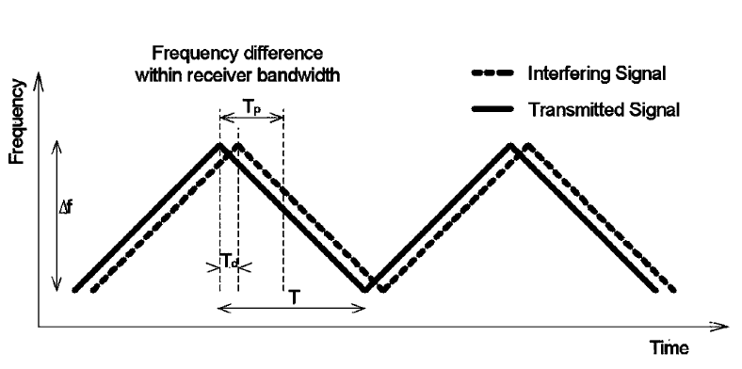
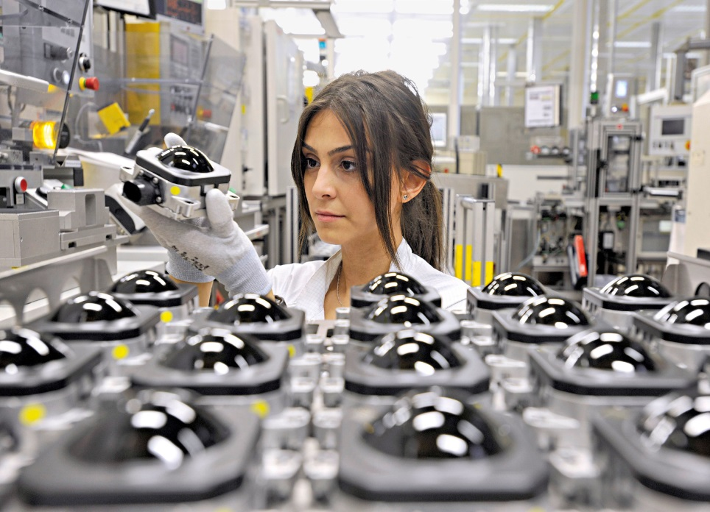
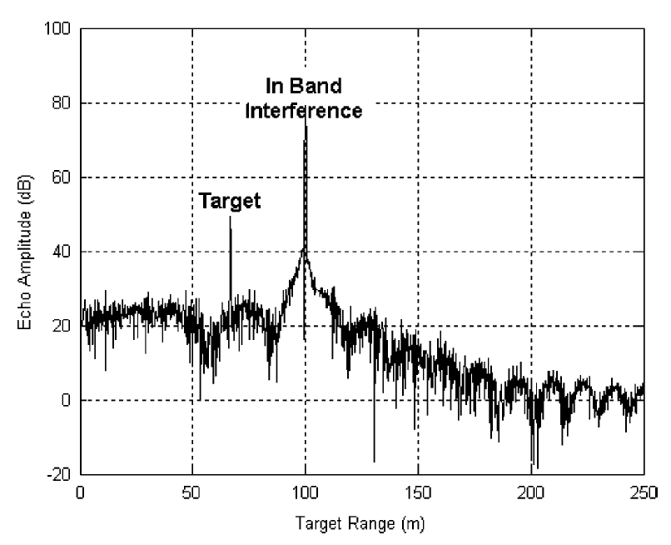
With a 200-MHz/ms FMCW sweep, and with 10 randomly-assigned bands, the probability of interference between two passing cars is less than 1 in 1500
Booker, “Mutual interference of mm-wave radar systems.” (2007)

Slide 17
With a 200-MHz/ms FMCW sweep, and with 10 randomly-assigned bands, the probability of interference between two passing cars is less than 1 in 1500
Booker, “Mutual interference of mm-wave radar systems.” (2007)

Slide 18
But the security of these systems against deliberate attack is weak because the FMCW modulation is trivially predictable
Booker, “Mutual interference of mm-wave radar systems.” (2007)

Slide 19
In years to come, we can anticipate ION panel sessions on all aspects of secure perception, from navigation to timing to collision avoidance. Emphasis will be on semi-autonomous and autonomous systems.

Slide 20
