Slide 1
Advances in GNSS Equipment
Todd Humphreys
With Input From:
Thomas Pany, Bernhard Riedl IFEN, Carsten Stroeber UFAF
Larry Young, JPL
David Munton, UT/ARL
2010 IGS Workshop, Newcastle Upon Tyne

Slide 2
Q: What advances in GNSS receiver technology can the IGS exploit to improve its network and products?

Slide 3
Outline
Review conclusions from Miami 2008
A look at commercial receiver state-of-the-art
Advances in software receiver technology
  DFE: The final front-end
  The CASES receiver
  The IFEN/UFAF SX-NSR receiver: Performance evaluation
Not all observables are created equal
Summary

Slide 4
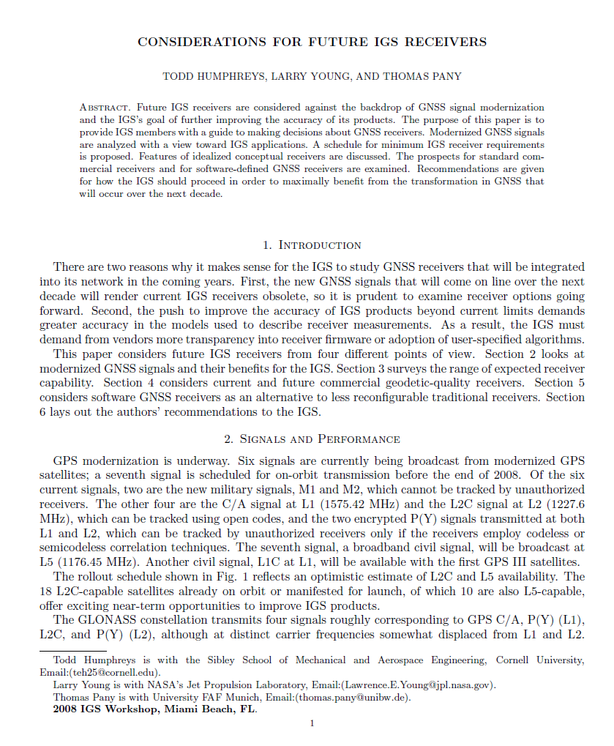
Conclusions from Miami 2008
Many excellent commercial RXs to choose from
All major manufacturers have road maps toward all-in-view capability
Pseudorange and phase measurement error statistics are heterogeneous and ill-defined, impairing IGS products
Software receivers show promise but have not been vetted

Slide 5
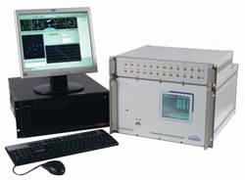

The Super Receiver
Tracks all open signals, all satellites
Tracks encrypted signals where possible
Well-defined, publicly disclosed measurement characteristics (phase, pseudorange, C/No)
RINEX 3.00 compliant
Completely user reconfigurable, from correlations to tracking loops to navigation solution
Internal cycle slip mitigation/detection
Up to 50 Hz measurements
Internet ready; signal processing strategy reconfigurable via internet
Low cost

Slide 6
The Ultra Receiver
Digital Storage Rx
RF Front-End
ADC
Mass
Storage
Digital Storage Rx
Software Post-Processing
RF Front-End
Reference
Oscillator
Sample
Clock
ADC
Mass
Storage
FFT-based
Acquisition
Digital Storage Rx
Tracking
Loops, Data
Decoding,
Observables
Calculations
RF Front-End
Reference
Oscillator
Sample
Clock
ADC
Mass
Storage
Software
Correlators
Digital Storage Rx
RF Front-End
Reference
Oscillator
Sample
Clock
ADC
Mass
Storage
Reference
Oscillator
Sample
Clock

Slide 7
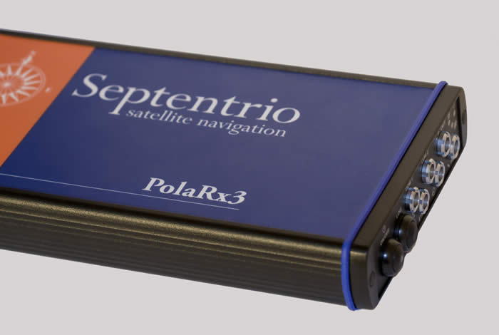
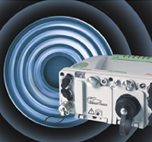
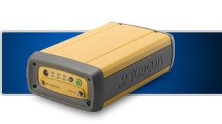
Commercial Receiver Offerings (2008)
Septentrio PolaRx3
Trimble NetRS/NetR5
Leica GRX1200
Topcon NET-G3

Slide 8
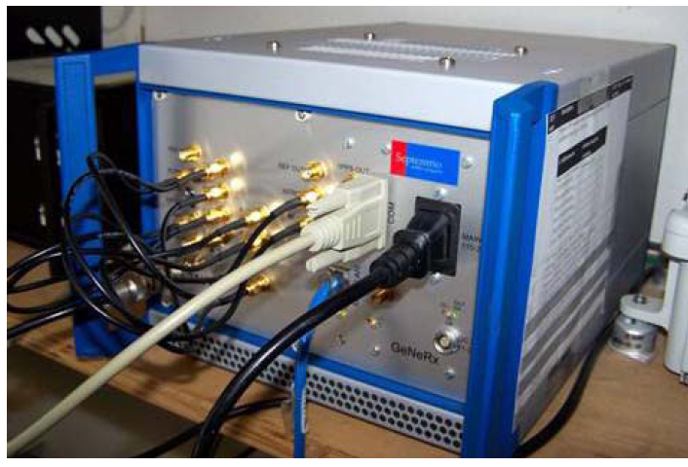
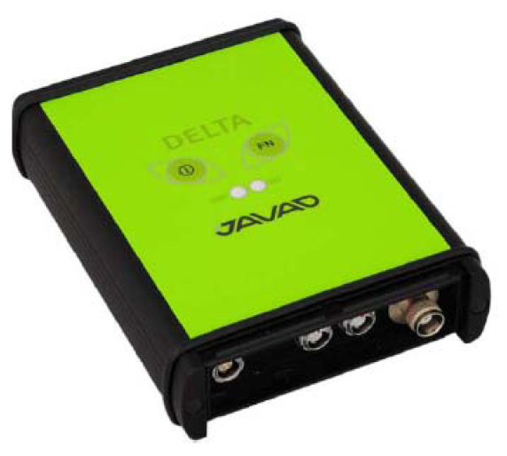
Commercial Receiver Offerings (2010)
Septentrio GeNeRx1
Trimble NetRS/NetR5/NetR8
Javad G3T
Leica GRX1200+GNSS
Topcon NET-G3

Slide 9
Receiver Type Distribution (June 2010)
Fastest Growth Since 2007

Slide 10
Approaching the Super Receiver
Example Commercial Reciver: Javad G3T
Except E5B,
216 channels
Tracks all open signals, all satellites
Tracks encrypted signals where possible
Well-defined, publicly disclosed measurement characteristics (phase, pseudorange, C/No)
RINEX 3.00 compliant
Completely user reconfigurable, from correlations to tracking loops to navigation solution
Internal cycle slip mitigation/detection
Up to 50 Hz measurements
Internet ready; signal processing strategy reconfigurable via internet
Low cost
Loop BW, update rate configurable
Only one G3T in IGS network (BOGI, Poland)
Performance appears good
~$8k

Slide 11
Outline
Review conclusions from Miami 2008
A look at commercial state-of-the-art
Advances in software receiver technology
  DFE: The final front-end
  The CASES receiver
  The IFEN/UFAF SX-NSR receiver: Performance evaluation
Not all observables are created equal
Summary

Slide 12
Recall: The Ultra Receiver
Digital Storage Rx
RF Front-End
ADC
Mass
Storage
Digital Storage Rx
Software Post-Processing
RF Front-End
Reference
Oscillator
Sample
Clock
ADC
Mass
Storage
FFT-based
Acquisition
Digital Storage Rx
Tracking
Loops, Data
Decoding,
Observables
Calculations
RF Front-End
Reference
Oscillator
Sample
Clock
ADC
Mass
Storage
Software
Correlators
Digital Storage Rx
RF Front-End
Reference
Oscillator
Sample
Clock
ADC
Mass
Storage
Reference
Oscillator
Sample
Clock

Slide 13
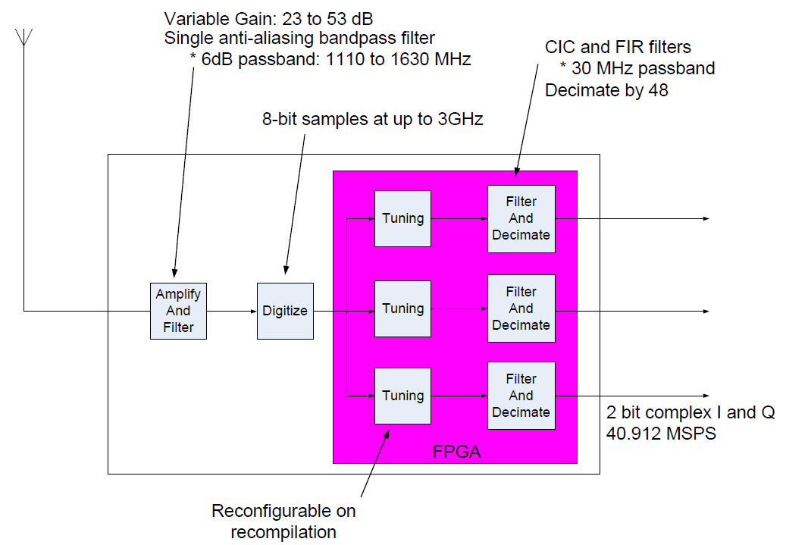
The ARL:UT Digitizing Front End

Slide 14
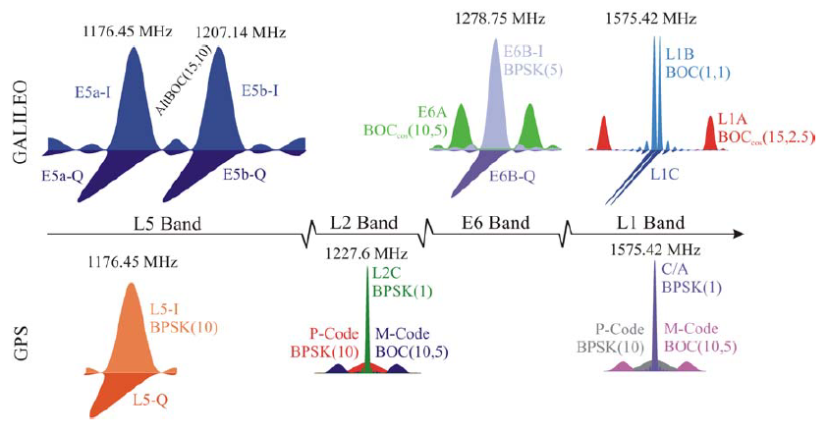
The ARL:UT Digitizing Front End
1130 MHz
500 MHz span
1630 MHz
(Fig. 1 of Wallner et al., "Interference Computations Between GPS and Galileo," Proc. ION GNSS 2005)

Slide 15
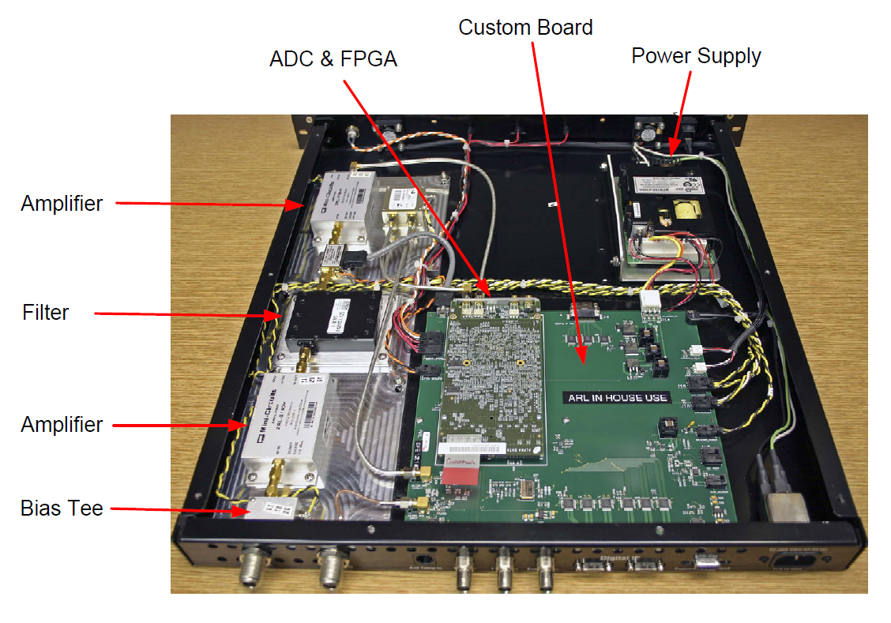
The ARL:UT Digitizing Front End
500 MHz bandwidth
Single RF signal path and ADC substantially eliminates inter-signal instrument biases
Temperature-stabilized signal conditioning chain
Open-source design, as with GPSTk
Debut at ION GNSS 2010

Slide 16
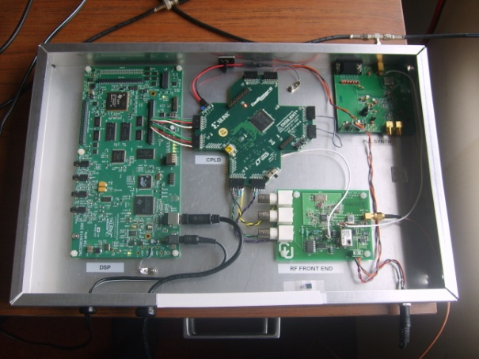
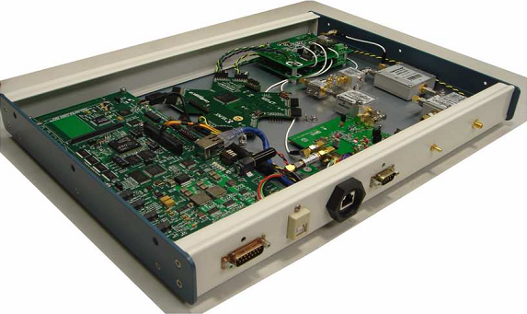
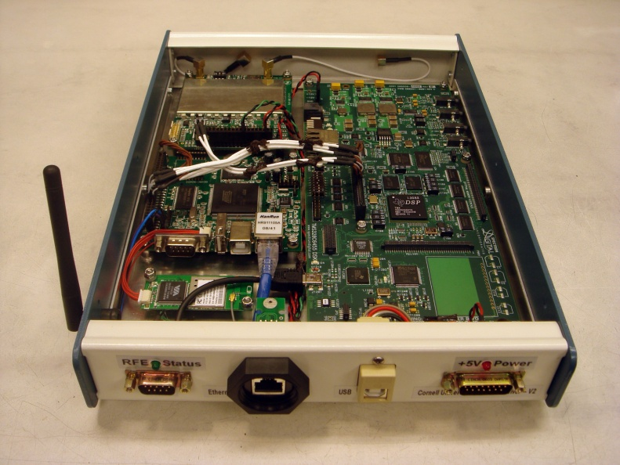
UT/Cornell/ASTRA CASES SwRx
V0
V1
V2

Slide 17
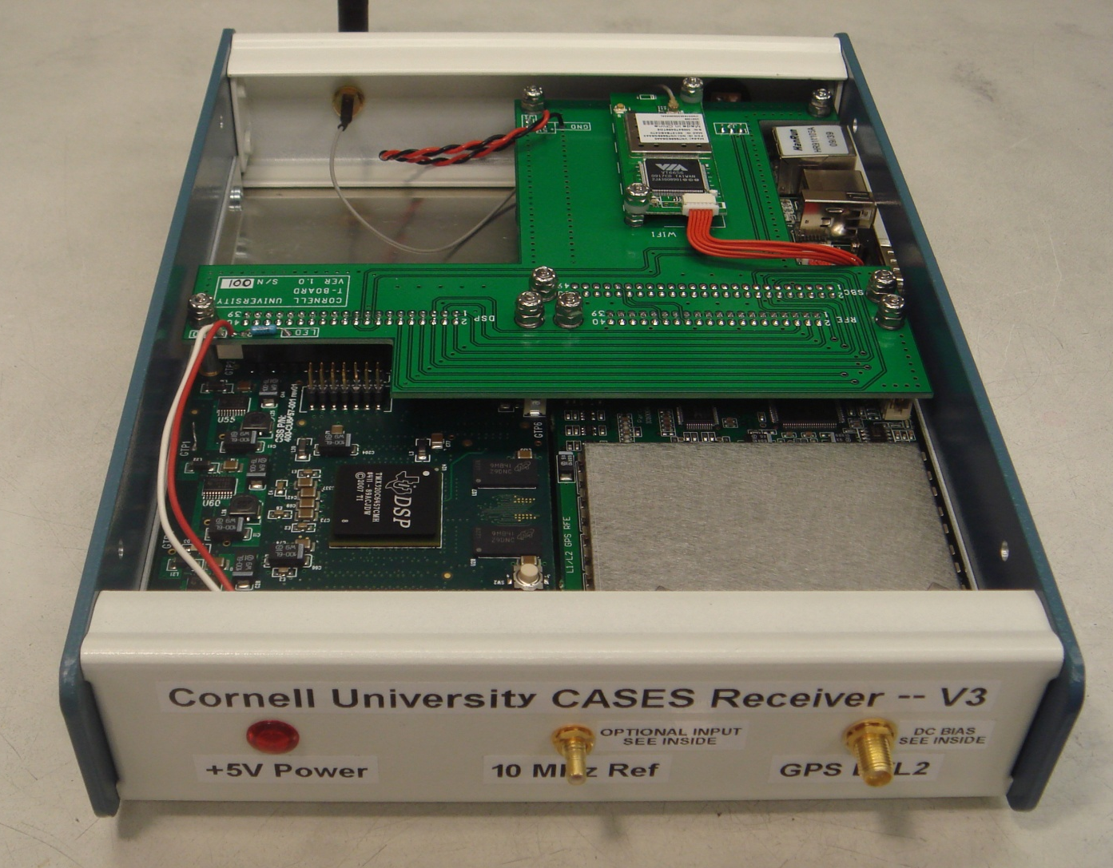
UT/Cornell/ASTRA CASES SwRx
Dual-frequency narrowband
Completely software reconfigurable
Antarctic deployment 2010
Space deployment 2012
(as occultation sensor)
V3

Slide 18
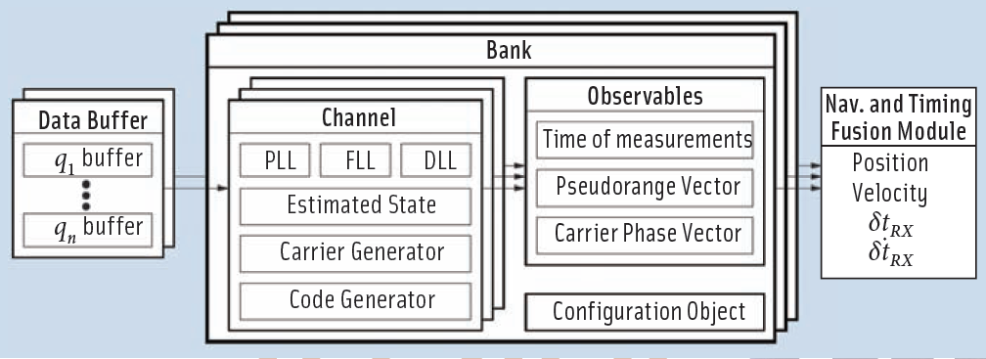
CASES Multi-System Receiver Bank

Slide 19
Approaching the Ultra Receiver
Digital Storage Rx
RF Front-End
ADC
Mass
Storage
Digital Storage Rx
Software Post-Processing
RF Front-End
Reference
Oscillator
Sample
Clock
ADC
Mass
Storage
FFT-based
Acquisition
Digital Storage Rx
Tracking
Loops, Data
Decoding,
Observables
Calculations
RF Front-End
Reference
Oscillator
Sample
Clock
ADC
Mass
Storage
Software
Correlators
Digital Storage Rx
RF Front-End
Reference
Oscillator
Sample
Clock
ADC
Mass
Storage
Reference
Oscillator
Sample
Clock

Slide 20
Approaching the Ultra Receiver
Mass
Storage

Slide 21
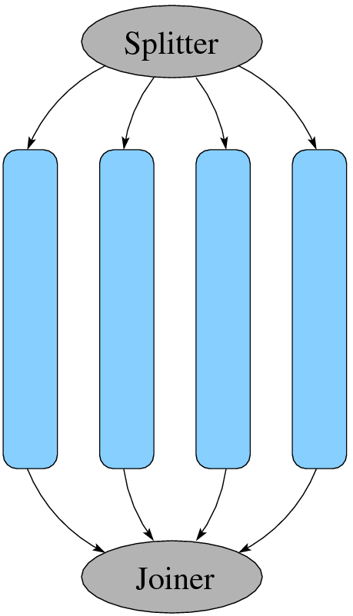
Multicore GNSS Processing
Signal-type level
  Low comm/sync overhead
  Poor load balancing
Channel level
  Low comm/sync overhead
  Good load balancing
  Favors shared memory architecture
Correlation level
  Higher comm/synch overhead
  Good load balancing
Sub-correlation level
  Very high comm/synch overhead
  Good load balancing
Demonstrated 3.4x speedup on 4-core machine with OpenMP
CASES post-processing now 25x real-time
Bodes well for reanalysis

Slide 22
UFAF SwRx Evaluation (Carsten Stroeber)
Running since | End 2007
Current Signals | GPS L1 C/A, L2C (CM+CL), L5 Giove A+B SBAS
Frontend | Fraunhofer, (IFEN possible)
Longest running time without external reset | >10 days
Longest running time with external reset | >1 month
Annotations:
External reset denotes automatic restart of the receiver via script program
Reference station was on a productive system simultaneously employing monitoring algorithms -> priority was not only given to long time stability
Currently Glonass is in test mode
Dedicated software receiver reference station (GPS L1, L2 only) intended for long run stability is in test phase
http://www.unibw.de/lrt9_3
Advantages
Extensive data analysis possible at measurement time
  e.g. instantaneous monitoring for signal distortions with access to “low” level measurements i.e. signal sample data
Software receiver is “independent” from utilized hardware

Slide 23
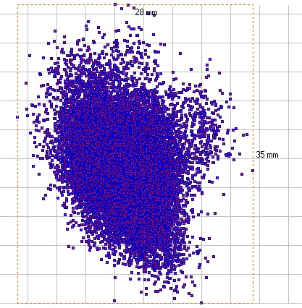
UFAF SwRx Evaluation
Date | DoY 170, Year 2007
Analysis Software | PrePos GNSS Suite
Measurements | GPS L1
Number observations (double differences) | 128614
Duration | 405 min
Data deleted due to cycle slips | 2% (for OEM 4 receiver 1%)
Standard deviation position | X 5.2mm Y 3.7mm Z 6.1mm
Horizontal scatter plot of final PDGPS adjustment at highest temporal resolution with bounding box (upward: north; right: eastward).

Slide 24
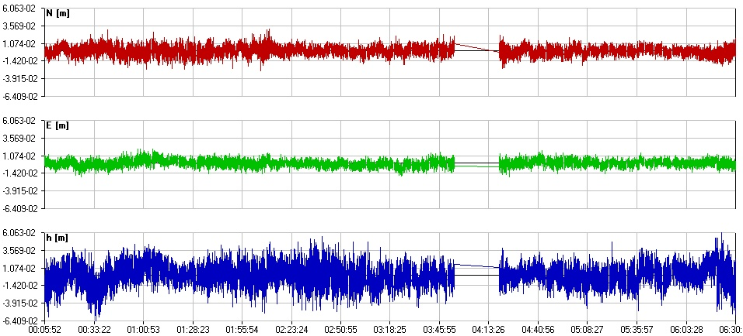
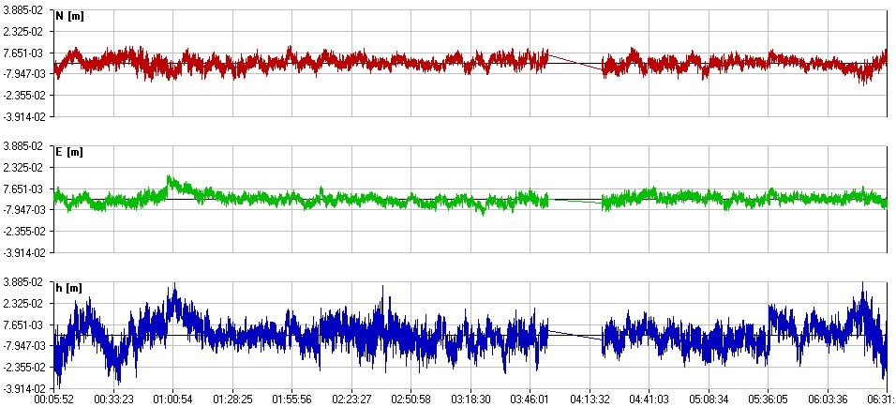
Operational performance comparable to NovAtel OEM 4
Coordinate time series of final PDGPS adjustment. Software receiver at top, OEM IV at bottom.

Slide 25
UFAF SwRx Evaluation
Drawbacks, suggested directions
Complex interaction between PC hardware, working system, additional applications and software receiver e.g.:
  USB access is controlled by working system (drivers …) -> buffering needed
  Additional applications starts unmeant, process time consuming action e.g. disk defrag -> additional applications must be deleted or configured too
Short-time internal processing load peaks due to frequently simultaneous execution of extensive tasks -> 2 strategies:
  For reference station no “real” real-time needed -> use already existing buffering
  Adapt configuration to PC hardware and use high power hardware
Free configurability leads to a big error source given by non optimal or wrong configuration -> in reference station mode this is relaxed due to fixed configuration

Slide 26
Outline
Review conclusions from Miami 2008
A look at commercial state-of-the-art
Advances in software receiver technology
  DFE: The final front-end
  The CASES receiver
  The IFEN/UFAF SX-NSR receiver: Performance evaluation
Not all observables are created equal
Summary

Slide 27
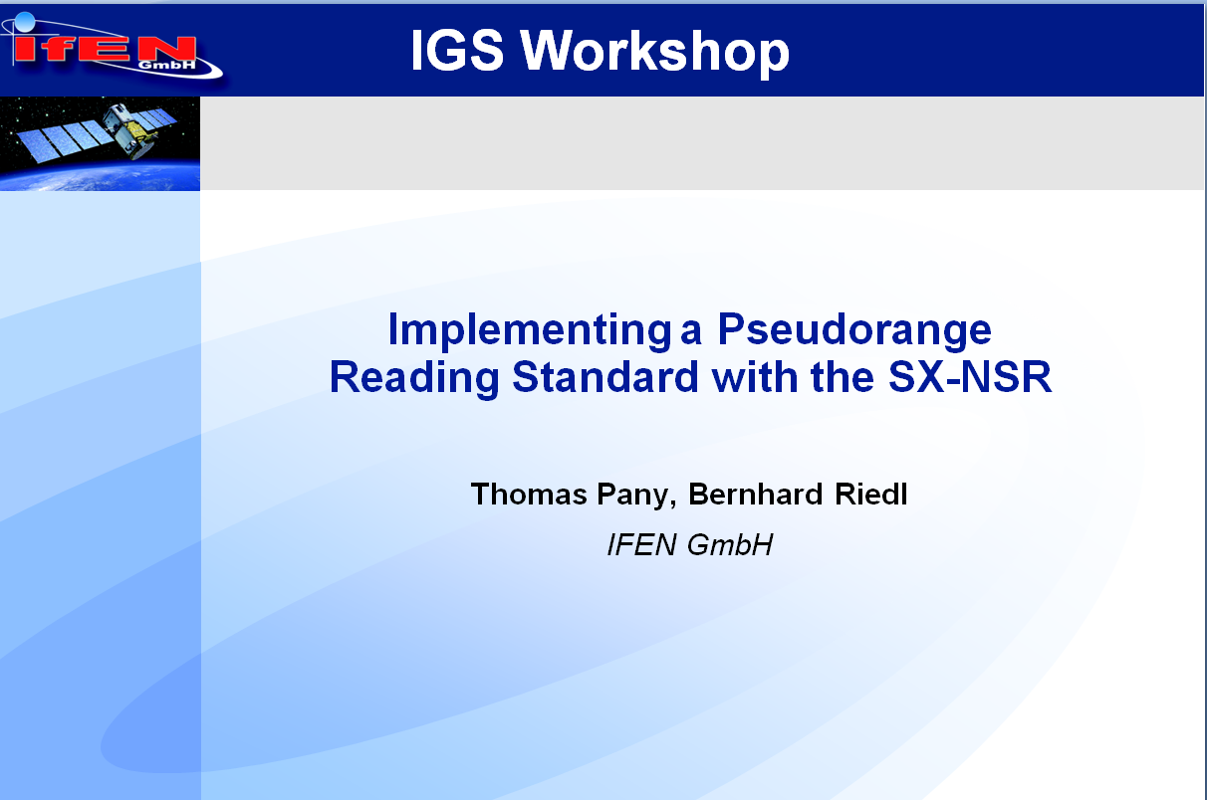

Slide 28
Toward a Standardized Carrier Phase and Pseudorange Measurement Technique
Different receiver manufacturers use proprietary (code/carrier) measurement definitions
Standard proposed by L. Young at last IGS workshop based on the US patent no. 4,821,294 (Thomas, Jr., Caltech)
Goal: to have stochastically independent code/carrier observations with a well understood observation principle
Use SX-NSR software receivers API for a prototype implementation

Slide 29
Illustration (Carrier Phase)
GPS C/A PRN13
Week 1570, sec ~
234179, NavPort-2
Frontend with OCXO
‘Verification’ that correlator based observations are truly independent
Download: C++ source code and exemplary data (GPS L1, Galileo E1/E5a) at www.ifen.com

Slide 30
Illustration (Pseudorange)
GPS C/A PRN13
Week 1570, sec ~
234179, NavPort-2
Frontend with OCXO

Slide 31
Evaluating the Example
Code minus carrier analysis shows that data is statistically independent
Discriminators cancel time correlation caused by the low bandwidth (0.1 -0.25 Hz) tracking loops
Phase discriminiator unwrapping together with FLL tracking gives valid carrier ranges

Slide 32
Summary
Q: What advances in GNSS receiver technology can the IGS exploit to improve its network and products?
  A1: Commercial receivers are approaching the “Super Receiver”: nearing all-GNSS-signals tracking, reconfigurable, low-cost
  A2: 500-MHz digitizing open-design front-end captures all current and planned GNSS signals, substantially eliminates inter-signal RX biases
  A3: 500-MHz front-end + Multi-system SwRx + Multi-core processing + data buffering → Ultra Receiver
  A4: SwRx performance comparable to commercial geodetic RXs (but not yet as reliable)
  A5: Receiver APIs offer path for measurement standardization (e.g., IFEN SX-NSR)

