Slide 1

Counter-UAV Challenges: Is GNSS Spoofing Effective?
Todd Humphreys
Department of Aerospace Engineering and Engineering Mechanics, The University of Texas at Austin
ION GNSS+ Hostile MAV Threats, Detection and Countermeasures | September 28, 2017

Slide 2
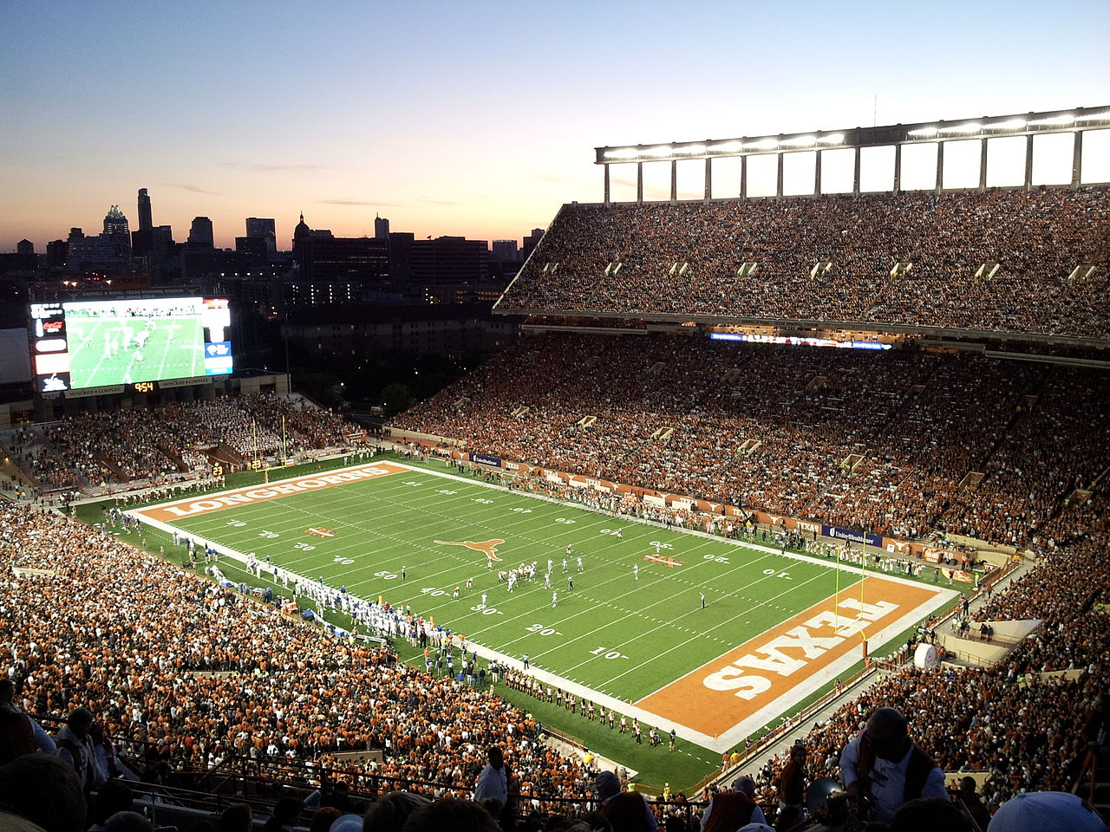

Slide 3


Slide 4
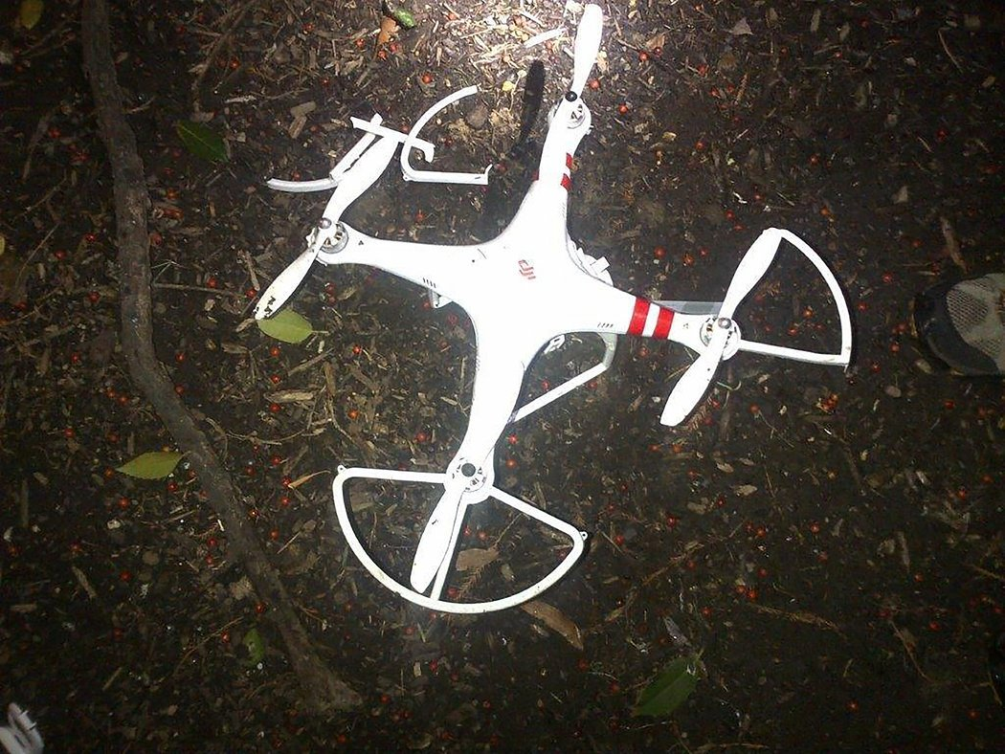
January 2015: A drone falls in Washington

Slide 5
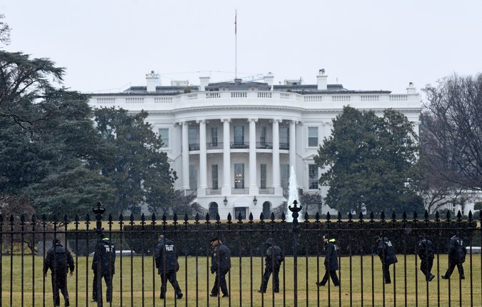

Slide 6
2015 Congressional testimony available at radionavlab.ae.utexas.edu

Slide 7
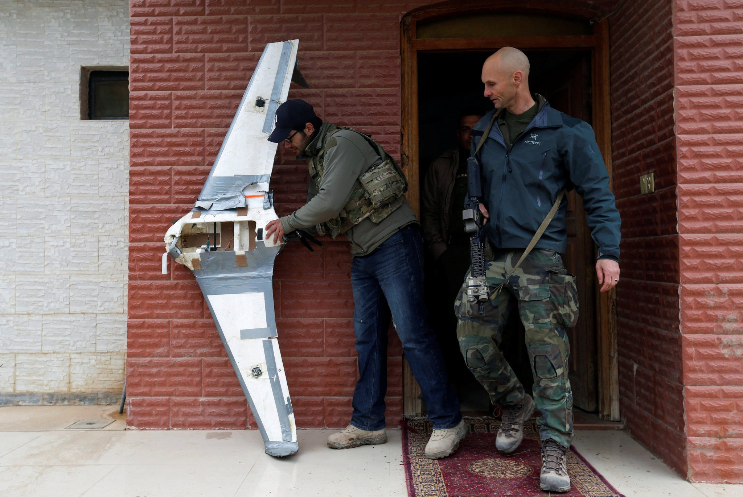
New York Times, Sept. 23, 2017

Slide 8
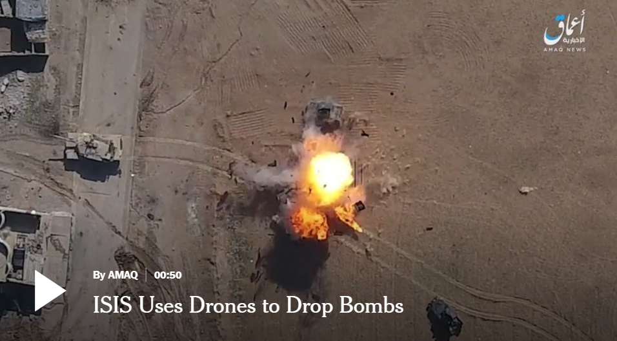
New York Times, Sept. 23, 2017

Slide 9

New York Times, Sept. 23, 2017

Slide 10
Note that counter MAV is an extremely difficult, asymmetric problem:
Expensive detection techniques and countermeasures can be easily and cost-effectively evaded by an adaptive adversary

Slide 11
Q: How effective is GNSS spoofing as a defense against hostile MAVs?

Slide 12
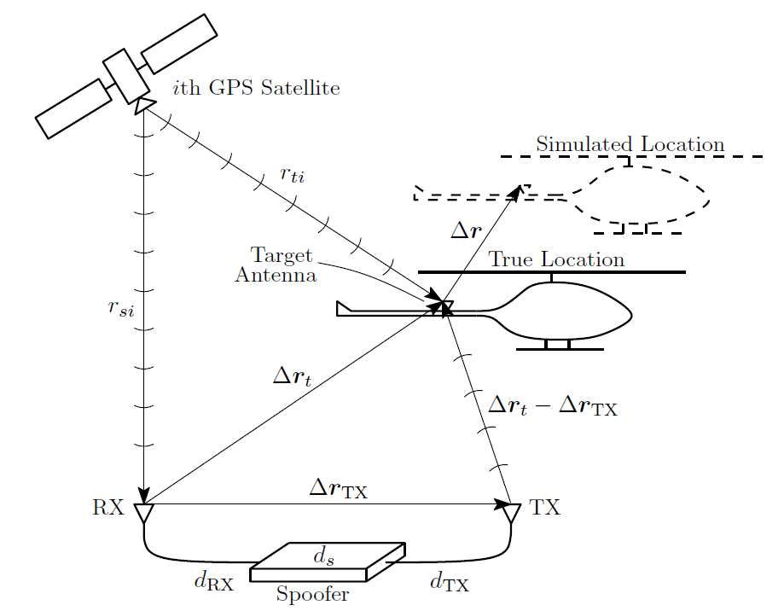
GNSS spoofing theory is straightforward

Slide 13
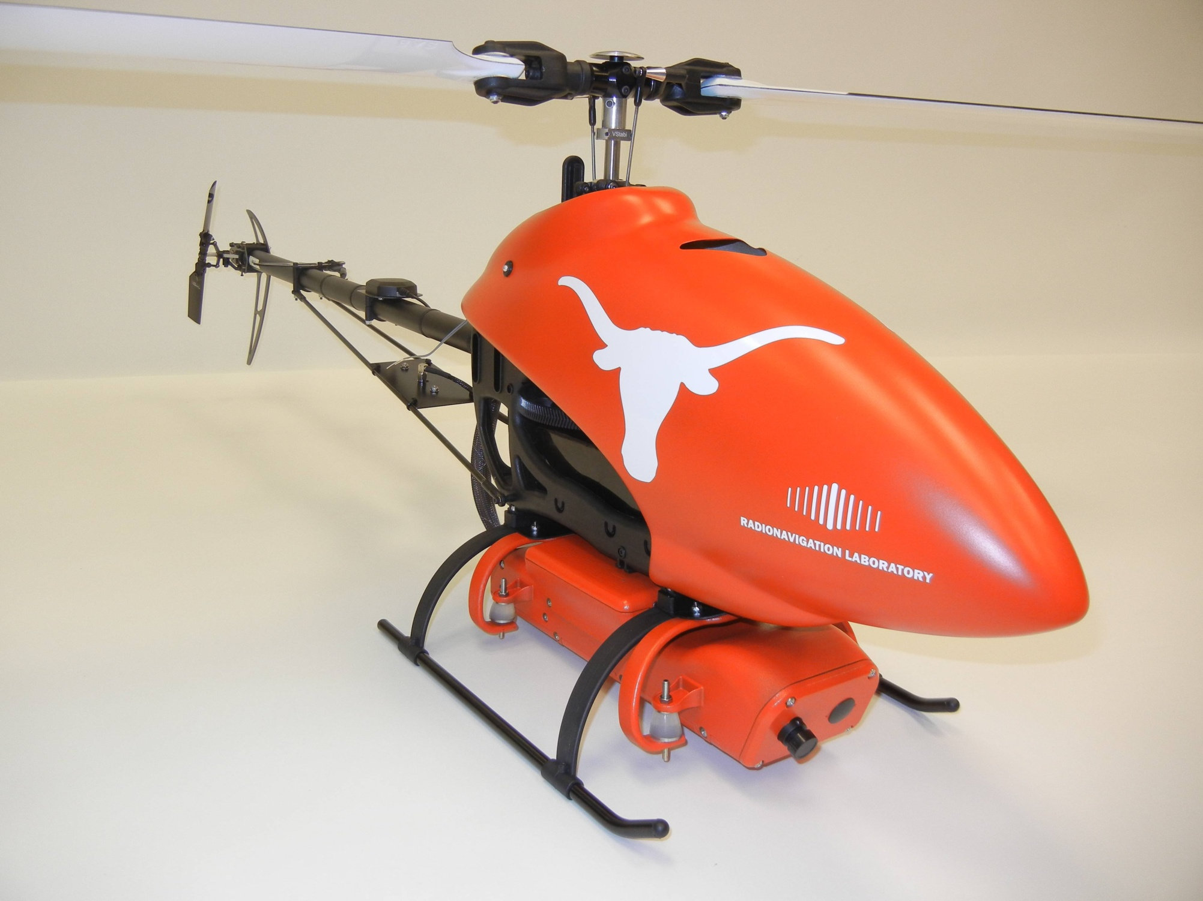
$60k Hornet Mini’s navigation system sensors:
civil GNSS + baro + IMU + magnetometer

Slide 14
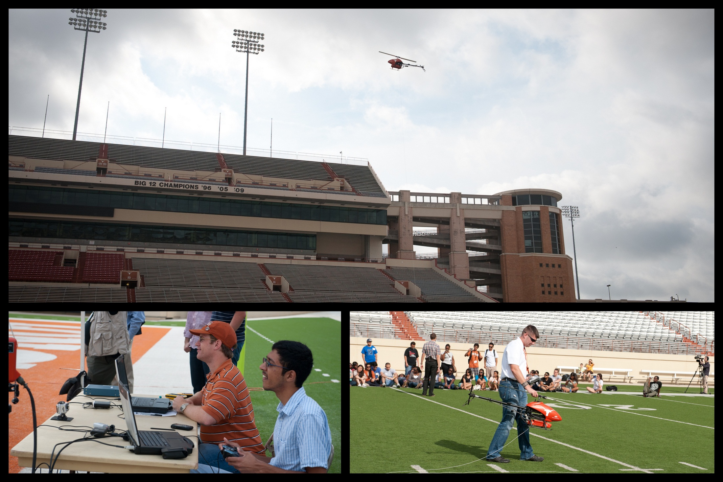

Slide 15
A.J. Kerns, D.P. Shepard, J.A. Bhatti, T.E. Humphreys, “Unmanned aircraft capture and control via GPS spoofing,” Journal of Field Robotics, 2014
Analysis of interplay between defender and attacker must consider full closed-loop system including: (1) vehicle dynamics (including state estimation and control), (2) defender’s detection strategy, (3) predictability of defender’s control actions, and (4) attacker’s state estimation system

Slide 16
With the most sophisticated techniques against a
GPS-INS-guided UAV, covert control is possible

Slide 17
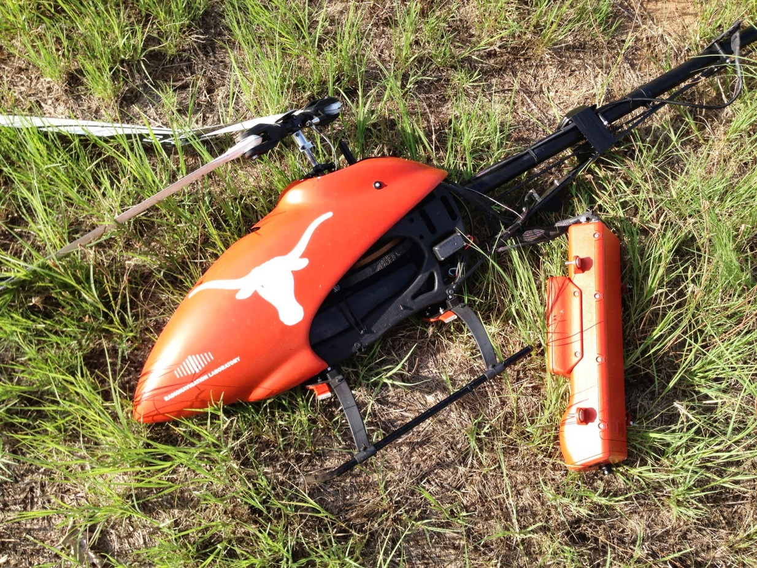
A.J. Kerns, D.P. Shepard,
J.A. Bhatti, T.E. Humphreys,
“Unmanned aircraft capture
and control via GPS spoofing,”
Journal of Field Robotics, 2014
Crashing is much easier than control

Slide 18
Q: Can collateral damage from spoofing be avoided?

Slide 19
Risk of affecting non-target GNSS users depends on transmitter gain pattern and ranging code alignment

Slide 20
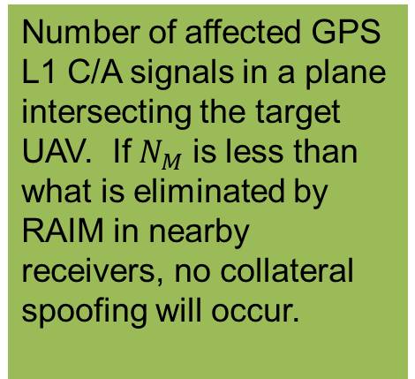
Number of affected GPS L1 C/A signals in a plane intersecting the target UAV. If $N_{M}$ is less than what is eliminated by RAIM in nearby receivers, no collateral spoofing will occur.

Slide 21
Probability of collateral degradation as a function of range to
target and number of outliers RAIM can eliminate

Slide 22
Keep in mind that if hostile MAV shuts off GNSS when it arrives in restricted area, GNSS spoofing is ineffective as countermeasure.

Slide 23
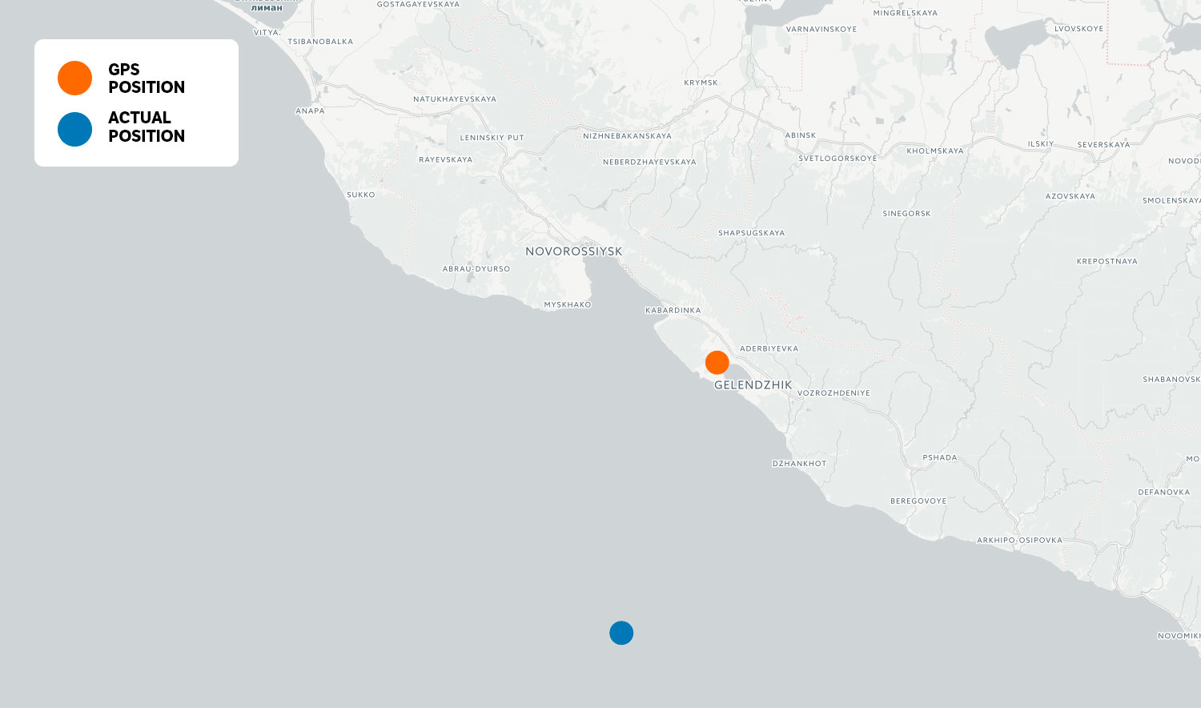
Russia believes that GNSS spoofing is an effective counter-MAV technique

Slide 24
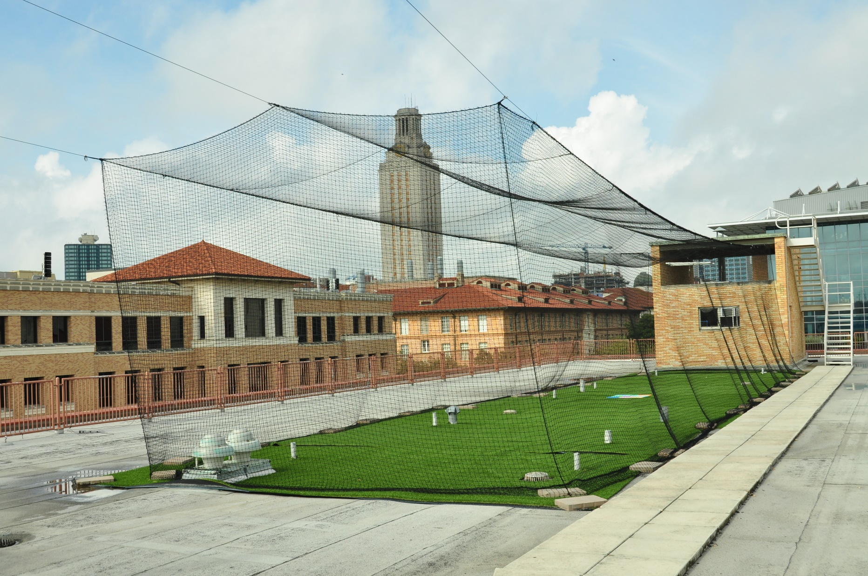
UT Austin MAV Arena: A playground for MAV security, perception, and control research

Slide 25
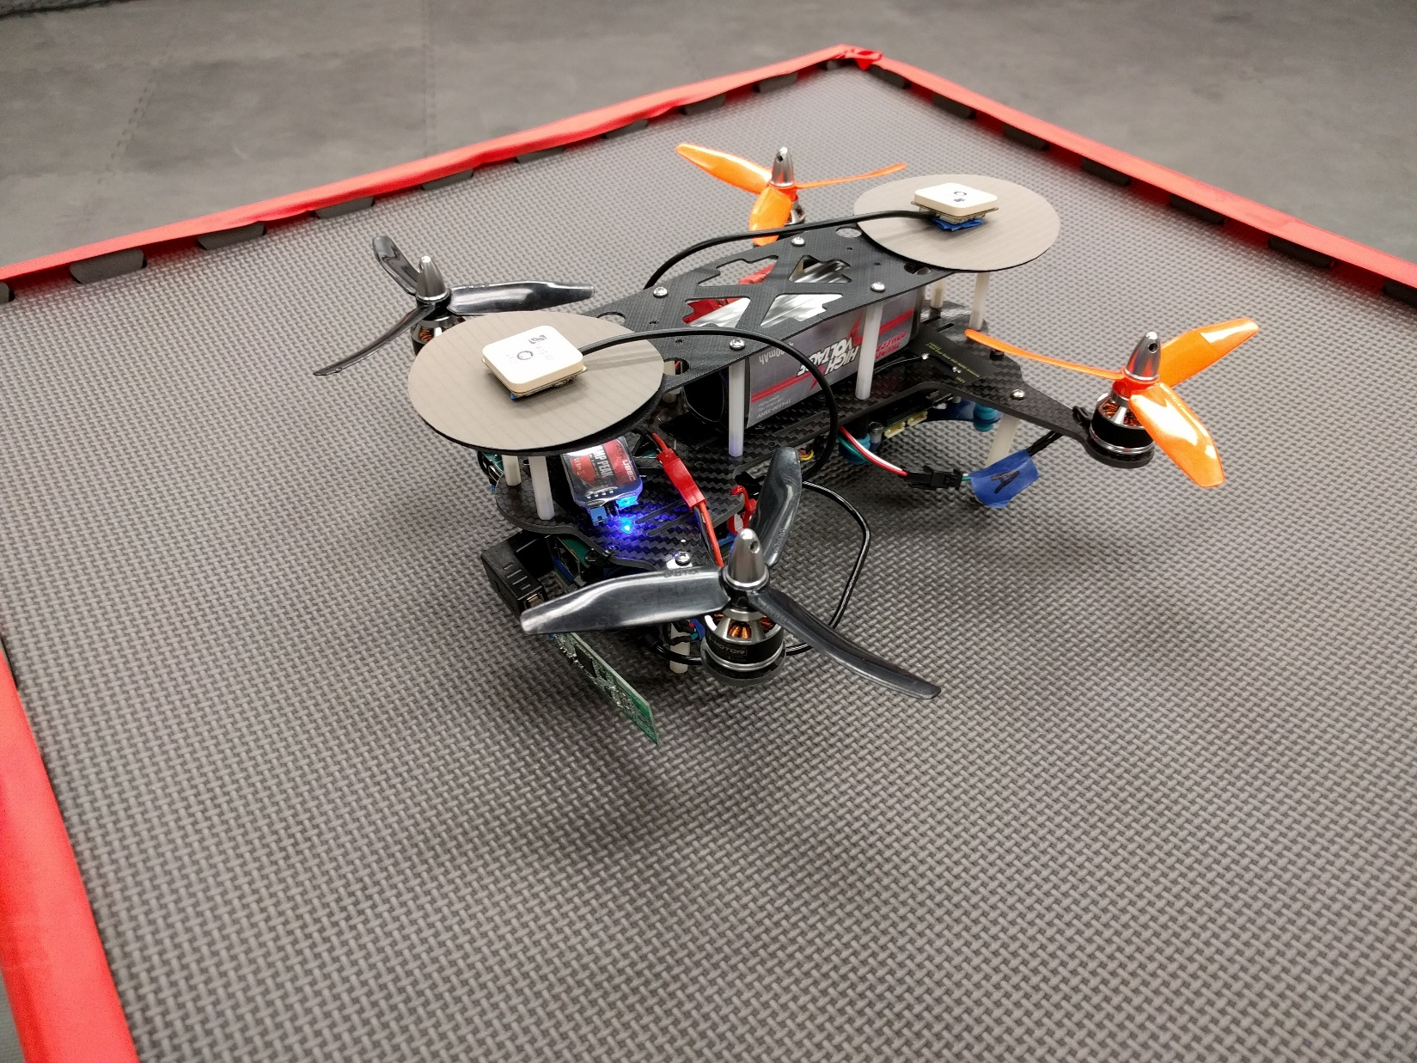
Custom-built MAVs with dual-antenna precise GNSS for controlled swarms

Slide 26
Precise Positioning Flight Demo

Slide 27


