Slide 1
Characterization of Receiver Response to a Spoofing Attack
Daniel Shepard
Honors Thesis Symposium
4/21/2011

Slide 2
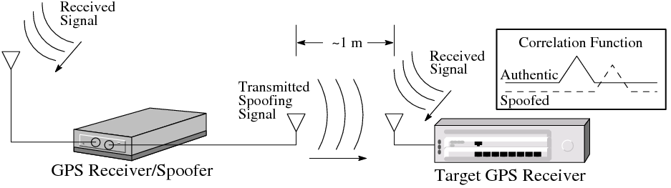
What is Civil GPS Spoofing?
The structure of the civil GPS signal is well known, and the signal can be readily reproduced
A spoofer seeks to alter a target receiver’s Position-Velocity-Time (PVT) solution by transmitting fictitious GPS signals
A typical spoofing attack involves: 1) alignment, 2) increase power, 3) carry receiver off

Slide 3
GPS Dependency Begets Vulnerability
Energy
Banking and Finance
Transportation
Communications
From Dane Egli, IDA

Slide 4
Research Questions to Assess Critical Infrastructure Vulnerability
How aggressively can receiver dynamics be manipulated by a spoofing attack?
Would a jamming-power-to-noise-power (J/N) type jamming detector trigger on a spoofing attack?

Slide 5

Would a J/N-type jamming detector trigger on a spoofing attack?
Power ratio (η): Ratio of spoofing signal power to authentic signal power
A power ratio above 3 would cause input power to exceed 95% of natural variation → J/N-type jamming detector would trigger
What power ratio is required for reliable spoofing?
P_{spoof}
P_{auth}

Slide 6
How Aggressively can Receivers be Manipulated?
We would like to know:
  How quickly could a timing or position bias be introduced?
    Critical infrastructure reliant on GPS often requires certain accuracy in position/time
  What kinds of oscillations could a spoofer cause in a receiver’s position and timing?
    Spurious synchrophasor oscillations as low as 0.1 Hz could damage power grid
  How different are receiver responses to spoofing?
    One defense strategy: choose receivers that are difficult to manipulate
Approach: Determine velocity at which a receiver can be spoofed over a range of accelerations
v
a
t

Slide 7
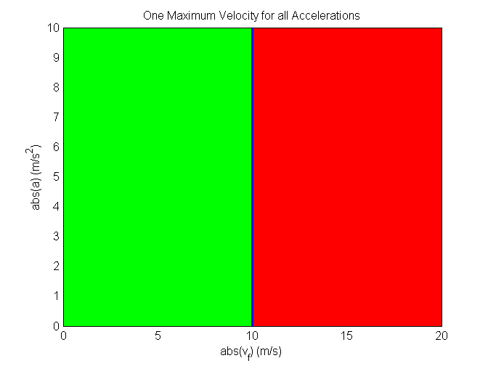
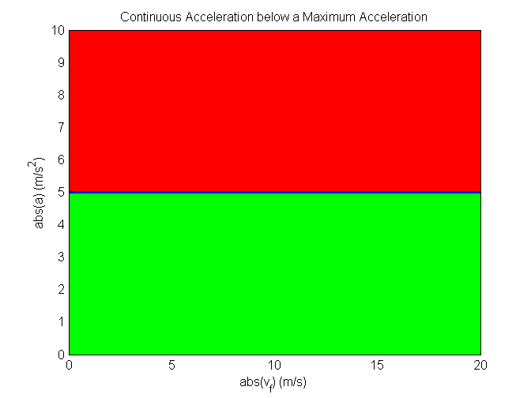
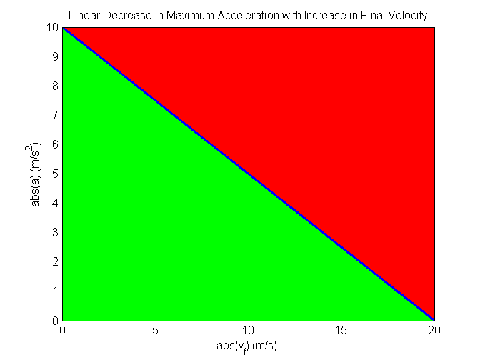
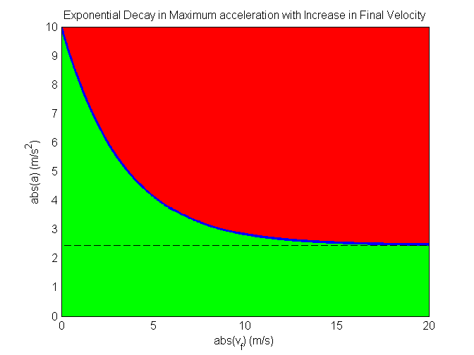
How Aggressively can Receivers be Manipulated? (cont.)
These are some potential shapes for the acceleration-velocity curves
Green: represents the region where a spoofer can operate without being detected
Red represents the region where a spoofer might be unsuccessful

Slide 8
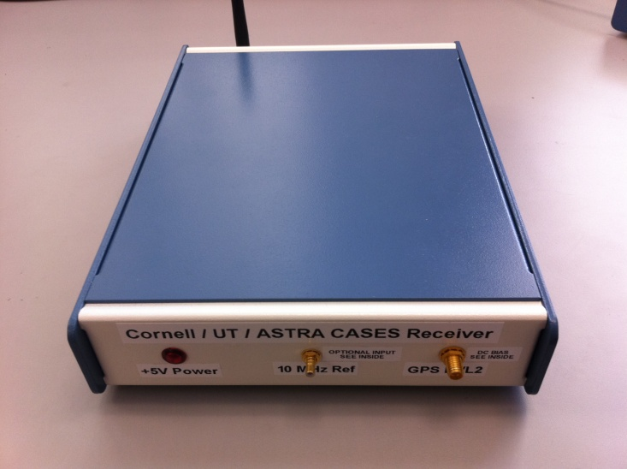
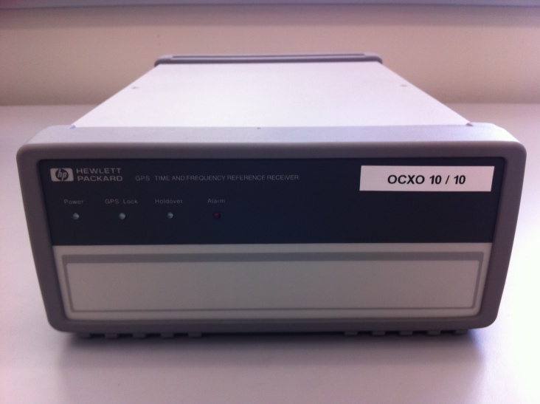
Tested Receivers
Science receiver: CASES receiver developed by UT Radionavigation Lab in collaboration with Cornell University and ASTRA.
Telecommunications Network Time Reference Receiver: HP 58503B, commonly used in cell phone base stations. Has a high quality Ovenized Crystal Oscillator (OCXO) steered by the GPS time solution.

Slide 9
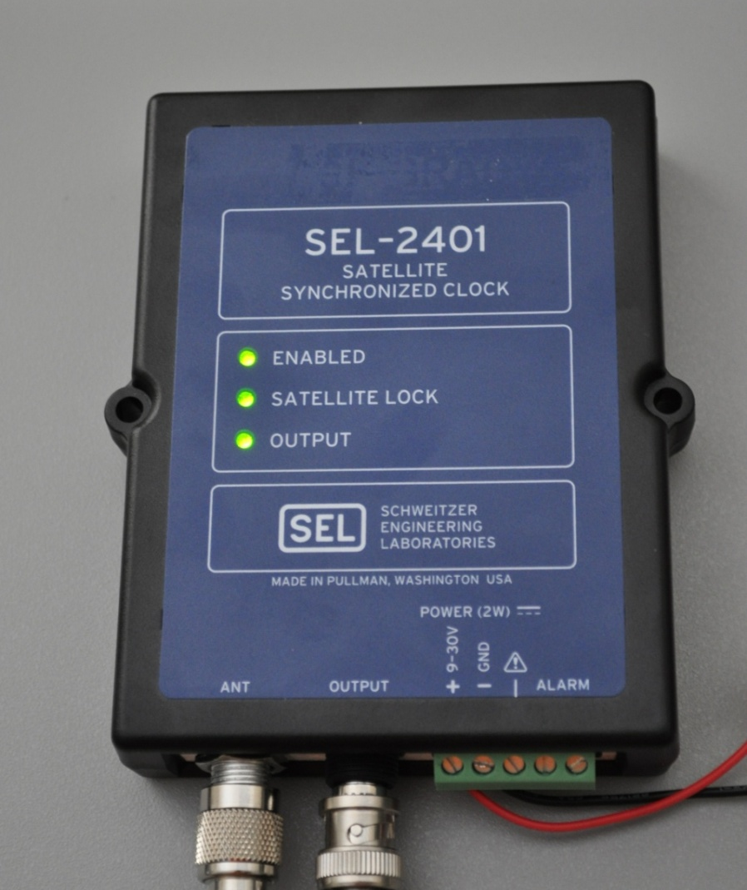
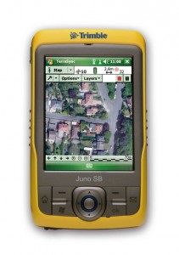
Tested Receivers (cont.)
Power Grid Time Reference Receiver: SEL-2401, provides time signal for power grid Synchrophasor Measurement Units (SMUs). Has low quality Temperature Controlled Oscillator (TCXO) slaved to the GPS time solution.
Name brand receiver: Trimble Juno SB.

Slide 10
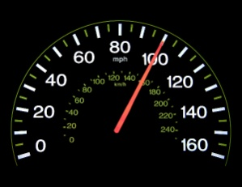
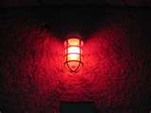
Procedure
Power Ratio
Spoofed Velocity and Acceleration
1. Power Adv. = x dB
2. Attempt Carry-off
3. Check for Success (Remove Authentic Signal)
4. Measure the Power
1 m/s
SV | 1 | 5 | 12
C/N₀ | 50 | 21 | 50
1. Acceleration = a m/s²
2. Velocity = v m/s
3. Check for Success (watch for alarms)
4. Iterate until a maximum velocity is found
v_{max} found?
v
no
a
yes
t

Slide 11
Results: Power Ratio
These tests showed that a power ratio of about 1.1 is all that is needed to capture a target receiver with at least 95% confidence
This increase in absolute power received by the target receiver’s front-end is well below the natural variations due to solar activity
Implications:
A spoofing attack would easily evade detection by a J/N sensor at the RF signal conditioning stage: J/N sensors are necessary, but not sufficient
Downstream signal processing is crucial for reliable spoofing detection

Slide 12

Results: Spoofed Velocity and Acceleration
The data points collected for each receiver were fit to an exponential curve of the form:
This curve fit defines the upper bound of a region of the acceleration-velocity plane where a sophisticated spoofer can successfully spoof that particular receiver
These curves can be used to assess the security implications of a spoofing attack

Slide 13
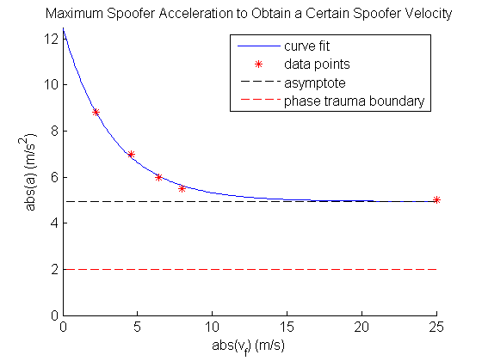
Results: Spoofed Velocity and Acceleration of Science Receiver
Notice the asymptote at 5 m/s² acceleration
The maximum speed is only limited by the doppler range of the correlators to around 1300 m/s (4.3 μs/s)
Implications:
Acceleration limited to 2 m/s² due to phase trauma
No limitation on velocity up until the receiver is unable to track the signal

Slide 14
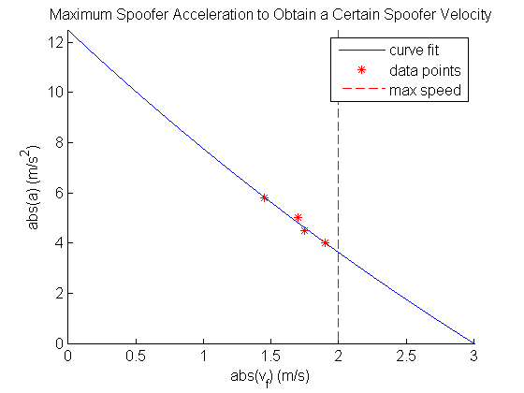
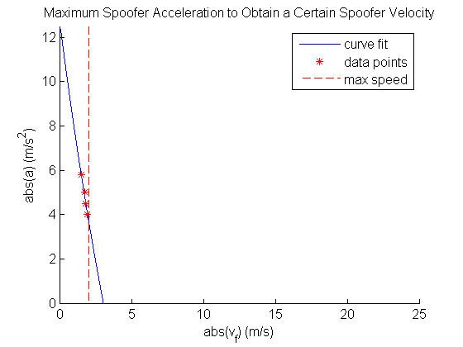
Results: Spoofed Velocity and Acceleration for Telecommunications Network Time Reference Receiver
Due to this receiver placing trust in the frequency stability of its oscillator, it cannot be moved very quickly
Maximum achievable speed in time is 2 m/s
Implications:
Can still be carried 10 μs off in time in around 35 min, which would cause cell network throughput to degrade

Slide 15
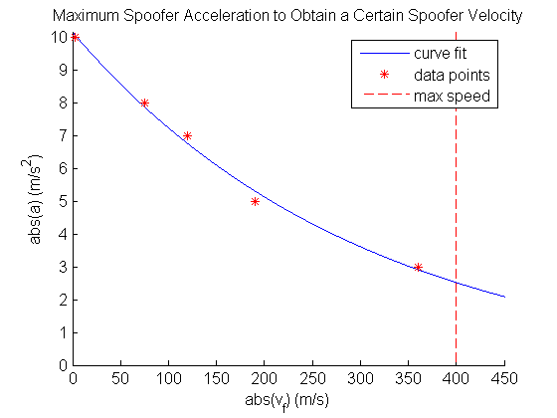

Results: Spoofed Velocity and Acceleration for Power Grid Time Reference Receiver
Can be easily manipulated by the spoofer
Corresponding induced phase angle rate is shown for a 60 Hz phasor
Implications
Can reach a maximum speed of 400 m/s resulting in a phase angle rate of 1.73º/min
Oscillations of even 0.1 Hz are not possible due to the low accelerations

Slide 16
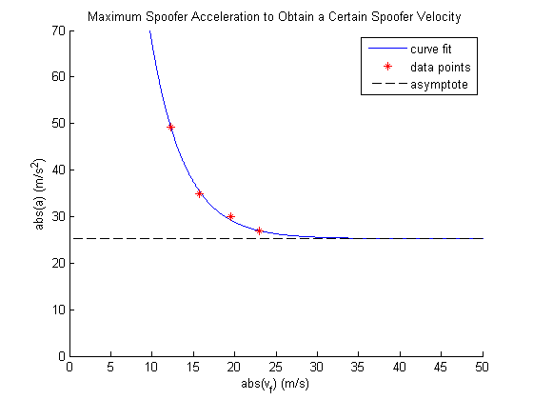
Results: Spoofed Velocity and Acceleration for Name Brand Receiver
Most easily manipulated receiver tested to date
Can be accelerated continuously at about 25 m/s² until the doppler limit of the correlators is reach at a velocity of about 1300 m/s
Implications
Large accelerations and velocities may be possible in many name brand receivers

Slide 17
Summary of Findings
We’ve never met a civil receiver we couldn’t spoof
J/N-type jamming detector won’t catch a spoofer
Large, quick changes in position and timing seem to be impossible, but smooth, slow changes can be quite effective and slowly accelerate to a large velocity in some receivers
It is difficult to cause oscillations in position and timing due to low acceleration capability of the spoofer
Areas of vulnerability exist in CDMA cell phone networks and the power grid

