Slide 1
Constructing a Continuous Phase Time History from TDMA Signals for Opportunistic Navigation
Ken Pesyna, Zak Kassas, Todd Humphreys
IEEE/ION PLANS Conference, Myrtle Beach | April 26, 2012

Slide 2
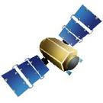
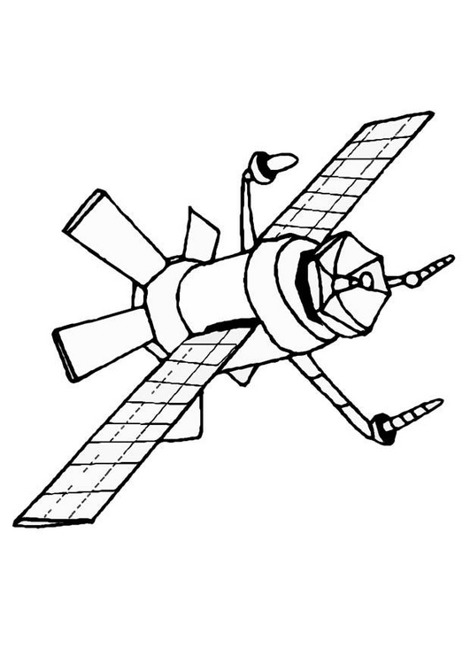
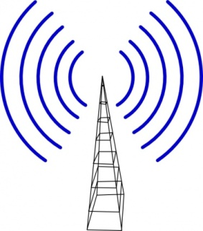
Opportunistic Navigation: All Signals Welcome
Receivers today have the capability to acquire heterogeneous signal types
Many of these signals can be used for positioning – Opportunistic Navigation
GPS
GPS
Iridium
cell
GNSS Restricted Environment
HDTV

Slide 3
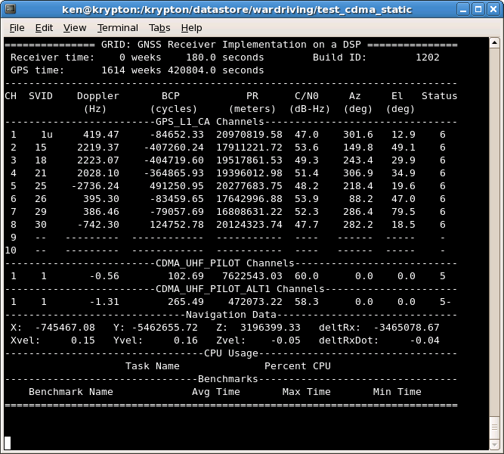
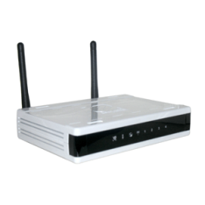
Opportunistic Navigation: Not quite there yet
CDMA
TDMA
OFDM
GNSS
GPS
Galileo
Compass
Cellular
GSM
Cellular
LTE
WiMAX
Sat Com.
Iridium [3]
Cellular [1,4]
CDMA Cellular
Wi-Fi
802.11n
802.11ac
HDTV
ATSC [2]
[1] R. Rowe, P. Duffett-Smith, et. al., “Enhanced GPS: The tight integration of received cellular timing signals and GNSS receivers for ubiquitous positioning,” in Position, Location, and Navigation Symposium, IEEE/ION, 2008.
[2] J. Do, M. Rabinowitz, and P. Enge, “Performance of hybrid positioning system combining GPS and television signals,” in Position, Location, And Navigation Symposium, IEEE/ION, 2006.
[3] M. Joerger, et. al., “Iridium/gps carrier phase positioning and fault detection over wide areas,” ION GNSS 2009.
[4] K. Pesyna, et. al., "Tightly-Coupled Opportunistic Navigation for Deep Urban and Indoor Positioning," ION GNSS 2011.

Slide 4
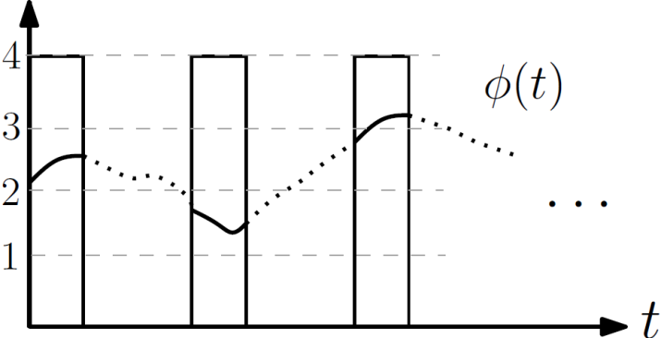
TDMA: A closer look
Signal Bursts
TDMA structure results in intermittent “burst-like” phase measurements at the receiver
This “quirkiness” makes it difficult to determine the phase time history in between bursts
Signal Burst Structure
Phase (cycles)
Time

Slide 5
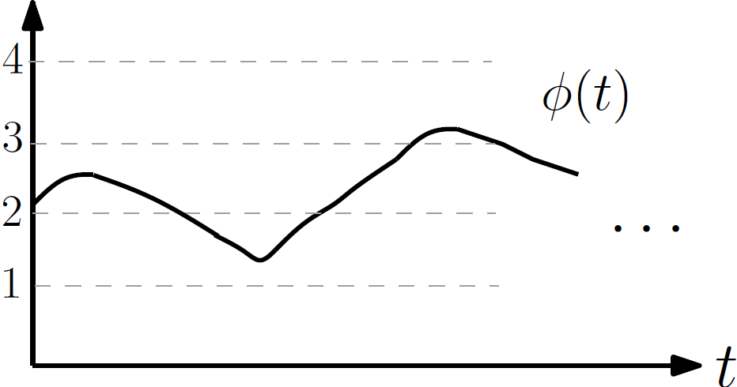
Residual Carrier Phase Model
Phase (cycles)
(I) Ideal Continuous Signal

Slide 6
Residual Carrier Phase Model
Phase (cycles)
(II) TDMA Burst Structure

Slide 7
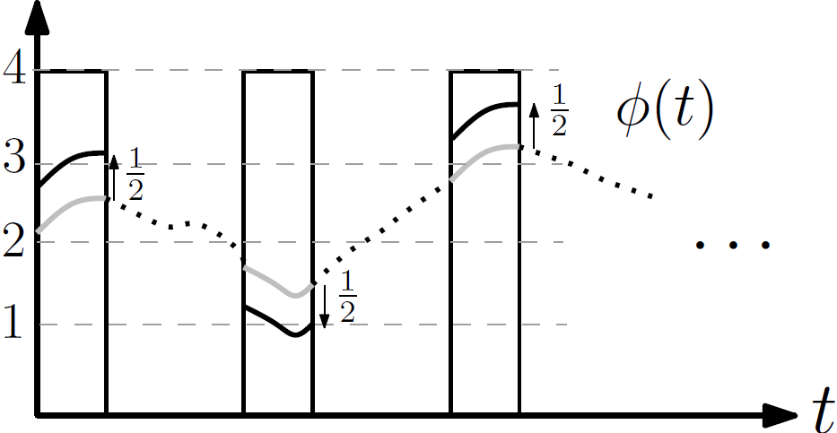
Residual Carrier Phase Model
Phase (cycles)
(III) TX imposed fractional-cycle phase offsets

Slide 8
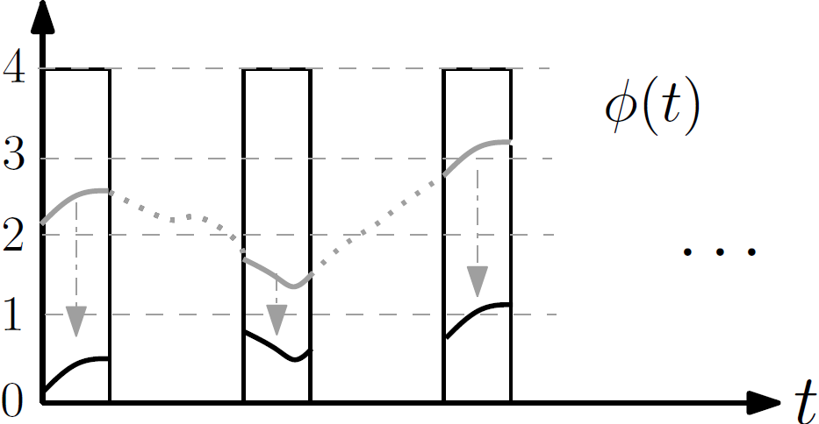
Residual Carrier Phase Model
Phase (cycles)
(IV) Phase Aliasing at RX

Slide 9
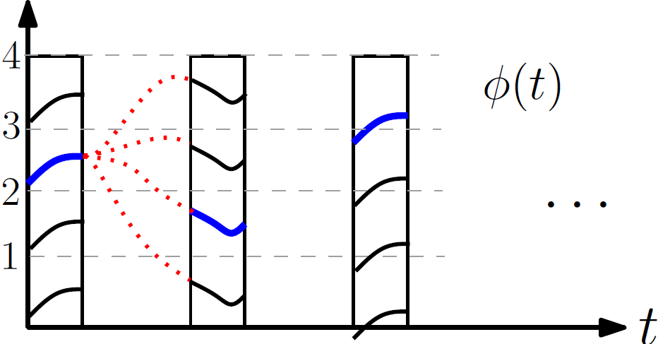
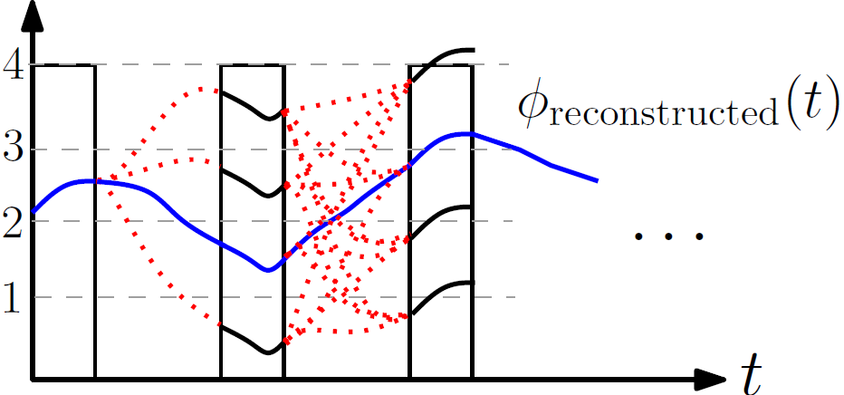
Summary of Challenges
Phase offsets and aliasing create phase ambiguities
These phase ambiguities lead to multiple possible trajectories
Integer-cycle phase ambiguities (M=1)
Q1: How can we optimally reconstruct the carrier phase from the burst measurements
Q2: How sensitive is the optimal reconstruction technique to various system parameters (e.g. time-between-bursts, burst-length, fractional-phase offsets, etc)?

Slide 10
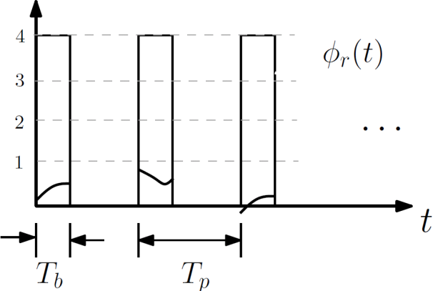
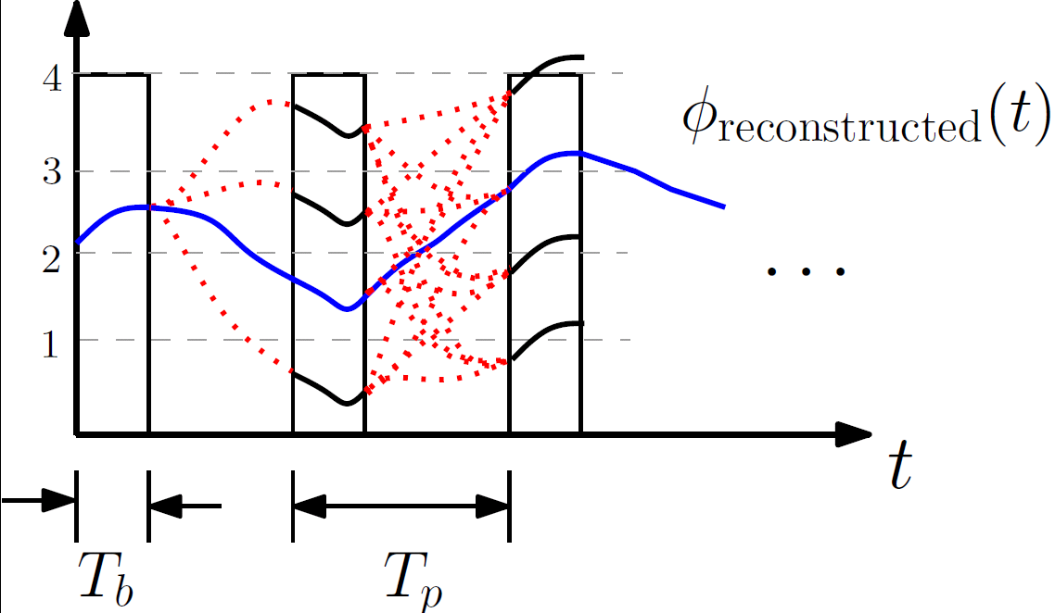
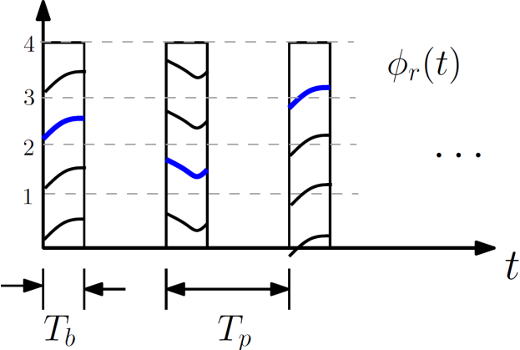
Optimal Solution: Mixed Integer/Real Kalman Filter and Smoother
LAMBDA method
Integer Ambiguity Resolution
Kalman Filter
Smoother
Integer-cycle phase ambiguities
Received Signal
Reconstructed Signal
Determine Integer Phase Ambiguities

Slide 11
Solution: Mixed Integer/Real Kalman Filter and Smoother
State: mixed real/integer
Real:
Integer:
Dynamics Model:
Real-valued:
Integer-valued:
Real-valued phase
Integer-cycle ambiguities
Phase
Phase-rate
Burst Ambiguities
Process noise covariance, dictated by error sources
Process noise

Slide 12
Kalman Filter and Smoother
Measurement Model:
Measurement Noise covariance, dictated by carrier-to-noise ratio
Measured Phase within bursts
Real-valued state
Integer state
Measurement Noise
Real-valued phase
Integer-cycle ambiguities

Slide 13
Solving the Real/Integer States
Cost function can be decoupled as [Psiaki 2010]:
After ingesting all measurements, find integer to minimize: (LAMBDA Method)
Insert into and:
Solve for real-valued filtered state: OR
Run the smoother, solve for smoothed estimate:
Incorporates measurements and dynamics contraints

Slide 14
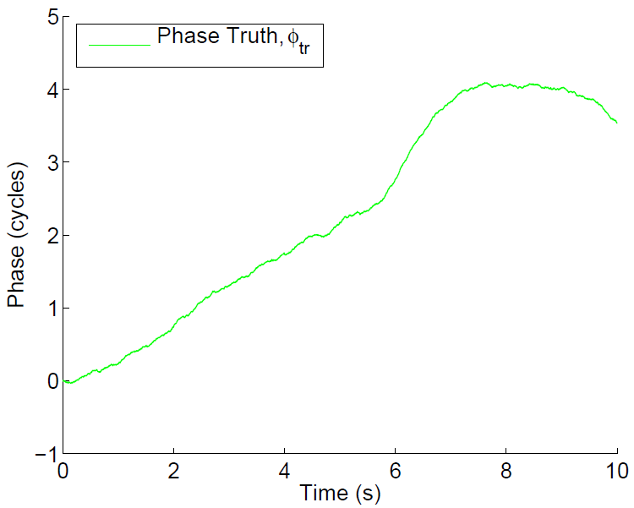
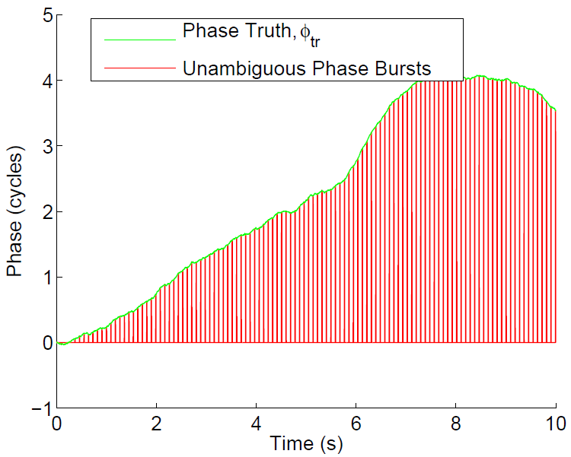
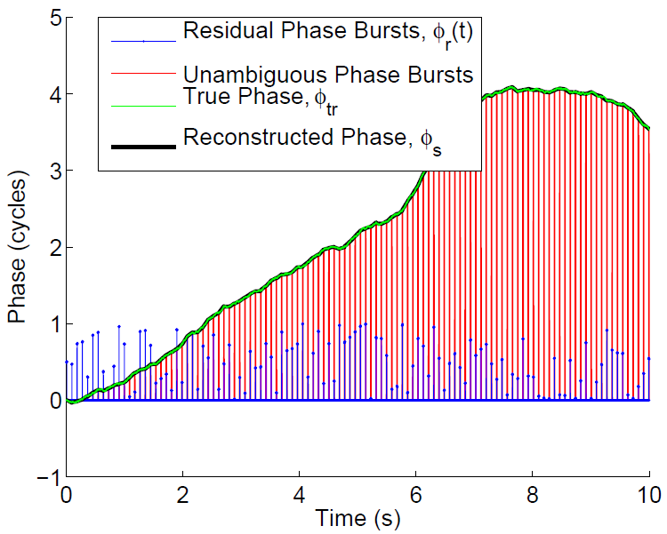
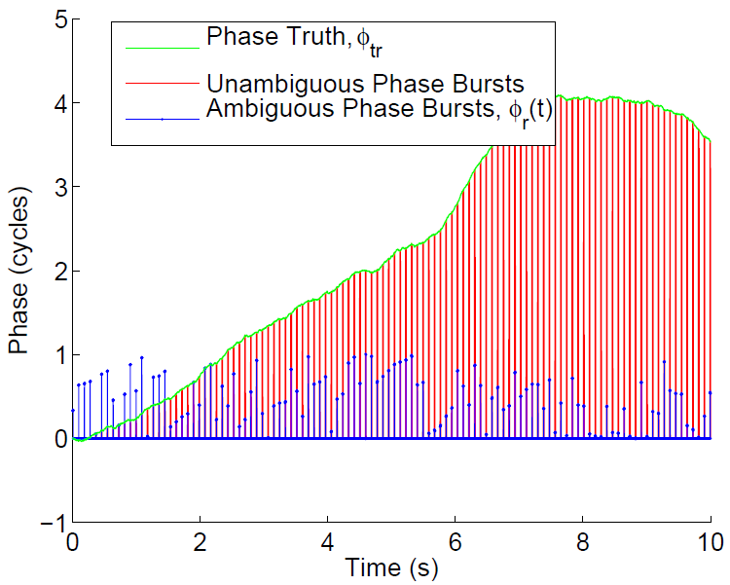
Evaluating the Reconstruction Technique
Simulate realistic phase time histories with errors: TX clock, RX clock, Front-end noise, etc.
Adds burst structure to mimic TDMA
Imparts phase aliasing/offsets
Applies the reconstruction technique
Evaluate the performance

Slide 15
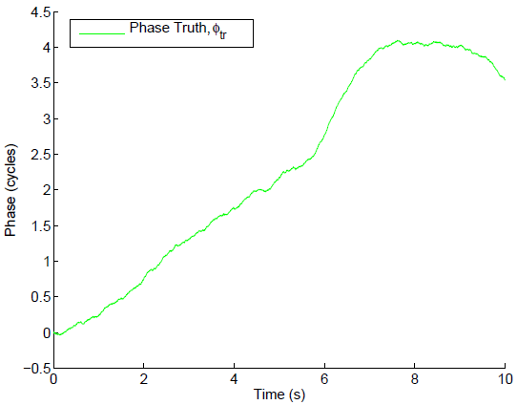
Component Modeling
Many sources of error make up the true phase time history
Transmitter clock errors
Receiver clock errors
LOS user motion errors
Front-end noise (meas. noise)
Propagation effects
These must all be modeled within the simulator

Slide 16
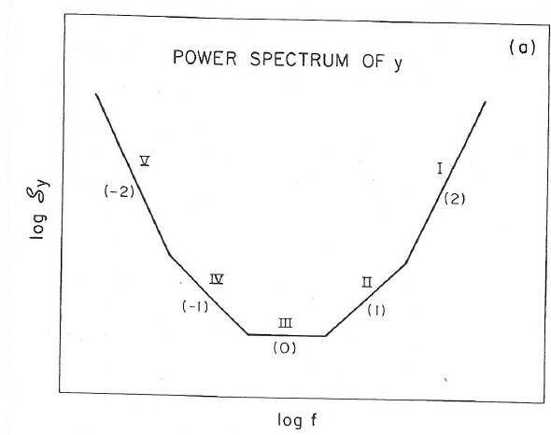
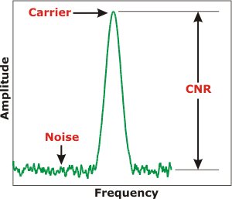
Key Observation: All Error Sources have Clock-Like Dynamics
(a) TX clock, (b) RX clock, (c) LOS motion, and (d) propagation errors are modeled by their power spectral density
(e) Front-end noise modeled by the received signal’s carrier-to-noise ratio
“h-parameters” characterize each error source’s PSD

Slide 17
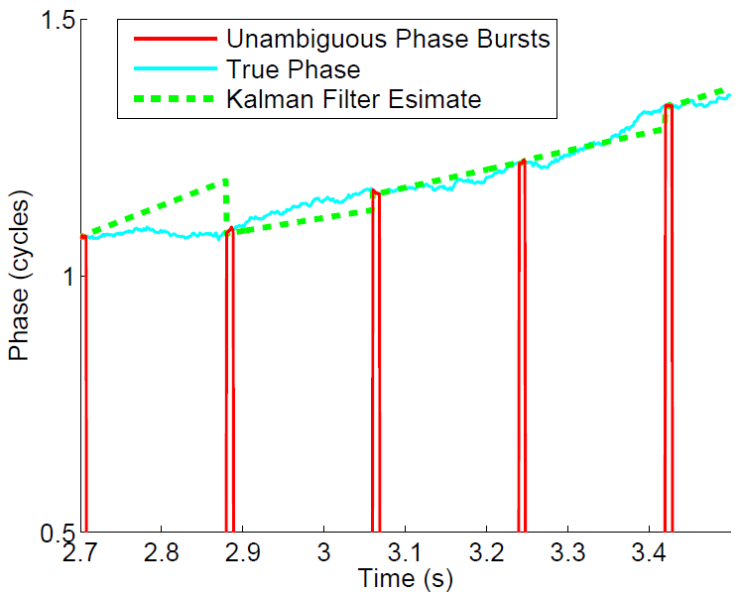
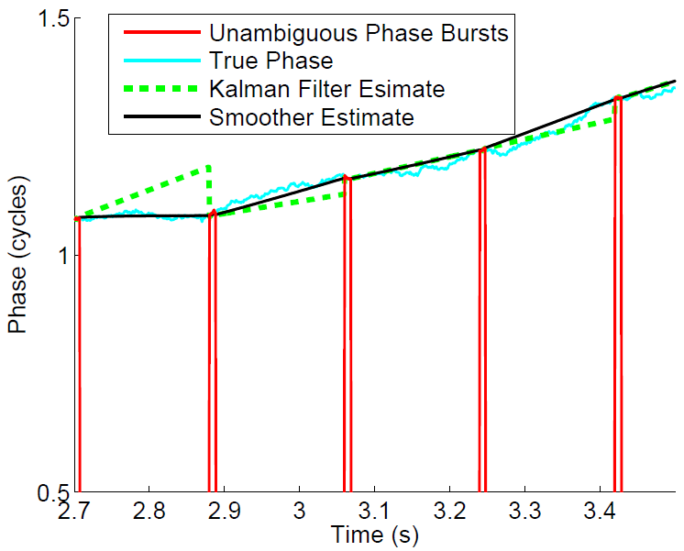
Why Backwards Smoothing?
Advantage: Allows future bursts to affect past estimates
Disadvantage: Not quite real-time

Slide 18
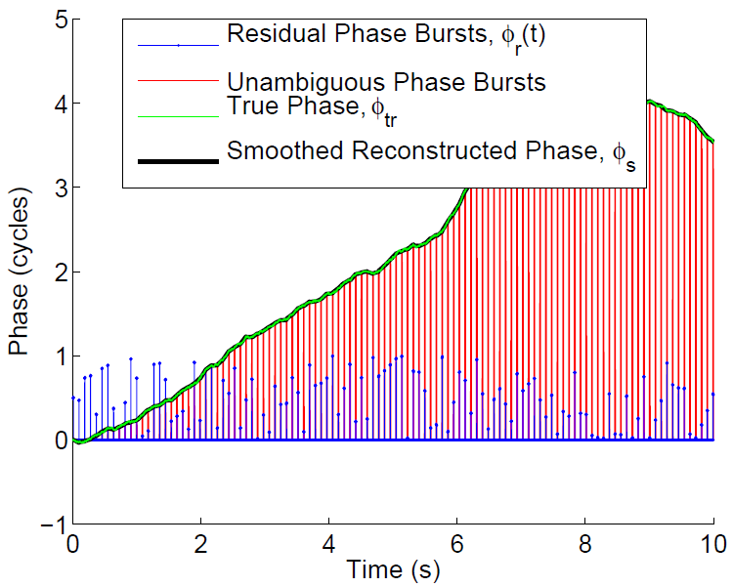
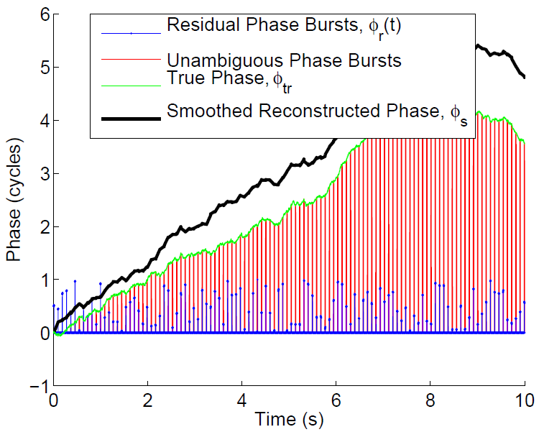
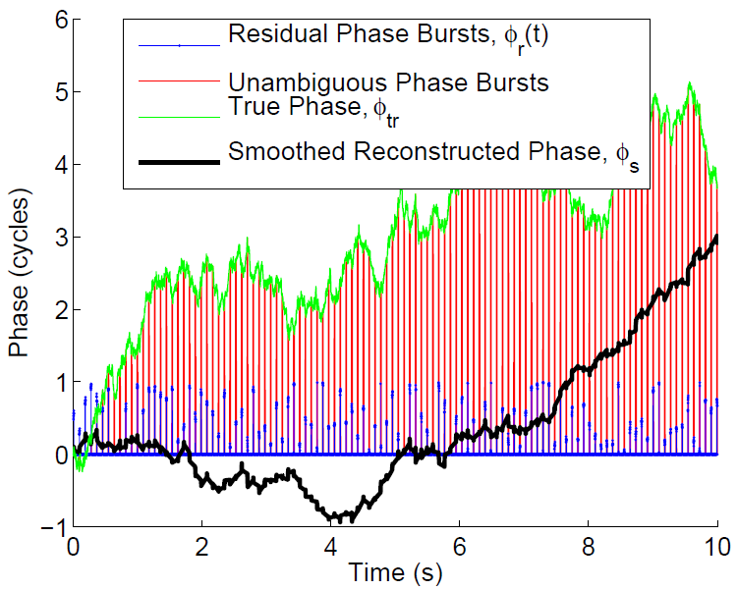
Monte-Carlo Sensitivity Testing
Performance of the reconstruction was tested against varying input parameters:
Clock stability
Time-between bursts
Burst length
Carrier-to-noise ratio, etc
Partially Successful Reconstruction
Successful Reconstruction
Failed Reconstruction

Slide 19
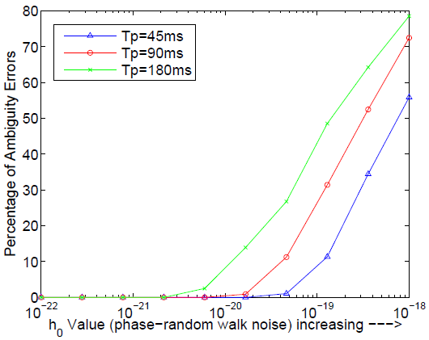
Sensitivity to h0 and the Burst Period
Time between bursts (i.e. burst period, Tp) varied while ambiguity error percentage calculated as a function of combined h0
Percentage of Ambiguity Errors

Slide 20
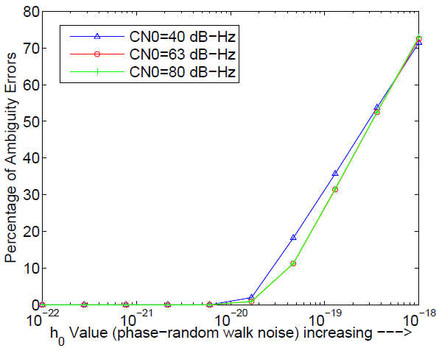
Sensitivity to h0 and carrier-to-noise Ratio
Carrier-to-noise ratio (CN0) varied while ambiguity error percentage calculated as a function of combined h0
Percentage of Ambiguity Errors

Slide 21
Conclusions
Developed a technique to reconstruct a continuous phase time history from TDMA signals
Build a simulation environment to simulate TDMA signals
Characterized many of the error sources in terms of clock-like dynamics
Analysis of performance demonstrated that the technique is:
Very sensitive to phase-random walk noise (h0) and the TDMA burst period
Less sensitive to the CN0

