Slide 1
Advanced Techniques for Centimeter-Accurate GNSS Positioning
on Low-Cost Mobile Platforms
Ken Pesyna
Committee
Dr. Todd E. Humphreys (supervisor)
Dr. Robert Heath (co-supervisor)
Dr. Sujay Sanghavi
Dr. Haris Vikalo
Dr. Johnathan York
Ph.D. Defense | The University of Texas at Austin | 25 August 2015
Notes:
Good morning. Thank you all for attending my Ph.D. defense. I’d like to thank my committee members and the rest of you for being here to critic and support me.

Slide 2
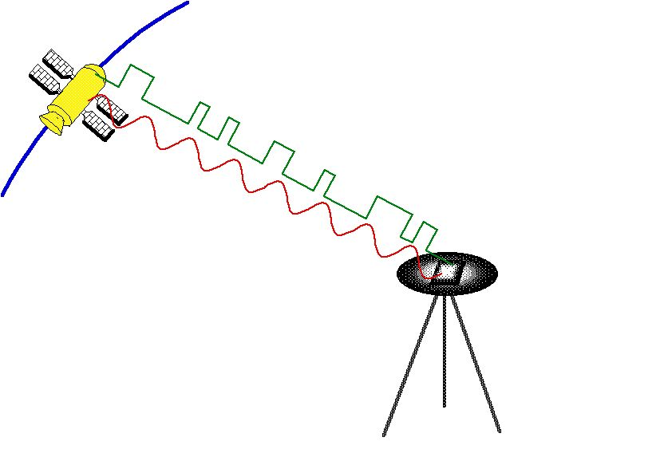
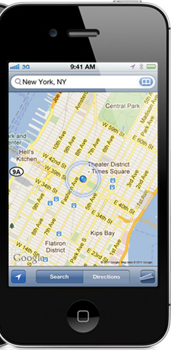
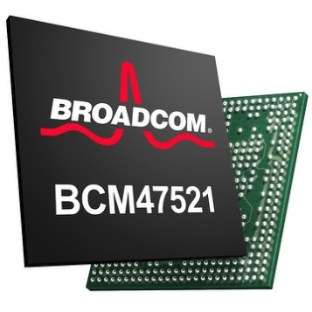
Global Navigation Satellite System (GNSS)
Introduction
Introduction
Range
Code-Phase Positioning
Range = (time reception – time transmission) x speed of light
Notes:
Over the past decade, GPS and other Global Navigation Satellite System (GNSS) chipsets have become smaller, cheaper, and more energy efficient, so much so that they now come standard in most smartphones and tablets. Here I show an iPhone computing its position using 4 GNSS satellites. It does this by measuring what feature of each signal’s pseudorandom chipping sequence it is currently receiving and deducing a range from that feature’s known time of transmission. With four or more ranges it can solve for it’s globally-referenced three dimensional position and time offset. This type of positioning that takes measurements of the signal’s chipping or code sequence, is known as code-phase positioning.

Slide 3

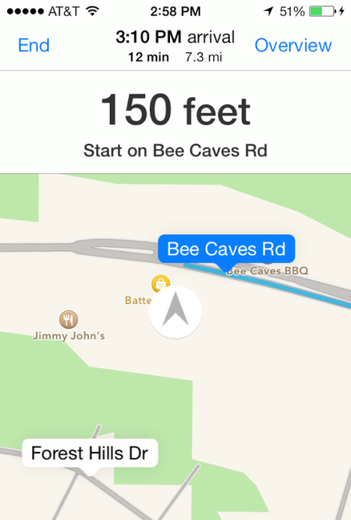

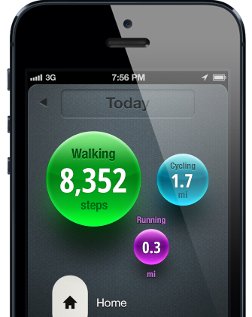
GNSS Positioning Today
Introduction
Location-based Searches
Driving Directions
Location Sharing
Fitness Tracking
Notes:
There are many different uses of GNSS positioning today. I list here four common smartphone applications. The pervasiveness of GNSS is so high, that we often don’t realize when it’s being used. We’ve come to expect it and it’s only when it doesn’t work well that we realize it’s not perfect. Like when it can’t figure out that that we’re already driving on the highway.

Slide 4
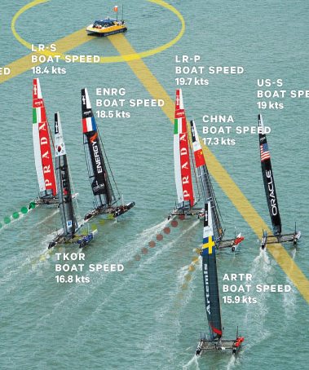
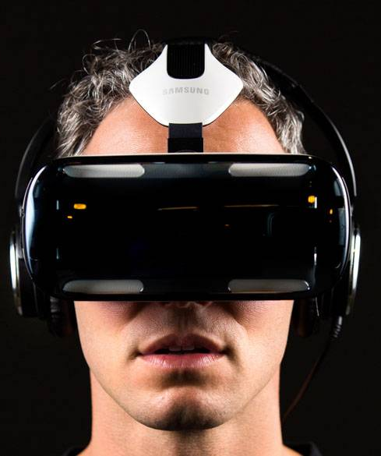
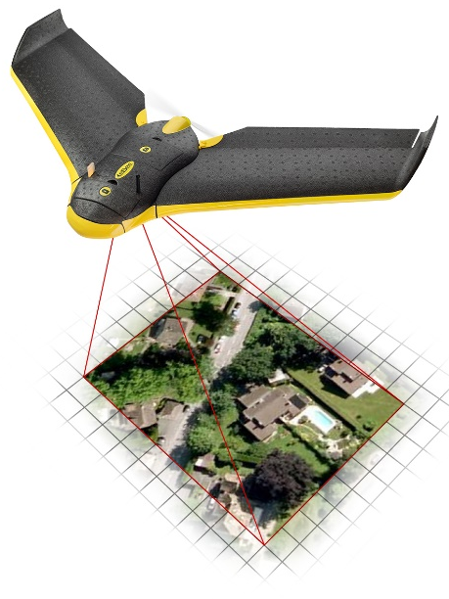
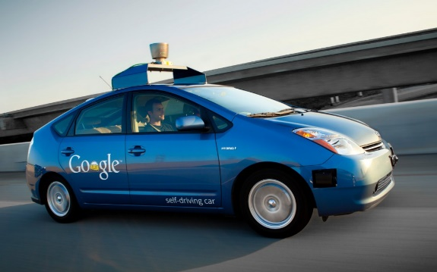
Where It’s Going
Introduction
Virtual Reality
Augmented Reality
Large-scale Mapping
Autonomous Driving
Notes:
But the use of GNSS, particularly for low-cost, mobile applications, has only begun. I show here four applications, all of which are up-and-coming areas for which GNSS could greatly expand their capability. These four applications all share something in common. The desire to know their position very accurately and cheaply. In virtual reality, users are at present confined to their seats or to a very small space so that a user’s movement can be tracked precisely by nearby infrared cameras. While these cameras offer the level of head tracking accuracy required to make the experience convincing to a user, GNSS-based tracking would enable a truly untethered, walk around, experience that has so-far been lacking on this platform.
In autonomous driving, another application, a swath of sensors are currently employed to ensure that the vehicle knows where it is to sub-lane-level accuracy. It is also the case that the maps that this vehicle is using to locate itself must be of equal accuracy, requiring precise mapping over large areas to be performed in advance. But these systems are currently expensive. Low cost, precision GNSS would open the doors for this technology to be brought to the mass-market.

Slide 5
Reduction in GNSS Range Error Has Stalled
Introduction
Prior to 2000
  Intentional degradation
  50+ meter errors
May 2, 2000
  Degradation turned off
Since 2000
  Steady Improvements
  Leveling off
  Meter-level precision
Average Civilian GPS Positioning Errors
Meters Error
Source: NOAA National Geodetic Survey
Notes:
So you might be thinking, “Well if my car’s GPS receiver sometime thinks that I’m on the highway when I’m actually on the feeder road,” there’s no way that GNSS can ever get us the sub-lane-level or even centimeter-level accuracy that we’ll need for these applications.” And you’d be right…well sort of…
I show here a plot of the average GPS range error over the last decade and a half. It shows that the attainable accuracy of GNSS has improved by roughly an order of magnitude over this time. Most of this came from the turning off of the intentional degradation of the civilian GPS signal, known as selective availability, by President Clinton in the year 2000. Since then, however, the reduction in range error has flattened out considerably. Today, the achievable accuracy of standard code-phase GNSS positioning is meter-level, at best and a few meters is typical.

Slide 6
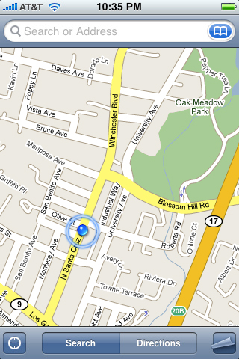
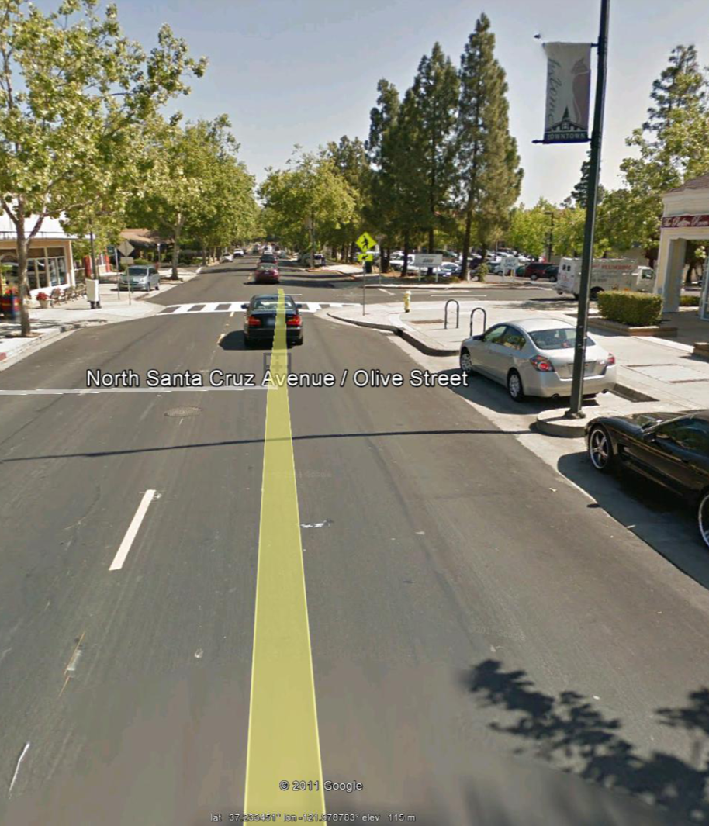

A Dramatic Accuracy Increase
Introduction
Notes:
For GNSS positioning to meet the needs of the future mass-market applications I showed earlier, a dramatic increase in accuracy is needed, and, for smartphone-based applications, this accuracy increase must also come at a low cost, be power efficient, and work as “invisibly” as we’ve come to expect with traditional GNSS positioning.

Slide 7
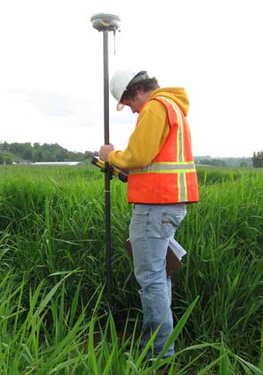

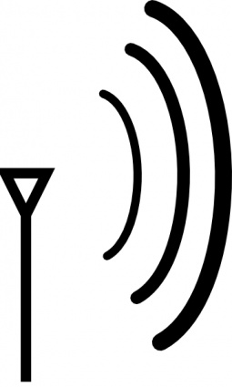

Carrier Phase Positioning
Introduction
Centimeter Accurate
Carrier Phase Differential GNSS (CDGNSS)
Notes:
By using techniques that exploit the carrier phase of the GNSS signal it is possible to achieve centimeter-level accuracy using GNSS.
Carrier Phase positioning works by tracking the underlying carrier signal of each GNSS signal in addition to the code-signal. Then, by differencing the carrier phase measurements with those from a nearby reference station and computing a so-called Carrier Phase Differential GNSS or (CDGNSS) solution, one can compute a three-dimensional position offset from the reference station to centimeter accuracy.
CDGNSS positioning is currently routine in farming and surveying to plow fields and locate ground markers. However, both of these applications benefit from the use of large antennas and receivers that have very minimal power, size, and cost constraints. Significant challenges remain before this technology can be integrated and work reliably on a low-cost mobile platform.

Slide 8
CDGNSS Challenges for the Mass-Market
Introduction
High Power Consumption
Reference Network
Long Initialization Time
Chips “always on”
Can’t “hot start” with rough position estimate
Mobile battery life is limited
Requires 10-20 km spaced reference network
Large upfront cost
Other techniques, e.g., PPP don’t require a network, but have longer convergence times
Time-to-first-fix (TTFF) can be much longer than traditional GPS/GNSS
Need to first resolve the carrier phase ambiguities
Mobile users are impatient
Notes:
I list here three challenges preventing the mainstreaming of CDGNSS into the mass market. First is high power consumption. With CDGNSS, the GNSS chip must retain constant lock on the underlying carrier phase of the signal. Any loss of lock would require a need to restart the resolution of each tracked signal’s so-called carrier phase ambiguity. To avoid losing lock, most chip manufacturers choose to keep the chip constantly “on”, consuming more power.
Second, CDGNSS requires a reference network. A nearby reference node collecting measurements from the same set of satellites, works to remove common mode phase errors such as clock, orbital, and atmospheric errors. We’ve done an analysis and have determined that about 10-20 km spacing of inter-node distance is needed for adequate convergence. Building this network will require a large upfront cost. Other precision GNSS techniques such as precise point positioning or PPP do not require such a reference network, but the tradeoff is that the convergence time of these techniques to centimeter accuracy is much larger than for CDGNSS.
Third, CDGNSS can have a long initialization time as compared to traditional GNSS positioning. The reason for this is that in order for the carrier phase measurement of each signal tracked to be useful, the signal’s underlying carrier phase ambiguity must first be successfully estimated. This resolution process can be very fast so long as enough signals are tracked or a good enough antenna is used, but on mobile platforms, as we will see, reducing this initialization time to reasonable levels can be a challenge.

Slide 9
CDGNSS Challenges for the Mass-Market
Introduction
High Power Consumption
Reference Network
Long Initialization Time
Chips “always on”
Can’t “hot start” with rough position estimate
Mobile battery life is limited
Requires 10-20 km spaced reference network
Large upfront cost
Other techniques, e.g., PPP don’t require a network, but have longer convergence times
Time-to-first-fix (TTFF) can be much longer than traditional GPS/GNSS
Need to first resolve the carrier phase ambiguities
Mobile users are impatient
Notes:
In this dissertation, I have developed strategies to tackle the first and last challenges, that is the high power consumption and long initialization times of CDGNSS, leaving the reference network challenge to future work.

Slide 10
Thesis Statement
Introduction
Centimeter-accurate GNSS positioning on low-cost platforms is achievable, but hard. These same platforms, however, have certain intrinsic features that can be exploited to make centimeter-accurate positioning easier.
Notes:
In this dissertation, I defend the following thesis statement.
In essence I’m saying that “alright, we’d like to get centimeter accurate positioning on low cost platforms. We might be stuck with a crappy platform, but it turns out that these have features that other platforms don’t have, that can make centimeter-accurate positioning on them easier.”

Slide 11
Contributions: “Advanced Techniques for Centimeter-Accurate GNSS Positioning on Low-Cost Mobile Platforms”
Introduction
A Carrier Phase Reconstruction Technique
A CDGNSS Demonstration and Analysis using Low-Cost Antennas
Demonstrate that centimeter-accurate carrier phase positioning using a smartphone antenna is achievable
A Joint Structure from Motion and CDGNSS Least Squares Framework
Develop a joint batch estimation framework that fuses vision and GNSS measurements for fast and accurate device pose determination
Develop a power-saving technique that reconstructs a continuous carrier phase time history from duty-cycled measurements
Explain why current carrier-phase-based positioning is power hungry
Identify the primary impediment to smartphone-based CDGNSS and develop strategies to mitigate its effect.
Demonstrate that the framework reduces the initialization time of CDGNSS and, in some cases, makes it instantaneous.
Notes:
In accordance with this, this dissertation makes the following three contributions. (list their names)
All three of these have to do with making centimeter-accurate carrier phase differential positioning easier on a mobile platform. I will be covering each one at a time.
%First is a carrier phase reconstruction technique designed to reconstruct a continuous carrier phase time history from duty cycled carrier phase measurements. Duty cycling of the underlying GNSS chip facilitates a power saving mode, and the proposed reconstruction technique enables such without loss-of-lock on the underlying signal.
%Second is a demonstration and analysis of the feasibility of CDGNSS positioning using low-cost antennas. In particular, a centimeter-accurate CDGNSS positioning solution is shown to be possible using the internal antenna of a smartphone. Using empirical data, the primary impediment to CDGNSS on a smartphone platform is identified and strategies to mitigate the its effect are developed.
%Lastly, a joint structure from motion and integer least squares framework that fuses GNSS carrier phase measurements with vision measurements from a camera is developed for fast and accurate pose determination. It will be shown that using the framework, sub-centimeter-level positioning and sub-degree level orientation of a smartphone camera and low-cost GNSS antenna platform is possible and that the underlying carrier phase ambiguities can be successfully resolved faster than using standalone CDGNSS, and in some cases, instantaneously.

Slide 12
First Contribution
A Carrier-Phase Reconstruction Technique for Low-Power Centimeter-Accurate Positioning
K. M. Pesyna Jr., Z. M. Kassas, R. W. Heath Jr., and T. E. Humphreys, “A phase-reconstruction technique for low-power centimeter-accurate mobile positioning,” IEEE Transactions on Signal Processing, May 2014
K. M. Pesyna Jr., Z. M. Kassas, and T. E. Humphreys, “Constructing a continuous phase time history from TDMA signals for opportunistic navigation,” in Proceedings of the IEEE/ION PLANS Meeting, April 2012

Slide 13
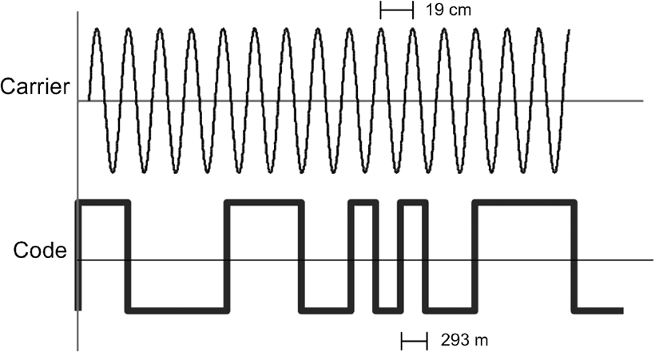
Problem: High Power Consumption
First Contribution
Code-phase positioning facilitates measurement duty-cycling:
Carrier-phase not amenable to duty-cycling:
Notes:
As mentioned previously, one of the challenges of CDGNSS is its high power consumption due to the need to always track the signal. I show two plots here. The top plot is of intermittent code-phase measurements taken of a GNSS signal’s chipping sequence. As shown, it is typical for a GNSS chip wishing to save power to duty cycle its measurements---taking a snapshot of the signal for a few milliseconds every second. The codes are unique and ambiguous, so each time the chip awakes to take another measurement, it can near-instantly determine which part of the chipping sequence it is receiving and thus easily compute it’s range to each satellite.
Such intermittent measurements or duty cycling is not so easy when tracking the GNSS signal carrier phase. The carrier is ambiguous so its much more difficult to determine which cycle you are receiving. If a receiver turns off, it risks awaking not knowing how many cycles have passed. If it get’s it wrong, we call this a cycle slip, which would lead to poor positioning performance. To avoid cycle slipping, CDGNSS receivers choose to constantly track each signal, forgoing the power saving that would come from measurement duty-cycling.

Slide 14
Motivation
First Contribution
Is it possible to reconstruct a cycle-slip free continuous carrier phase time history from intermittent phase measurements?
Notes:
The question that this contribution seeks to answer is “Is it possible to reconstruct a cycle-slip free continuous carrier phase time history from intermittent phase measurements?”

Slide 15
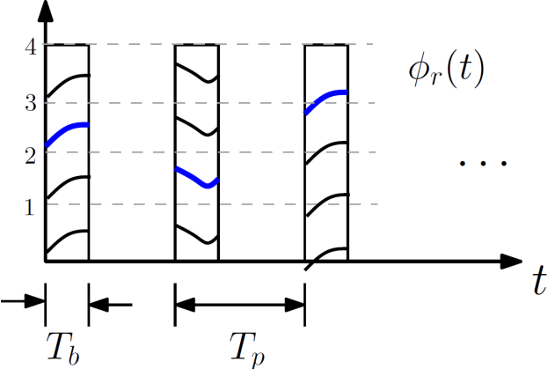
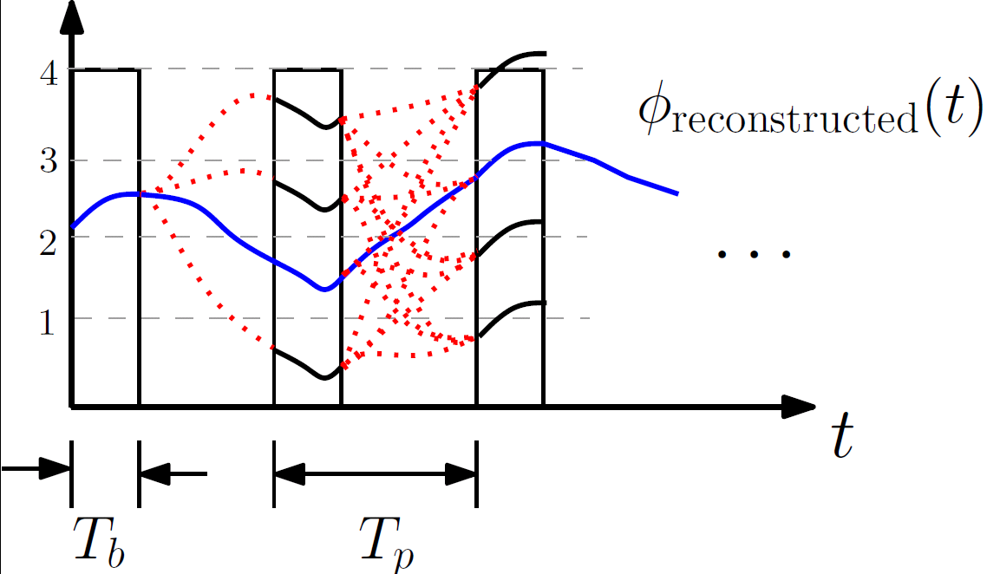
Proposed Reconstruction Technique
First Contribution
Filtering
Integer ambiguity resolution
Reconstruct continuous phase
Integer-cycle phase unknowns
1. Filter aliased measurements
2. Estimate integer offsets
3. Reconstruct continuous phase
Notes:
The answer is “yes”, and to prove this, this contribution proposes a reconstruction technique that employs maximum likelihood estimation to “undo” the phase slipping that would otherwise occur as a result of measurement duty cycling. The reconstruction technique has three stages.
The first stage accepts the intermittent phase measurements, filters them according to its internal noise models, and also uses measurements from an onboard inertial measurement unit to remove the effects of short-time-scale receiver dynamics.
The second stage uses an optimal integer-least squares solver to estimate a set of integer-cycle phase unknowns, necessary to disambiguate the phase at the beginning of each measurement burst, essentially preventing any cycle slipping which occurred between measurements.
The third stage accepts the set of integers and reconstructs the carrier phase as it would have been received if the original measurements were captured under a non-duty-cycled framework.

Slide 16
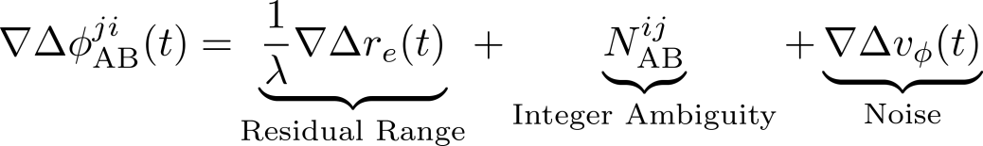
Two Key Insights
First Contribution
Double-Differencing
Inertial Aiding
Removes clock and atmospheric variations
Removes receiver-motion-induced variations
Notes:
Two key insights of this contribution which work to significantly improve the chances of successful phase reconstruction include double-differencing and inertial aiding.
By double-differencing, I man that the intermittent phase measurements collected by the receiver prior to reconstruction are time aligned and differenced from measurements taken by a nearby reference station. This differencing acts to remove many random noise sources including clock and atmospheric errors, which would otherwise make reconstruction more difficult.
Second, the onboard inertial measurement unit, also known as an IMU, present in most all mobile devices, can be used to remove much of the phase variations that come due to receiver motion.
All this to say that reconstruction will now be much easier since the phase will not be varying as randomly between intermittent measurements.

Slide 17


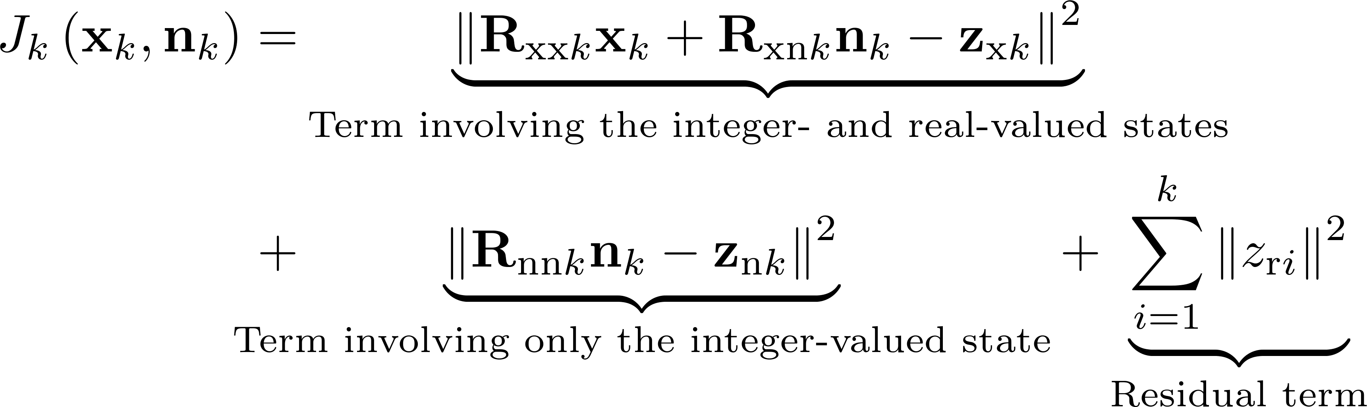
Reconstruction Filter Framework
First Contribution
State:
  Real-valued:
  Integer-valued:
Measurement Model
Solving for the real- and integer-valued state:
Desired Unambiguous Reconstructed Phase
How many cycles have passed
since previous measurements
Ambiguous measurement
Ambiguous Measurement of the phase
Notes:
This section briefly describes the reconstruction filter framework. Pay specific attention to this section, because it is a common theme in all of my work and will re-appear again later.
The filter can be boiled down into a mixed real and integer least squares problem. The filter’s state contains a real component, x, which contains our desired unambiguous reconstructed phase and an integer component, n, which models how many phase cycles have passed between the current and previous measurement.
These can be combined into a measurement model that models the intermittent phase measurement. In solving for the real- and integer-valued state, it is possible to do a factorization on the least-squares cost function that decorrelates the integer-valued state from the real-valued state, as shown here, such that the integer component of the state can be first solved for on its own by minimizing the cost component shown in blue. This minimization can be done using common integer least squares techniques such as using the LAMBDA method. Then once this integer component of the cost function is minimized, the cost-minimizing value of n can be substituted into the green box, to solve for the real-valued state, x, which, again, is our desired reconstructed phase.

Slide 18
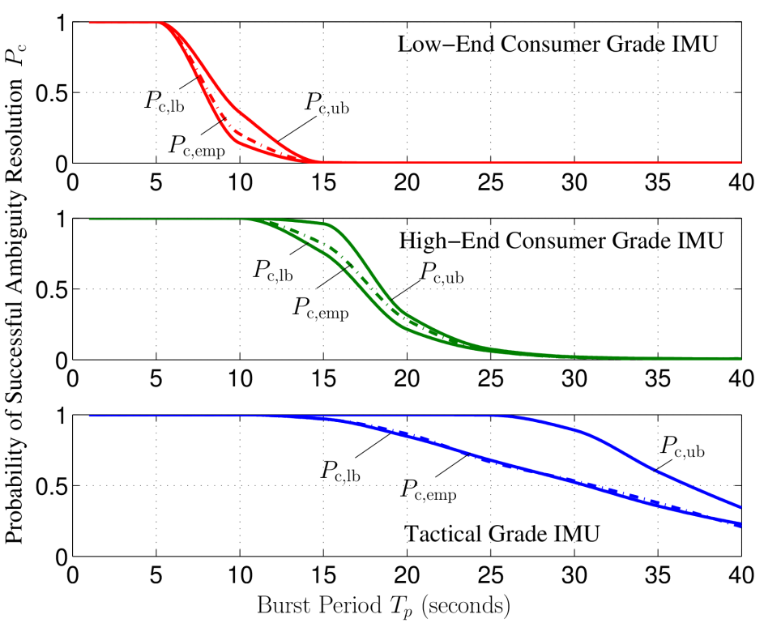
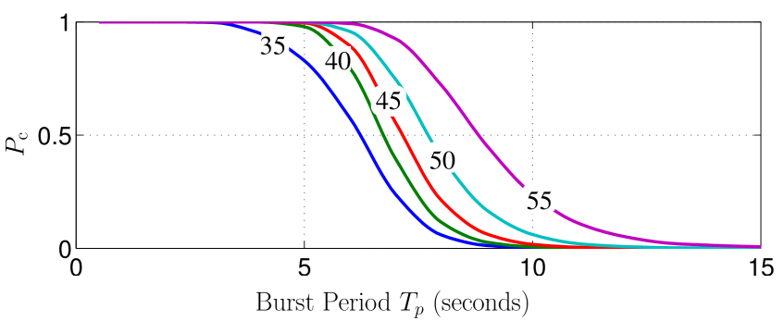
Reconstruction Results (Simulation)
First Contribution
Varying IMU Quality
Varying Carrier-to-Noise Ratio
Higher carrier-to-noise ratio → Longer time between measurements
Higher quality IMU → Longer time between measurements
Probability of Correct Integer Resolution
Probability of Correct Integer Resolution
Time between measurements (sec)
Time between measurements (sec)
Notes:
Shown are reconstruction results using simulated data. The left-hand plot shows a waterfall curve for the probability of correct integer resolution as a function of the time between intermittent measurements and IMU quality. It is clear that the use of a higher quality IMU facilitates a longer time between measurements. Similarly, the right-hand plot shows curves for the probability of successful integer resolution as a function of the time between measurements and the carrier-to-noise ratio. Again, it’s clear that a higher carrier to noise ratio facilitates longer time between measurements.

Slide 19
Second Contribution
A CDGNSS Demonstration and Analysis using Low-Cost Antennas
K. M. Pesyna, Jr., T. Novlan, J. C. Zhang, R. W. Heath, Jr., and T. E. Humphreys, “Exploiting antenna motion for faster initialization of centimeter-accurate GNSS positioning with low-cost antennas," IEEE Transactions on Aerospace and Electronic Systems, Aug. 2015. (submitted).
K. M. Pesyna, Jr, R. W. Heath, Jr., and T. E. Humphreys, “Accuracy in the palm of your hand: Centimeter positioning with a smartphone-quality GNSS antenna," GPS World Magazine, vol. 26, pp. 16-31, Feb. 2015.
K. M. Pesyna, Jr., R. W. Heath, Jr., and T. E. Humphreys, “Centimeter positioning with a smartphone-quality GNSS antenna," in Proceedings of the ION GNSS+ Meeting, Sept. 2014
Notes:
My next two contributions will tackle a second challenge of CDGNSS on low-cost mobile devices. That is, it’s relatively long initialization time as compared to standard code-phase positioning. These initialization times will be shown to be especially long when using the poor-quality antennas that come standard in these devices.
For my second contribution I will present a CDGNSS demonstration and analysis using low-cost antennas.

Slide 20
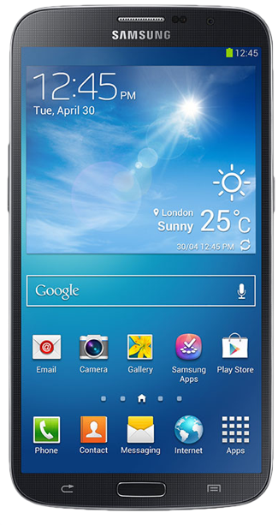
Motivation
Second Contribution
Is carrier-phase-based GNSS positioning feasible on consumer-grade mobile platforms such as smartphones and tablets?
What are the primary impediments to doing so?
How can these be addressed?
Notes:
This contribution aims to answer the following questions:
Is carrier-phase-based GNSS positioning feasible on consumer-grade mobile platforms such as smartphones and tablets?
What are the primary impediments to doing so?
How can these be addressed?

Slide 21
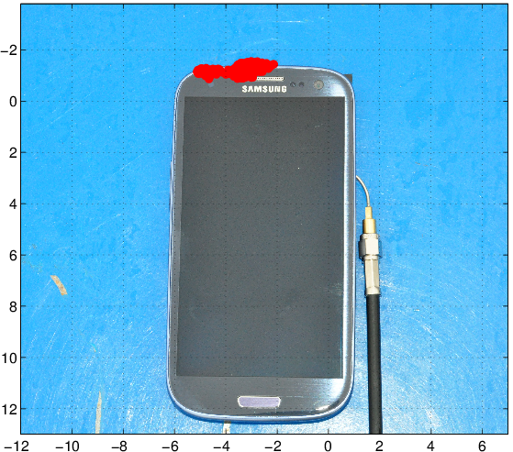
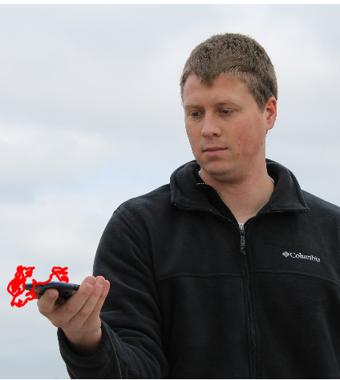
Feasibility
Second Contribution
East Error (cm)
North Error (cm)
Static solution 300 seconds
metal backplane
Handheld solution
300 seconds
Notes:
These two photos show my first attempts to compute a CDGNSS solution using the internal antenna and low-noise amplifier of a smartphone. The left hand photo shows a successful CDGNSS solution superimposed over a photo over the smartphone and properly scaled. The cluster of red designates the computed position of the antenna over a 300 second interval. The axis, labelled in centimeters, reveal the positioning error from the smartphone’s true antenna position to be about 2-3 centimeters, which was determined by surveying the location of the antenna with a higher quality antenna after data collection.
The right-hand photo shows a second CDGNSS positioning solution while the smartphone was held in my hand. My hand moved slightly during the interval, as reflected in the figure.
I should point out that before we did these demos, there were many who believed these results were simply not feasible. That is, many thought that there were too many obstacles to overcome to achieve cm-accurate GNSS positioning on a smartphone. While both of these figures do indeed reveal that such accuracy is achiveable, they don’t reveal the challenges faced in realizing these successes.

Slide 22
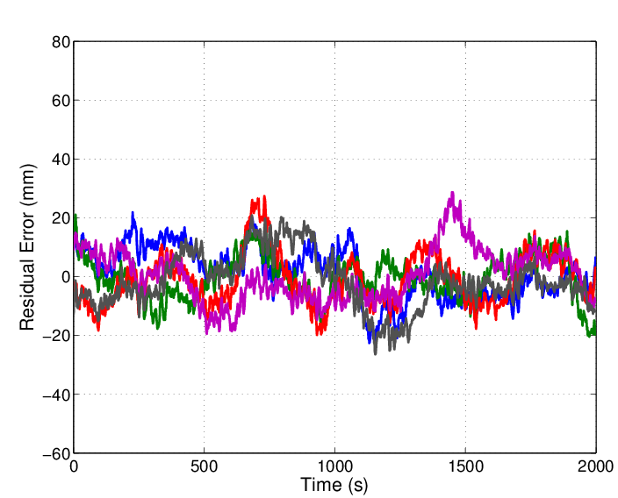
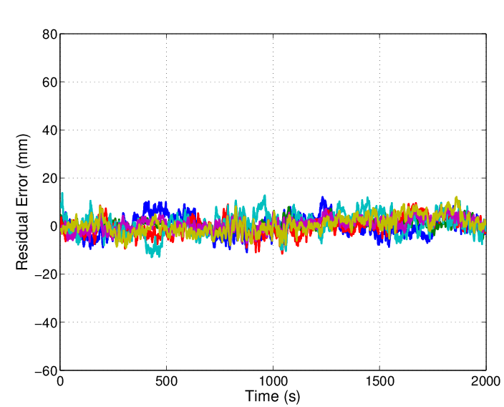
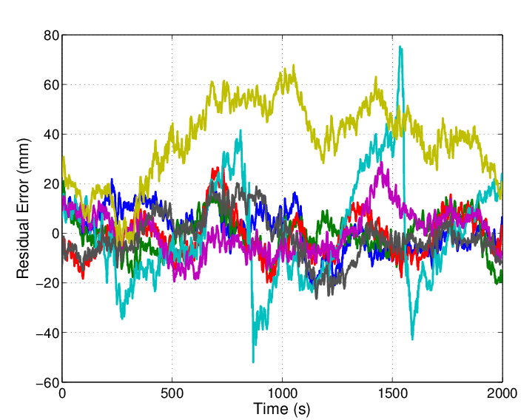
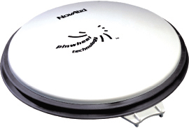

Primary Impediment: Large Time Correlated Multipath
Second Contribution
Phase Residuals
Survey-Grade Antenna
Phase Residuals
Smartphone Antenna
Standard Deviation:
Standard Deviation:
3.4 mm
8.6 mm
11.4 mm
Notes:
To investigate these challenges, I’d like to show you the so-called phase residuals, or the errors in the double-differenced carrier phase measurements.
Shown here is a 2000 second time history of phase residuals for phase measurements taken from 8 satellites using a high-quality survey-grade antenna. This antenna has very good multipath rejection. It is designed for centimeter-accurate positioning, as evidenced by the standard deviation of the residuals being approximately 3.4 millimeters.
Now shown is a 2000 second time history of phase residuals for phase measurements taken using the smartphone antenna. You’ll first notice the presence of a few outliers whose large errors persist for thousands of seconds. It’s likely that these large residuals are due to antenna phase center variations. BUT, even if these are excluded, as I’ve now done, the standard deviation of the remaining residuals remains large compared to the survey-grade antenna. For residuals with such a large ensemble standard deviation, the time correlation in the residuals becomes more important. This long time correlation (100-200 seconds as is shown here) is a well studied phenomenon. It is due to multipath. Such correlation is present in the residuals of both antenna types, but it becomes a problem when the residuals are both large AND time correlated. What is the consequence? We’ll see shortly that this will lead to a significant increase in the CDGNSS initialization time, what’s known as the time to integer ambiguity resolution.
And this is not just a problem for smartphone antennas. It’s seen in low-cost standalone antennas as well.

Slide 23
Existing Multipath Mitigation Techniques
Second Contribution
Existing techniques include:
  Multipath-Estimating Delay-Lock Loop [NeeSie&94], [TowFen&95]
  Coupled multipath-estimating delay-lock, phase-lock loop [PsiErt15]
  Signal-to-noise-ratio-based multipath error correction [AxeCom&96]
  Enhanced Strobe Correlator [GarRou97]
  Ray tracing [LauCro07]
Downsides are that these existing techniques require either:
  A-priori knowledge of antenna motion profile [PsiErt15] or range to nearby reflection surfaces [LauCro07],
  Extra computational power to generate measurements at more than the standard number of correlation taps [NeeSie&94], [TowFen&95],
  A lengthy measurement duration to identify the multipath frequency [AxeCom&96], or
  A high sampling rate in excess of 20 megasamples per second [GarRou97]
Notes:
Here I list a series of well-known multipath mitigation techniques. These include (list)…
However, these techniques either require (1) precise, centimeter-accurate apriori knowledge of the motion profile of the GNSS antenna [28] and, in some cases, also knowledge of the position of and angle to the nearby reflection surfaces [30], (2) extra computational power to generate measurements at more than the usual number of correlator taps [26, 27], (3) a lengthy measurement duration, e.g., hundreds of seconds, for the correct identification of the multipath error frequency [24], or (4) a high sampling rate—in excess of 20 (real-valued) megasamples per second (MSPS) [29].

Slide 24
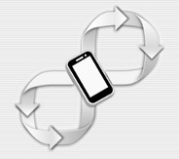

Main Takeaways of Existing Work
All appear too expensive for low-cost receivers
None taking advantage of the cheap features of mobile devices
  Easy to move
  Have a camera
The remainder of this contribution and the next contribution look at using these features to make multipath irrelevant
  This contribution focuses on the mobility
  The next contribution focuses on using the camera

Slide 25
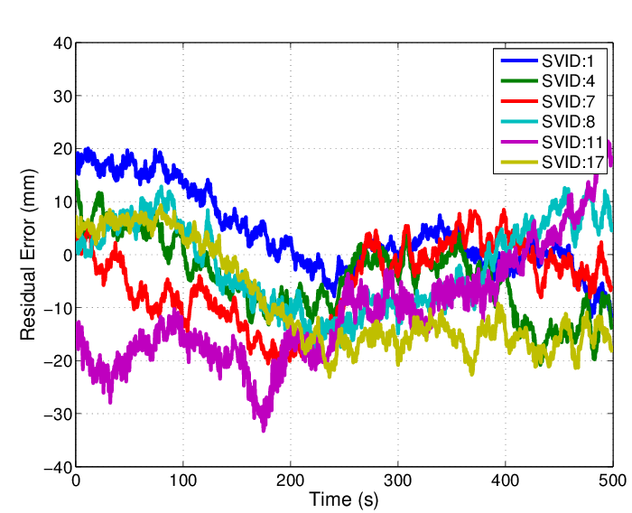
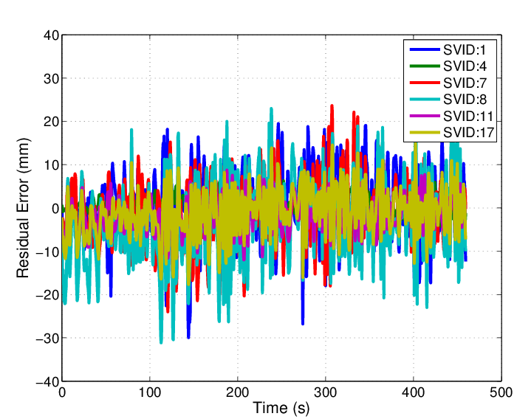
Multipath Mitigation Suited for Smartphones: Suppression via Antenna Motion and Non-Coherent Averaging
Second Contribution
Can’t reduce the magnitude of multipath errors
Reduce correlation time via antenna motion (and appropriate modeling):
Phase Residuals (No Motion)
Phase Residuals (Motion)
Notes:
A multipath mitigation technique well suited to smartphone platforms is motion. As it turns out it is possible to significantly reduce the correlation time of the multipath via simple wavelength-scale motion (show example). Then by appropriately modeling this motion and resulting lowered time correlation within the CDGNSS filter, significant improvements to the initialization time can be seen.
You might think that moving the phone is the wrong thing to do. After all, if the phone remained static, this knowledge could offer a valuable constraint within the CDGNSS positioning filter. And it would, but, as I’ll show, for low-quality antennas with large phase residuals, the information gain that comes from motion-induced phase decorrelation outweighs the information gain that would come from a static motion constraint

Slide 26
Modeling Antenna Dynamics and Phase Errors
Third Contribution
Phase Measurements
(dynamics)
CDGNSS
Estimator
,
Position Estimate
Integer Ambiguity Estimates
Single Reflection
Multipath Model
,
(error statistics)
(quality)
Notes:
This slide shows a block diagram for how antenna motion and antenna quality are related to the phase noise statistics for modeling within CDGNSS estimator. Proper modelling facilitates faster initialization of the carrier phase ambiguities and more accurate position determination.
The antenna motion or dynamics is characterized by these two parameters, sigma_p and tau_p. Sigma_p models how large the antenna movements are while tau_p models how quickly the motion returns to some center of movement. These two parameters along with antenna quality, modeled by alpha, can be passed through a single-reflection multipath model to determine the corresponding phase noise parameters, that is sigma_phi and tau_phi, the magnitude and correlation time of the multipath-induced phase errors, respectively. Then all five of these parameters are passed into the estimator along with the phase measurements. The output of the estimator is then the antenna position estimate and an estimate of the integer ambiguities, one for each signal tracked.

Slide 27
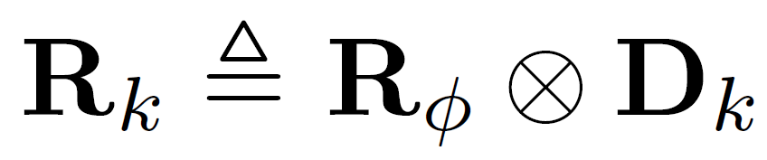
Formal Dynamics and Phase Noise Model
Second Contribution
Measurement Model
Noise Model:
Dynamics Model:
Notes:
This slide shows the formal model for modeling the dynamics and noise statistics within the estimator. We were very careful about the way we expressed our motion and phase errors. I’m not going to walk through it all, other than to point out the presence of a real- valued and integer-valued state. In this contribution, the real valued state represents the desired centimeter-accurate three dimensional position of the antenna, while n represents the underlying carrier phase ambiguities that must be resolved before a centimeter-accurate position can be determined.

Slide 28
Solving for the Integer and Real-valued State
Second Contribution
Solve this cost function for the real- and integer-valued state elements
Notes:
Also like the previous contribution, the real- and integer- valued state elements of this contribution can also be decorrelated, solving for the integer-valued state first using integer-least-squares techniques, followed by the real-valued state.

Slide 29
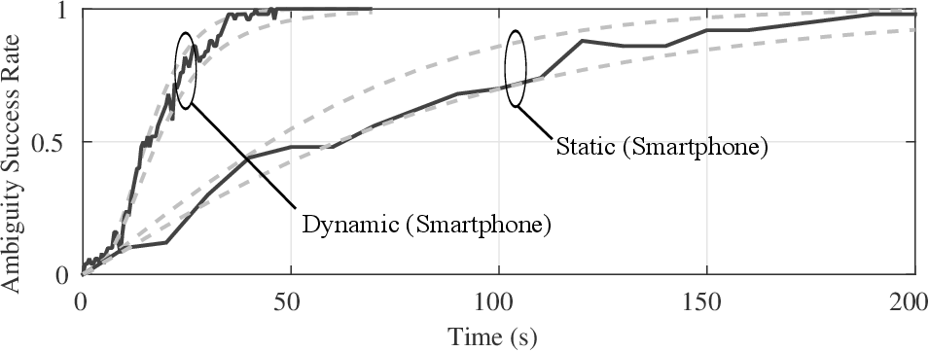
Results: How Much does Motion Help? (simulation)
Second Contribution
Smartphone-grade antenna
Time to Ambiguity Resolution (TAR)
Notes:
So now, for some results. These first results are in simulation. Simulated were phase measurements received by a smartphone-grade antenna first while stationary, and then while moving. These measurements were run through the CDGNSS estimator to produce an estimate of the integer ambiguities as a function of the total measurement duration. At a certain measurement duration, enough measurements were ingested by the estimator to guarantee convergence above a certain predetermined success threshold. We call the time to surpass this success threshold, in this case 90%, the time to ambiguity resolution or (TAR).
Shown here is the ambiguity success rates for both the static and dynamic solutions. Empirically-computed results using Monte-Carlo simulation are shown in dark black, while success rate upper and lower bounds are shown in dashed gray. It is clear that the TAR for the static smartphone antenna, that is, the time it takes the success rate to surpass 90%, is close to 150 seconds whereas the TAR for a dynamic smartphone antenna would be under 50 seconds.
This result is significant. It shows that by simply exploiting the innate mobility of the smartphone platform, we can reduce the CDGNSS initialization time to approximately 1/3 of what it was if the platform remained static.

Slide 30
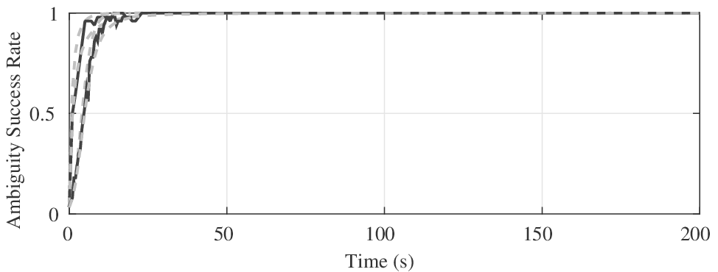
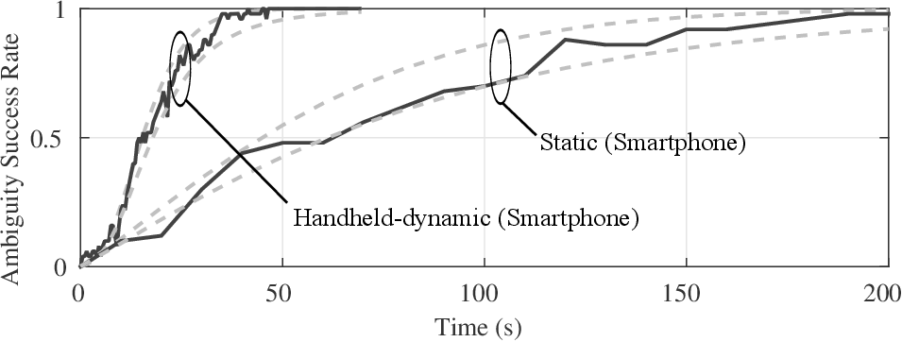
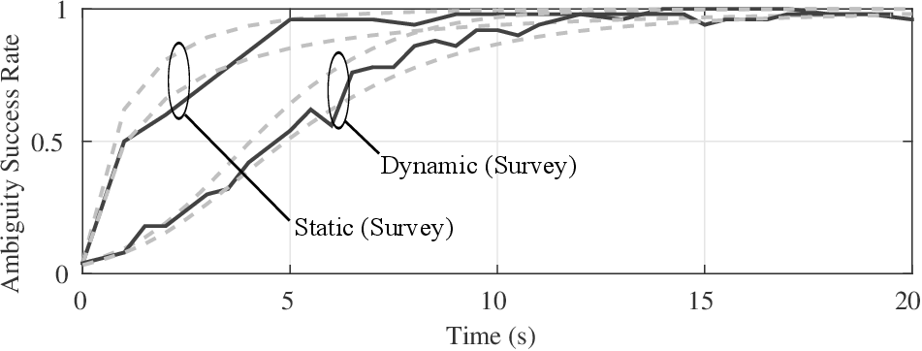
Results: How Much does Motion Help? (simulation)
Second Contribution
Survey-grade antenna
Notes:
Now how would this motion improvement hold up for a higher quality antenna. To analyze this, I similarly simulated measurements as would be received by a static and a dynamic survey-grade antenna. These results are harder to see since the survey grade antenna has a much smaller TAR in both cases. So lets zoom in.

Slide 31
Results: How Much does Motion Help? (simulation)
Second Contribution
Survey-grade antenna, motion hurts
Notes:
Shown now, it’s clear that the dynamic scenario had a higher TAR than that of the static scenario. The reason for this is due to the constraint tradeoff that I discussed earlier.
For high-quality antennas with small phase residuals, the information gain that comes from motion-induced phase decorrelation does not outweigh the information loss that comes from no longer being able to apply a static motion constraint within the filter. As shown it would be better to keep the antenna static, even though the residuals are highly correlated, than to move the antenna.

Slide 32
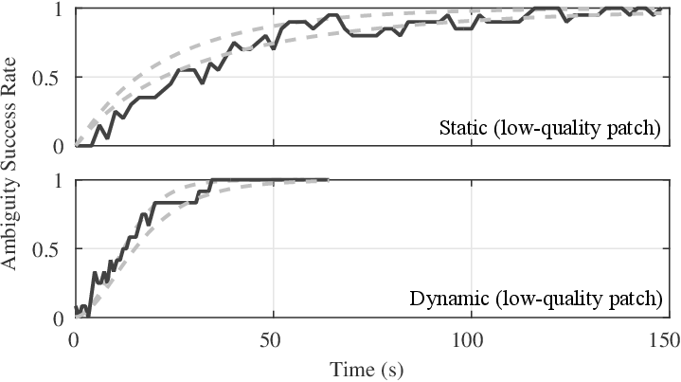
Results: How Much does Motion Help? (real data)
Second Contribution
Notes:
This slide shows the improvement to TAR of motion using real data collected from a low-quality standalone patch antenna. Here, the TAR improves from about 80 seconds to 30 seconds when the low-quality patch antenna is moved.

Slide 33
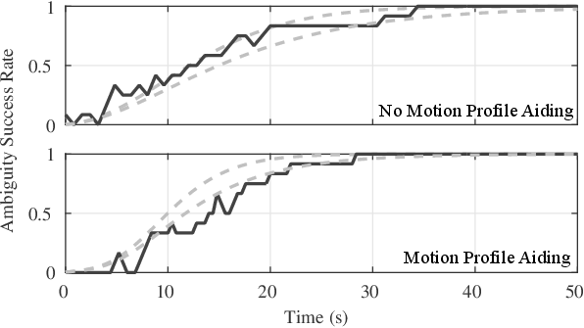
Results: Antenna Motion with a Known Motion Profile
Second Contribution
30 second TAR is still a long time. Is it possible to improve?
Yes, if the estimator knows how we moved, e.g., had a motion profile
This is synthetic aperture processing applied to GNSS [PanFal&13], except applied non-coherently at the phase measurement level
Notes:
But 30 seconds is still a long time to wait. It is possible to improve further? Yes, in two ways. The first way is to track more satellite signals. The European and Chinese GNSS systems are quickly ramping up and their satellite constellations will mature greatly over the next 2 years, bringing with them approximately a doubling in the number of overhead signals at any given time.
The second way, and what will be the focus of my third and final contribution is to use a-priori knowledge of how the antenna was moved---what I’ll call the antenna motion profile---as a constraint within the estimator.
The plot shown here shows that the TAR improvement can be reduced by another 30% from just over 30 seconds to just over 20 seconds if a motion profile of the antenna was available.
But what could provide this motion profile. The inertial sensors inside of phones are sometimes used to track their motion. But these inertial sensors are not nearly good enough to support accurate-enough trajectory prediction over 20 seconds of movement. Their dead-reckoning position estimates diverge too quickly. Fortunately, only the shape of the motion trajectory is really needed and nearly all mobile devices also have a camera with extremely high resolution that, as it turns out, can be used to determine this shape.
(BRIDGE TO NEXT CONTRIBUTION)

Slide 34
Third Contribution
A Joint Structure from Motion and CDGNSS Framework for TAR Reduction and Pose Determination
K. M. Pesyna, Jr., D. P. Shepard, R. W. Heath, Jr., and T. E. Humphreys, “VISRTK: Fusion of camera and GNSS carrier phase measurements for fast, robust, precise, and globally-referenced mobile device pose determination,“ IEEE Transactions on Signal Processing, 2015. (In preparation).
D. P. Shepard, K. M. Pesyna, Jr., and T. E. Humphreys, “Precise augmented reality enabled by carrier-phase dierential GPS," in Proceedings of the ION GNSS Meeting, (Nashville, Tennessee), Institute of Navigation, 2012.
Notes:
And that brings me to my final contribution. This contribution will focus on using a smartphone camera in an optimal way to determine a motion profile of the GNSS antenna and use it further reduce TAR. I’ll then show at the end how we can even make ambiguity resolution instantaneous using the camera. And as a final bonus, I’ll show that the camera can be used to map it’s surrounds to centimeter-level accuracy.
I call the framework to be discussed in this contribution a joint structure from motion and CDGNSS framework for TAR reduction and Pose Determination.

Slide 35

Motivation
Third Contribution
Is it possible to use the high-resolution camera on smartphones to measure the shape of a device’s trajectory to reduce TAR beyond what is achievable using motion alone?
Notes:
The question that this contribution attempts to answer is, “Is it possible to use the high-resolution camera on smartphones to measure the shape of the device motion to reduce TAR beyond what is achievable using antenna motion alone?”

Slide 36
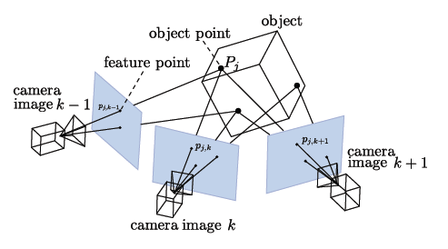
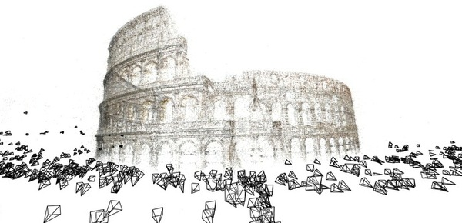
Structure from Motion
Third Contribution
Much prior work in the computer vision community
Known as
  Structure from motion [HarZis00], [TriMcL&00], [KleMur07]
  Photogrammetry [StraMon&12]
  Vision-based Simultaneous Localization and mapping (VSLAM) [NueWei&11], [StraMon&12]
Borrow concepts from this technique to optimally fuse GNSS and camera measurements.
OpenMVG, 2015
Colosseum
Agarwal, Snavely, 2009
Notes:
Before getting into the details of this contribution, I first need to introduce a technique, very popular in the computer vision community, known as structure from motion. Structure from motion, also known as photogrammetry, also known as visual simultaneous localization and mapping is a technique that identifies point features across multiple images of a scene to reconstruct the scene and determine the position and orientation of the camera taking the images relative to the objects in the scene.
We will borrow concepts from this technique within this contribution to optimally fuse GNSS and camera measurements for our goal of TAR reduction. But as we’ll also see at the end of these contribution, we’ll also get a side benefit of centimeter-accurate, three-dimensional absolute mapping.

Slide 37
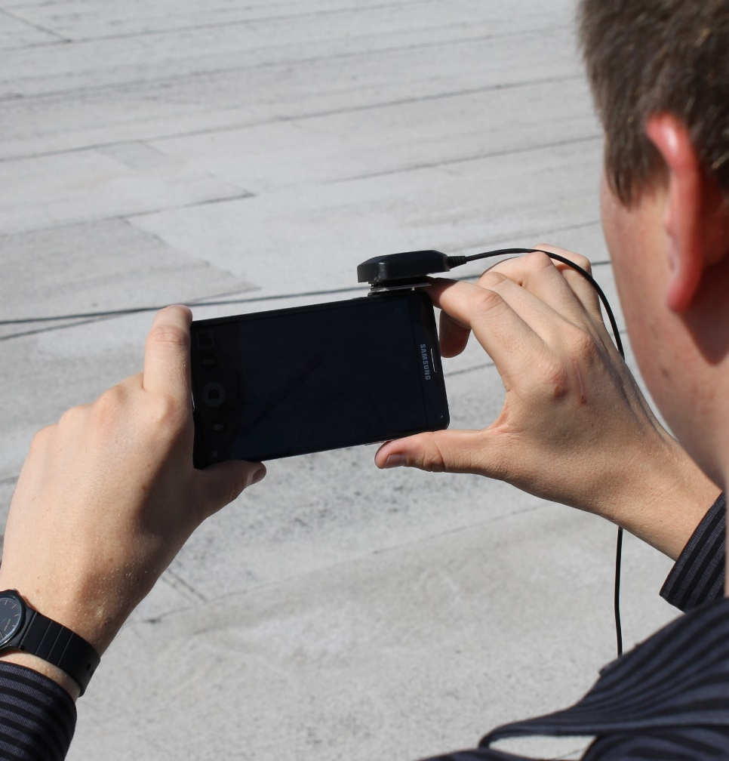
Proposed Framework: VISRTK
“VISRTK”: Combining vision with the RTK algorithm, the alternative name for CDGNSS
VISRTK Platform
Notes:
We call our proposed framework VISRTK because we are combining the vision-based structure from motion technique with the real-time kinematic or (RTK) algorithm. RTK is the industry term for CDGNSS.
Shown on the right side of the slide is our VISRTK platform using which we will capture both images and GNSS carrier phase measurements, simultaneously.

Slide 38
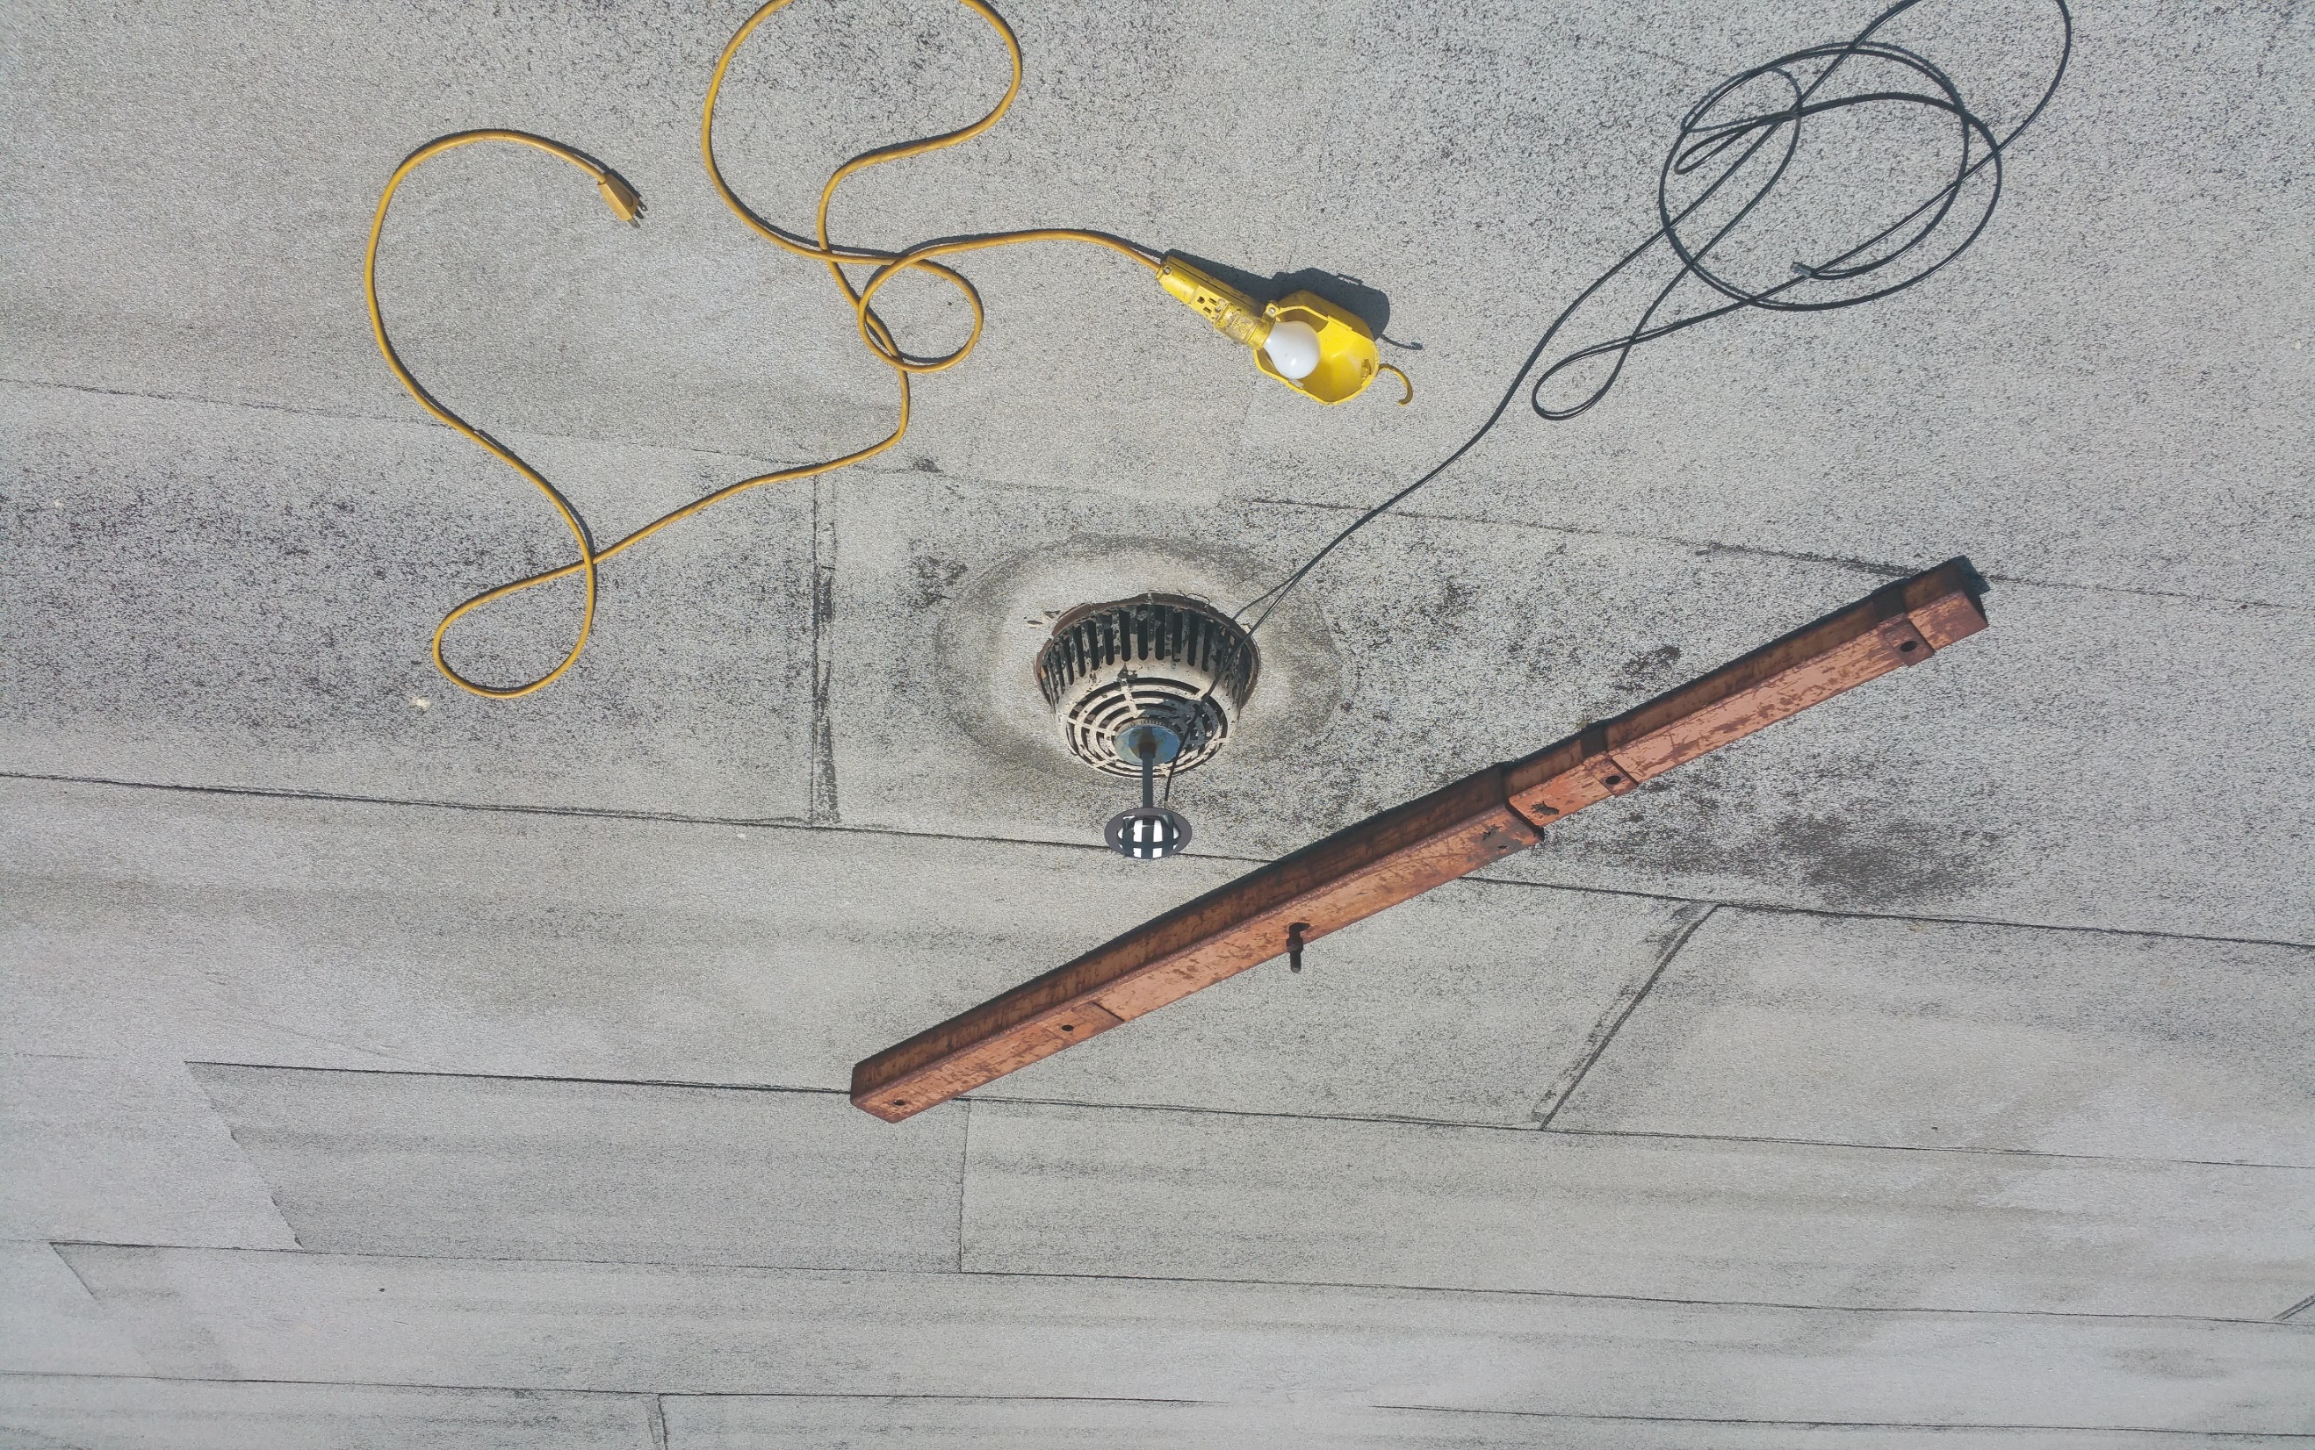
Notes:
Here is a series of images that I took of a few objects on the rooftop of the WRW building. I took 14 photos in total from different angles, 4 of which I’m scanning through now.

Slide 39
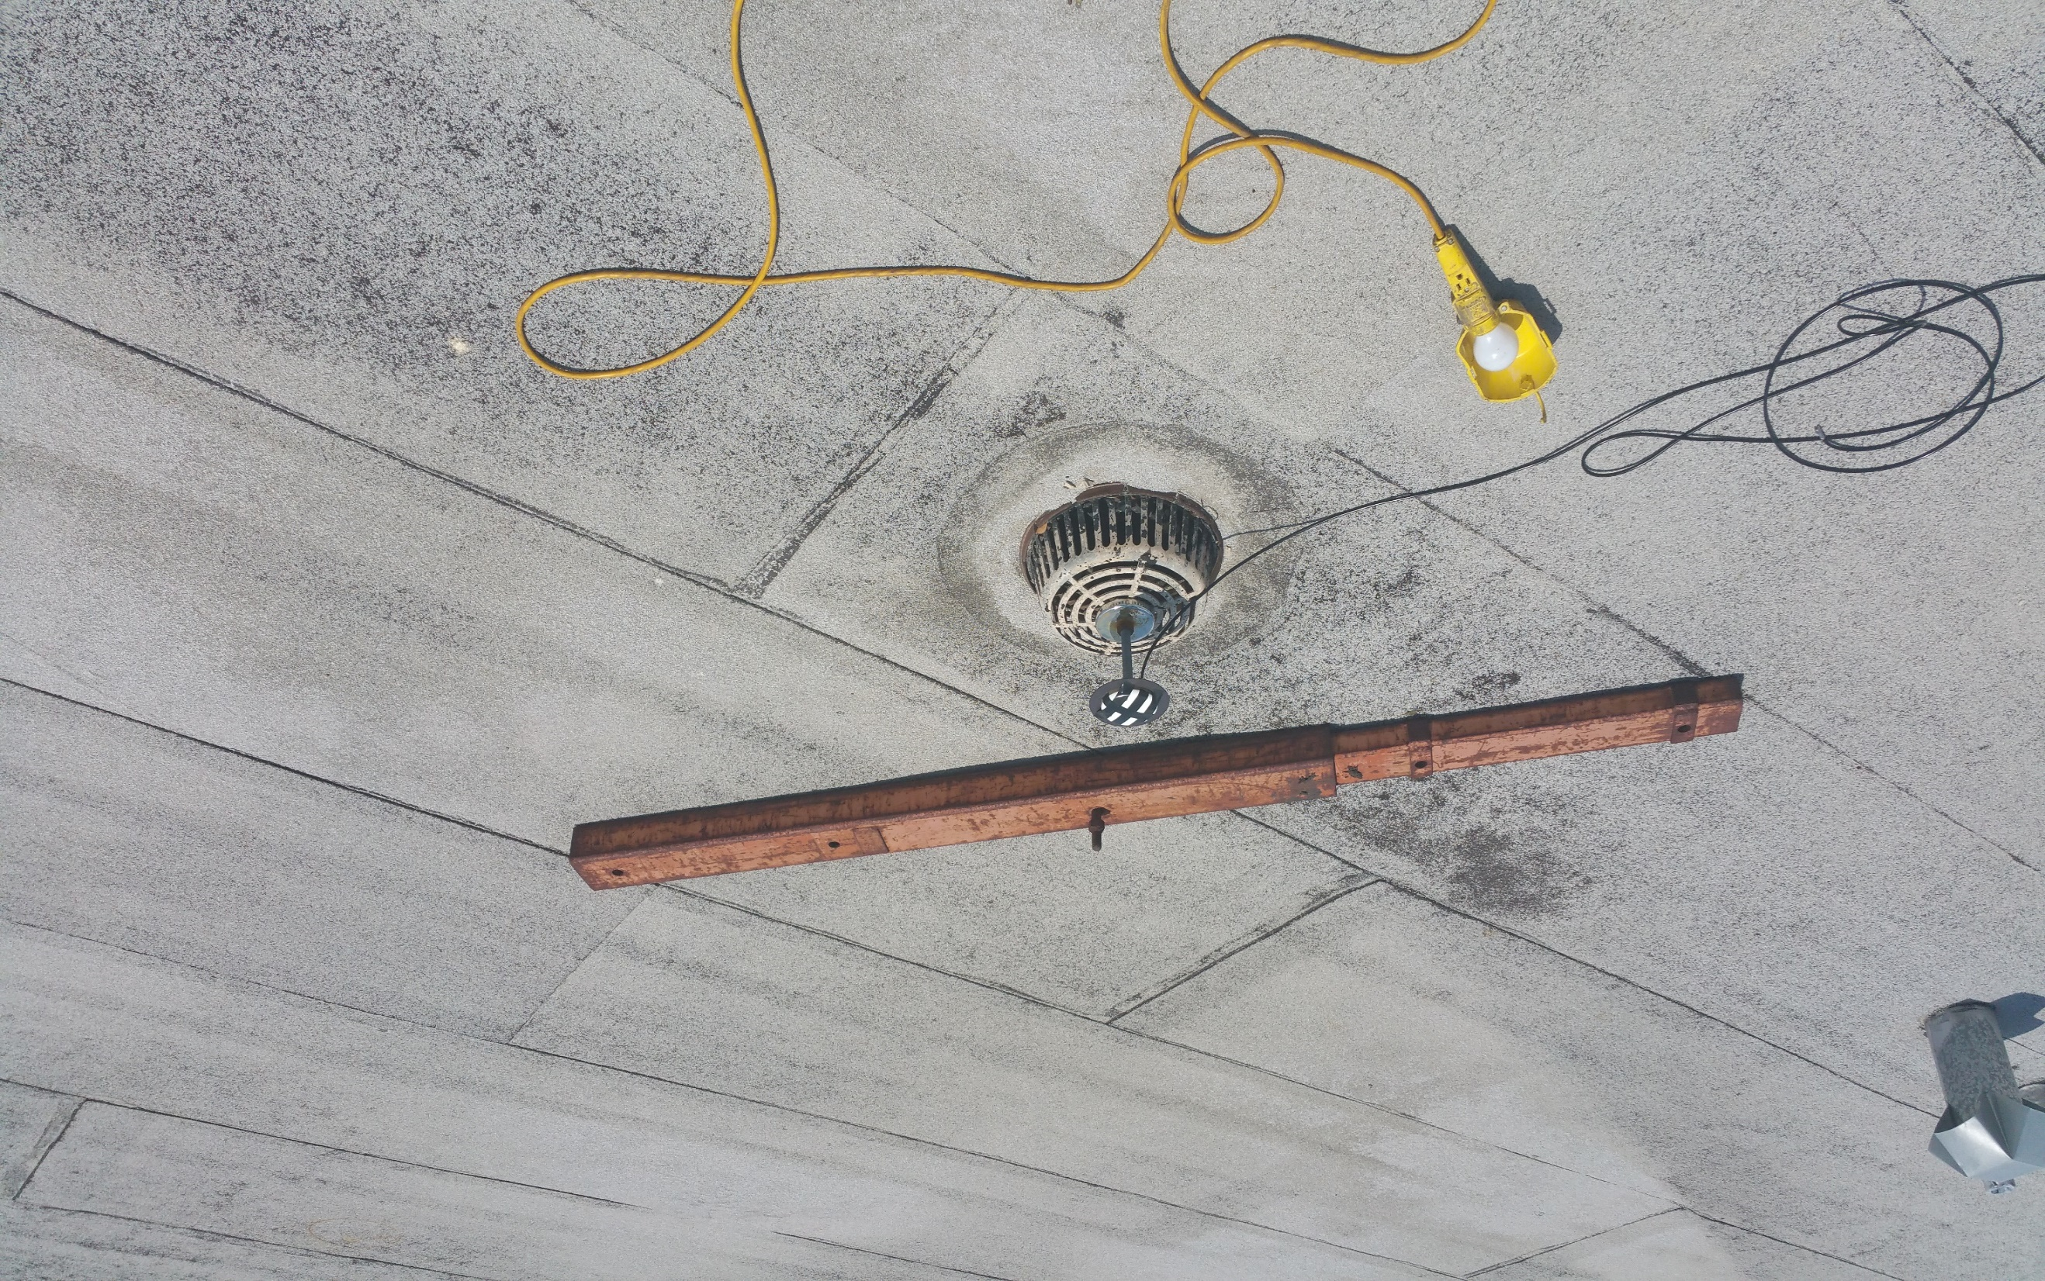

Slide 40
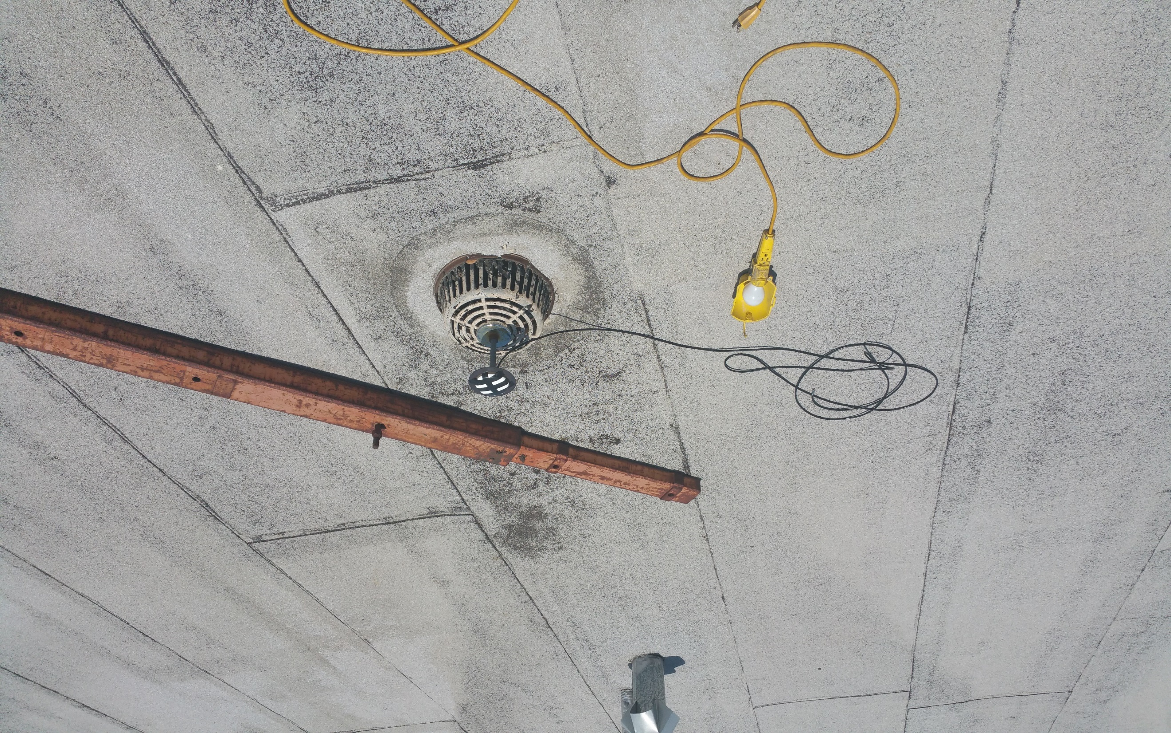

Slide 41
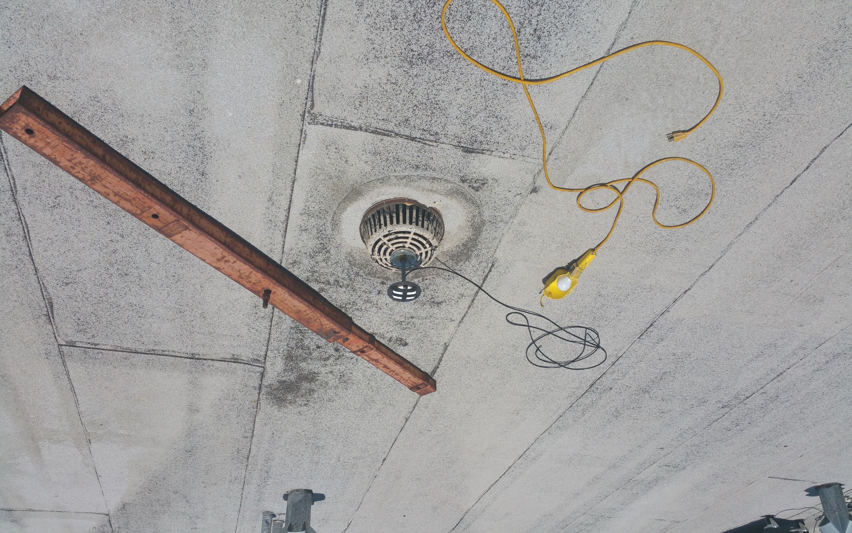

Slide 42
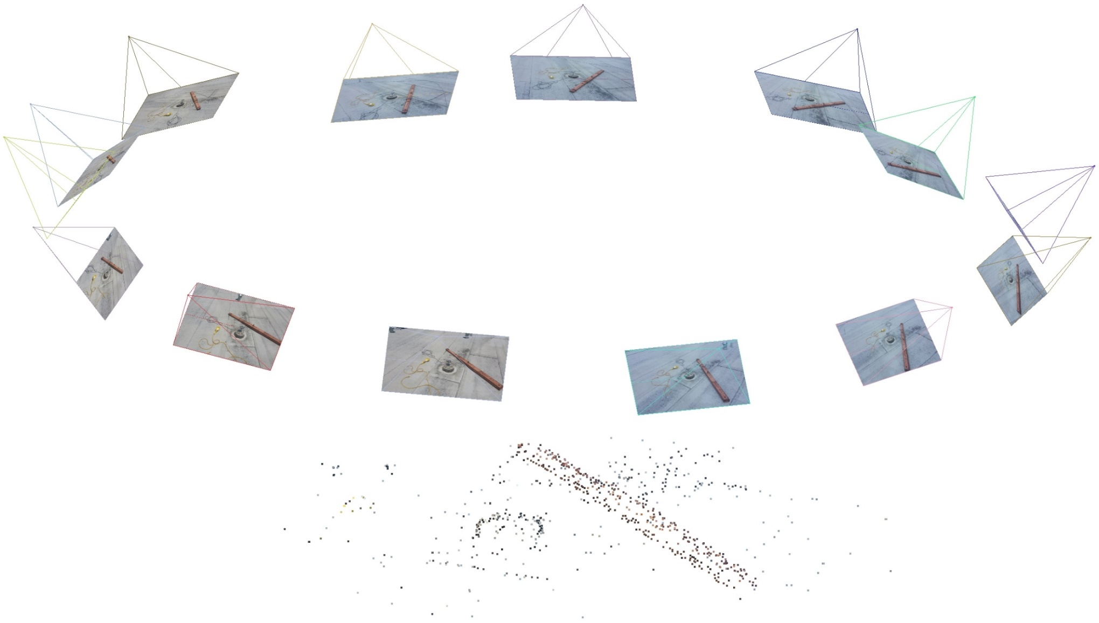
Sparse Scene Reconstruction
C.C. Wu, VisualSFM, 2011
Notes:
Using an open-source structure from motion package known as VisualSFM, I was able to use the images only to reconstruct a sparse point cloud of feature points identified across multiple images as well as the relative position and pose of each of the camera’s while the images were taken.
@article{wu2011visualsfm, title={VisualSFM: A visual structure from motion system}, author={Wu, Changchang}, journal={URL: http://homes. cs. washington. edu/\~{} ccwu/vsfm}, volume={9}, year={2011} }

Slide 43
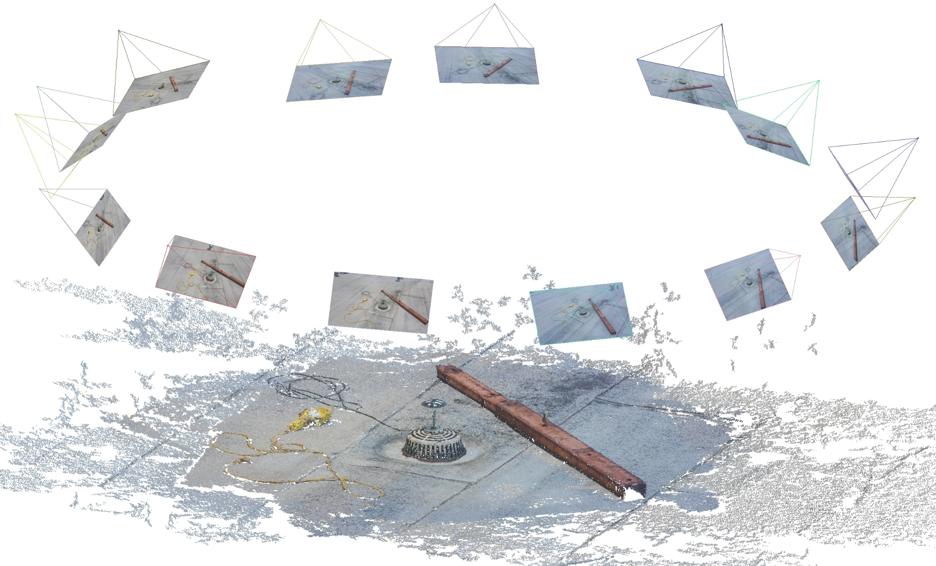
Dense Scene Reconstruction
Notes:
Furthermore, by taking the output of the sparse reconstruction and using this as a prior to search for more point features by applying an algorithm known as multi-view stereo, it’s possible to reconstruct a dense point cloud.
But this dense point cloud is just for show because I thought it was pretty cool. What we really care about are the estimated positions of those cameras, not so much the points. The question that this contribution wants to answer is “can we use the position of those camera’s as determined by structure from motion to constrain the motion of our GNSS antenna to improve TAR?” And secondly, “if so, what is the optimal way to do this?”
Now you might be thinking…

Slide 44

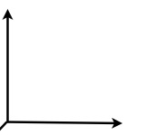
Rotational, Translational, and Scale Ambiguity
Third Contribution
Vision Reference Frame
Notes:
But there’s a catch. As it turns out, with all vision-only algorithms there is a rotational, translational, and scale ambiguity in the reconstruction. That is, without some sort of identifiable fiduciary marker in the scene, it’s impossible to tell how large everything is and how it’s oriented and positioned on the Earth. The reconstruction is in an arbitrary reference frame, what we call the vision reference frame rather than the absolute GNSS reference frame.
But this is OK. It turns out that it’s really the shape of the camera motion that we care about, not so much the geo-accurate trajectory. The shape, as it turns out, since it can be so very well estimated using vision measurements, is a fantastic constraint that can, as it turns out, provide information gain to the CDGNSS algorithm close to what would be achievable if this vision-only solution was scaled and rotated appropriately.

Slide 45
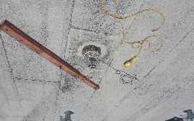
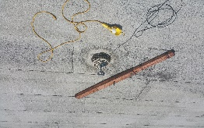
VISRTK: Tightly-Coupled GNSS Phase and Vision Measurements
Third Contribution
GNSS Phase Measurements
(VisualSFM)
Feature Point
Identification
VISRTK
Points Measurements
Integer Ambiguities
Camera Positions
Camera Orientations
Point Feature Positions
Original Images
…
(1) (14)
Notes:
Here’s a block diagram of what’s going on under the hood. We take our original images, and run them through visualSFM, not so much for the scene reconstruction but just for the point feature identificantion part that identifies common point features across multiple images and stores measurements of these points.
We then take these point measurements and combine them with GNSS Phase measurements within the VISRTK framework. The framework does a minimization problem, that again, is combination of mixed integer- and real- least squares.
Finally VISRTK outputs the following:

Slide 46

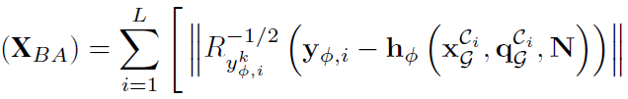

VISRTK: Tightly-Coupled GNSS Phase and Vision Measurements
Third Contribution
Optimal ML solution
Jointly fuse GNSS carrier phase and vision measurement in the same non-linear estimator:
CDGNSS Integer Ambiguities
Point Feature Positions
Vision Measurements
2
2
J
Phase Measurements
Camera Positions
Camera Orientations
Notes:
Here’s how the VISRTK nonlinear cost function looks. It’s an optimal maximum-likelihood non-linear least squares estimation problem.
It is minimizing the cost as a function of the objective variables which again are the camera positions, the camera orientations, the point feature positions, and the carrier phase integer ambiguities. This problem can be solved by linearizing this nonlinear cost function around an initial guess and use the Levenberg Marquardt algorithm to iteratively converge to the minimal state estimates.
But, I should point out, that not only is this problem optimal, but it also retains the features that make it’s solution fast and accurate. In combining the vision measurement and phase measurements, as it turns out, I was able to retain the sparsity of the SFM algorithm that makes it the minimization of this algorithm so fast and the integer-nature of the phase ambiguities the result in an very accurate solution. So we achieve an accurate solution, but also in a computationally way.

Slide 47


VISRTK TAR Reduction (real data)
Third Contribution
14 images in total
Measurements from
  3500 points
  7 GNSS signals
VISRTK
Theoretical Best
Standalone CDGNSS
Notes:
So now let’s look at how we perform. We’ll first look at the VISRTK results from the real-dataset of 14 images and GNSS measurements that we took.
Again we had 14 images in total and VisualSFM was able to identify 3500 feature points in the scene. We also were using carrier phase measurements from 7 GNSS signals. On the right-hand side is the VISRTK estimated scene. That is the point positions and camera poses in the absolute East-North-Up GNSS coordinate frame.
At the bottom are the ambiguity success rate results as a function of the number of poses for which feature point and GNSS measurements were provided to the estimator. In blue is shown the success rate for the standalone CDGNSS algorithm. It shows that it takes measurements from 11 poses to get the ambiguities correct. In yellow, is the ASR for VISRTK, showing that instead only 10 poses were necessary. Finally, in yellow, is the theoretical best, computed via providing the standalone CDGNSS estimator with a pre-computed motion profile, determined by running the CDGNSS algorithm in advance.
In summary, this slide is showing that the gain to TAR using the VISRTK algorithm is there, but somewhat lackluster. We only resolved the ambiguities successfully one pose sooner. But in theory, for this scenario, we should be able to cut TAR down by nearly 50%. So what happened. Why don’t we see better gains. I’m not entirely sure. But I have a few guesses. First, this is just one test case. It could be that the geometry of the scene with the points all being toward the ground, made it so that the motion profile provided by the information in the vision measurements was not as tightly estimable as I thought. More likely, however, this is due to the incorrect point feature correspondence between images. You can see that a few of the point features at the edges of the scene were such that these points were estimated to be off the ground. In reality, these were likely misidentified points that were being treated as associated with actual objects. Such misidentification is hazardous to structure from motion scene reconstruction because the noise on the resulting measurements of these misidentified point features is not Gaussian, but being treated as such within the filter.
These misidentified point features and their sub-optimal modelling within the VISRTK filter could be the reason for that orange line not being closer to the yellow line.

Slide 48


VISRTK TAR Reduction (simulated data)
Third Contribution
15 poses
600 points
Cylinder of radius 4 meters
Theoretical Best
VISRTK
Standalone CDGNSS
Notes:
I show now, a more encouraging result, this time using simulated data. I show here a VISRTK reconstructed scene that consists of a cylinder of point features around which 14 poses of GNSS and point feature measurements were taken. The ambiguity success rate results are shown in the upper-right-hand plot, again for the standalone CDGNSS algorithm, in blue, the VISRTK algorithm, in orange, and the theoretical best computed using a perfect motion profile, in yellow. This time the VISRTK TAR approached much closer to theoretical best, likely due to either better scene geometry or the presence of no mis-identified feature points, since the data was simulated to have none.

Slide 49


Jumpstart VISRTK for Instantaneous TAR (real data)
Third Contribution
What if position priors were available on some of the points?
3 points with priors
VISRTK
Standalone CDGNSS
Notes:
But now, going back to the real-data scene. What if I knew in advance the position of a few of the points in the scene? Possibly because I mapped their positions in the past. Could I use this information to help improve TAR The answer is yes. I show here 3 points for which position priors were determined by running VISRTK over all 14 poses. And as shown, just by having a-priori knowledge of the position of these three of points in the scene, I can resolve my ambiguities instantaneously, using measurements from just the very first camera pose.
We call this jumpstart VISRTK, because we are using the prior point positions to jumpstart the ambiguity resolution. This means that after just the first frame of measurements we can trust the position information to be centimeter accurate from that point forward and start immediately using it within an application.

Slide 50

Notes:
So we can clearly reduce TAR, whether marginally with regular VISRTK or to instantaneous TAR using jumpstart VISRTK. But I want to emphasize another benefit of VISRTK. And that’s this: once the solution is completed, and the integers are resolved, the final accuracy of the antenna positions is much better than it would be without the visual data. So the camera is good, not just for reducing TAR, but for making everything more accurate. And how accurate? The best way for demonstrate the improved accuracy is to reconstruct a 3-dimensional scene that has a GNSS antenna within it. What I didn’t tell you earlier when I showed you the VISRTK is that that funny looking pedastool in the middle is a GNSS antenna. And it’s a simple thing after I’ve completed the 3d reconstruction to ask the reconstruction where the antenna is and to compare that to the surveyed location of the antenna. And remember, I’m not cheating here, I didn’t use the surveyed location of the antenna in the 3d reconstruction, I just used VISRTK.

Slide 51

Accuracy Validation
Third Contribution
Difference between surveyed and VISRTK computed location
(in meters)
Notes:
And the results surprised even me. We were 3 millimeters off with this dataset, which is very encouraging.
Now you could think of this extremely accurate, 3d map as nothing more than a byproduct of VISRTK. But of course it has value of it’s own. Besides reducing TAR, VISRTK also offers a path to inexpensive, 3d mapping.
And because it’s globally reference, it’s trivial to make the mapping effort collaborative. Just combine the data. It’s already all in the same reference frame.

Slide 52
Contributions: “Advanced Techniques for Centimeter-Accurate GNSS Positioning on Low-Cost Mobile Platforms”
Conclusion
A Carrier Phase Reconstruction Technique
A CDGNSS Demonstration and Analysis using Low-Cost Antennas
Demonstrated that centimeter-accurate carrier phase positioning using a smartphone antenna is achievable
A Joint Structure from Motion and CDGNSS Least Squares Framework
Developed a joint batch estimation framework that fuses vision and GNSS measurements for fast and accurate device pose determination
Developed a power-saving technique that reconstructs a continuous carrier phase time history from duty-cycled measurements
Explained why current carrier-phase-based positioning is power hungry
Identified the primary impediment to smartphone-based CDGNSS and develop strategies to mitigate its effect.
Demonstrated that the framework reduces the initialization time of CDGNSS and, in some cases, makes it instantaneous.
Notes:
In accordance with this, this dissertation makes the following three contributions.
(list their names)
All three of these have to do with making centimeter-accurate carrier phase differential positioning easier on a mobile platform. I will be covering each one at a time.
First is a carrier phase reconstruction technique designed to reconstruct a continuous carrier phase time history from duty cycled carrier phase measurements. Duty cycling of the underlying GNSS chip facilitates a power saving mode, and the proposed reconstruction technique enables such without loss-of-lock on the underlying signal.
Second is a demonstration and analysis of the feasibility of CDGNSS positioning using low-cost antennas. In particular, a centimeter-accurate CDGNSS positioning solution is shown to be possible using the internal antenna of a smartphone. Using empirical data, the primary impediment to CDGNSS on a smartphone platform is identified and strategies to mitigate the its effect are developed.
Lastly, a joint structure from motion and integer least squares framework that fuses GNSS carrier phase measurements with vision measurements from a camera is developed for fast and accurate pose determination. It will be shown that using the framework, sub-centimeter-level positioning and sub-degree level orientation of a smartphone camera and low-cost GNSS antenna platform is possible and that the underlying carrier phase ambiguities can be successfully resolved faster than using standalone CDGNSS, and in some cases, instantaneously.

Slide 53


How long does ambiguity resolution take?
Second Contribution
Notes:
Shown now, are similar traces for the other three antenna types also tracking 7 satellites. It is clear that higher-quality antennas give shorter times to ambiguity resolution, as they are able to better combat multipath.

Slide 54


Simulated and Empirical Results
Second Proposed Contribution
Varying IMU Quality
Varying Carrier-to-Noise Ratio
Better IMU → Larger T_{p}
Higher CNR → Larger T_{p}
Probability of Correct
Integer Offset Resolution
Probability of Correct
Integer Offset Resolution
  2.5% duty cycle
  5% duty cycle
Notes:
Waterfall structure indicates a breakdown in ambiguity resolution performance

